Slide 1

Year 12 Parents’
Information Evening
September 2017

Slide 2
Overview
Welcome and introductions
Sixth Form timeline
Learning post-16
Work Experience
Beyond Sixth Form
Key dates
Q&A

Slide 3
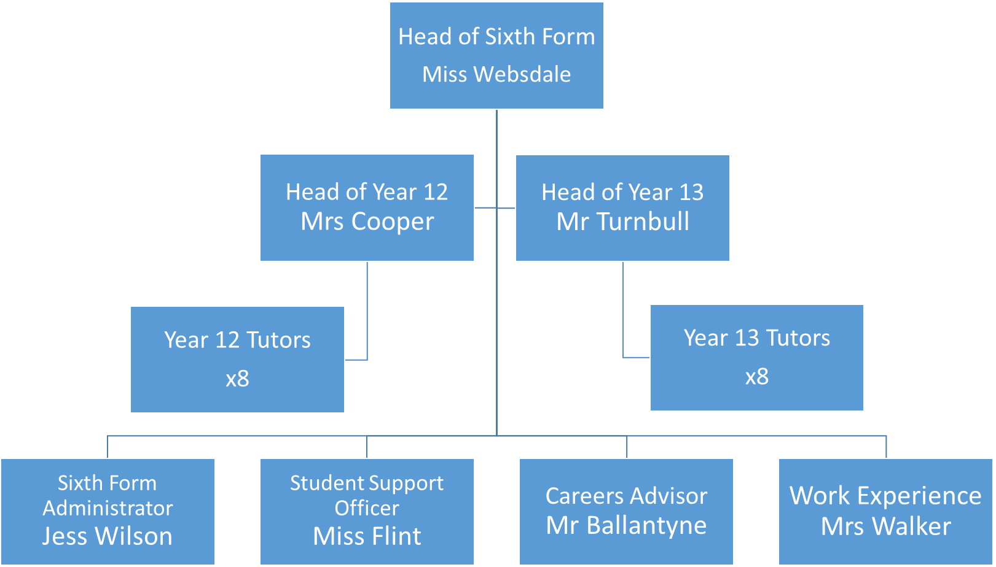
Sixth Form Team
Miss Tumelty
x6
x6

Slide 4
Sixth Form reputation & success
One of the Highest Performing Sixth Forms in the North East, possibly Nationally
2016 Year 13 success:
  A*-B%: 75%
  A*-A%: 58%

Slide 5
Year 12 Timeline
Terms 1+2
Confirmation of timetable
Resit English/Maths courses
Terms 3+4
Mock Examinations
Terms 5+6
Main revision & examination season
Rich Experience – focus on beyond sixth form (University and employment routes)
4 week subject trials- due to complete this week 29th Sept
Acclimatising to post-16 study / formation of independent study routines
Working out how to use Study Periods effectively
Start to access Careers Advice (1:1 meetings)
UCAS Convention
Focus on linear examination skills
Term 6- Begin UCAS process

Slide 6
Year 13 Timeline
Terms 1+2
Review of results and timetable confirmation
Terms 3+4
Coursework / practical exams
Term 5
Main revision & examination season
Sign off
Curriculum change for some
UCAS submission deadline (early deadline for some courses)
Completion of all BTEC courses

Slide 7
Financial Support
Bursary payment offered to students who qualify in order to help them with the cost of remaining in education (e.g. transport)
Paid to students who:
  Are in, or have been, in public care
  Live without the support of family
  Eligible for Free School Meals
Paid weekly in arrears and is dependent on attendance, behaviour and completion of work
Emergency funds available to any student where there is a significant emergency need

Slide 8
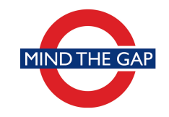
GCSE to A-level Study
Higher level study, fewer subjects
New subjects
Changing relationships
Greater freedom / independence
Increasing responsibilities

Slide 9
Common issues
Falling behind
Attendance
Part-time jobs
Leaving revision to the last minute
Plagiarism

Slide 10
Attendance/ Absence
Clear link between attendance and qualification success
Holidays in term time have a significant affect on their education
If absence is planned then please ensure that either:
  You call the school in advance (ext 335) or
  A note is brought in by the child
For unplanned absence (e.g. illness)
  Please call the school each morning (ext 335)
Attendance target for each student is 95%
  A meeting with parents will be held where attendance is a significant concern. (90% = 1 day off a fortnight)
  A formal attendance contract will be drawn up if attendance falls below 80%

Slide 11
Part-time employment
Helps students to become more financially independent
Helps students to develop useful skills for the workplace (including time management)
… but students need to remember that they are in full-time education.
8 hours per week is a recommended maximum

Slide 12
Early warning signs
Contact about absence / punctuality
Low indicators on modular reports
Missed assignment/homework deadlines
Reduced focus/interest evident at home
Contact your son/daughter’s HoY (Ms Cooper)

Slide 13
Communication with parents
Letters via students
  Text message if a letter goes out to the whole year group
Letters via post
  Report
  Important mailings
Phone Call
  Discuss concerns (academic or pastoral) referred by subject teachers

Slide 14
Enrichment opportunities
Fortnightly enrichment afternoon:
  Debating, GCSE Spanish, CSLA, Art Leadership, Work experience, Duke of Edinburgh
Additional Studies
  Extended Project
Charity Week
Other opportunities:
  World Challenge
  Trips (e.g. CERN / France / New York / Holocaust)

Slide 15
Work Experience
Why? Good quality Work Experience can…
  give students a better understanding of the world of work.
  help to develop “employability skills” such as independence and punctuality.
  make students more attractive to future employers.
  help to improve motivation
  help students to decide between university and apprenticeship routes
Work Experience can be “compulsory” for some students wishing to pursue certain university courses (e.g. nursing, medicine, law)

Slide 16
Work Experience
Y12 Work Experience week: 9 – 13 July 2018
Student deadline for placements 9 February 2018
Once arranged forms should be returned to Mrs Walker as soon as possible.
After 12 February we will do our best to allocate students to placements but we cannot guarantee that it will meet their career needs.
We will be asking student to…
  Speak to family and friends about work experience as they may be able to help you find a placement.
  Begin contacting businesses by letter or telephone as soon as possible, remembering that the most popular placements will be taken quickly.

Slide 17
Beyond Sixth Form
In 2015
  About 70% of students continued into higher or further education
Support also provided for those going direct to employment
  Also includes employment with training (e.g accountancy firms)

Slide 18
Support for University
Early entry / competitive courses
  Range of opportunities & visits offered (e-mail list)
Careers Advice
  1:1 appointments (External Careers Advice Mr Ballantye)
  Group briefings for specific sectors (e.g. health/nursing, primary education)
UCAS Convention
Student & Parent briefings

Slide 19
Support for University
Presentations from:
  Newcastle University (includes Partners scheme)
  Northumbria University
Durham University HE Day
Student Finance evening and UK tour
Gap Year information

Slide 20
Support for other destinations
School leaver schemes (e.g. accountancy)
Apprenticeships
Direct to Employment
Support provided through Miss Tumelty, Connexions specialist and Miss Flint

Slide 21
Year 12 Key Dates
Y12 Parents’ Evening: Tuesday 14 November 2017
Y12 Full Report: Monday 14 May 2018 (posted)
Y12 Mock exams: Monday 25- Friday 29 June 2018

Slide 22
Messages from current students
“I wish my parents had…”
Made me listen (easier said than done).
They encouraged me to work hard but they didn't understand the step-up and pressure of workload. It has been really tough.
I wish I'd listened to them more.
Been able to help me more with my UCAS application.
They didn't really understand the process as they hadn't gone through it themselves.
Some guidance to help them to help me would have been good.
Had known how to help me. They didn't go to sixth form so don't really know how to help me.
Some guidance for parents with this would have helped her to help me.
Pushed me to get work experience sorted in the area I want to study.
I hadn't realised how important that would be to my application for university.
Imposed stricter boundaries with home works / revision etc.
Also help with writing and checking my UCAS statement.
Pushed me to listen about the number of subjects I chose to study. I chose 4, they said 3.
They were right. I wish I'd followed their advice.
Helped me get organised with a filing system.
Hadn't allowed me to take odd days off.
Everything builds up very quickly and I found it hard to recover and catch up with work when I had these odd days off.
Limited my outside working hours. At Christmas I was working 30-40 hours per week.
This really impacted on my January exams. I would suggest no more than 8 hours per week.

Slide 23

Any questions

