Slide 1
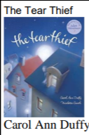
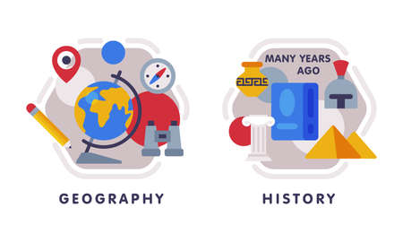






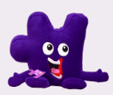





English
We will explore the ‘Tear Thief’ by Carol Ann Duffy. The children will create a shared poem, diary entry, persuasive poster and letter of explanation. We will build up skills, such as similes and metaphors, before writing our main outcome: Newspaper Article.
Music
The theme for our music is. Creating themes for animations! Skills include singing/playing in time together and matching movement to emotions in Music.
Geography
Our topic for this half term is-
Who lives in Antarctica? We will locate using a range of maps, examine the climate and discover who lives in Antarctica.
PSHE
Our PSHE is called Celebrating Differences and will discuss different types of families, how we treat people and recognising bullying, including the role of the by-stander
PE- Tuesday and Thursday
In dance, we will be moving our bodies like robots! We will create funky dances and improvise robotics dances.
Outdoor PE We will explore a range of invasion games (e.g. 4 vs 4 keep ball,
skittleball, adapted netball/ basketball,
tag rugby etc.)
We will also be inventing games with rules and leading others.
Maths
Add 2-digit and 3-digit numbers
Subtract a 2-digit number from a 3-digit number
Estimate answers
Inverse operations across all 4 operations (add, subtract, multiply and divide)
Computing: We will revisit internet and online safety in week 1, we will learn about the internet being a vast network and the parts of a network needed for a website to work. Children will also recognise the role of the cloud in storing data.
Year 3
Autumn 2
Science
Forces: Children will learn to identify examples of pushes, pulls and twists. Define a force, including describing, naming and classifying contact and non-contact forces. Friction and Magnetism.
How you can support your child at home
Daily reading and discussion of the text, asking questions about the characters, plot and setting.
TT Rockstars to secure quick recall of key multiplication and division facts.- focus on 3 times table.
Hit the Button- a free online maths game to help with quick recall. Focus on number bonds.
Hit the Button - Quick fire maths practise for 6-11 year olds
Spelling of Year 3 and 4 words
Practise column method for addition and subtraction up to 3 digits.
RE
Our unit is called, “What is it like for someone to follow God?” We will learn about the Old Testament people of God and how they lived their lives. We will learn the story of Noah, considering what it was like for him to follow God We will consider why following God might sometimes feel hard for believers.
DT
Our unit focuses on Structures: constructing a building. We will examine the features of castles before planning and building junk models of our own.
MFL
We will be revising our Autumn 1 learning before moving onto numbers to 12.

