Slide 1

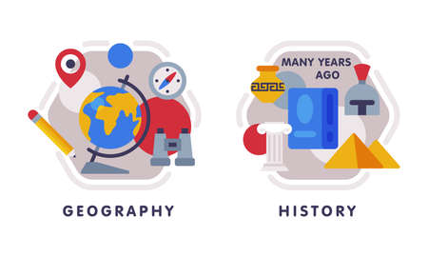






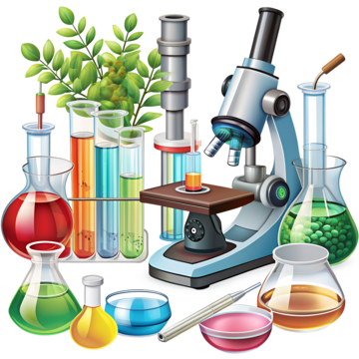



English
Throughout Summer 2, we will continue to add to our moderation portfolio. We will be revising punctuation and grammar techniques to enhance our writing. We will also be taking part in script reading as part of our end of year production.
Music
The theme for our music is.
Composing and performing ready for our end of school production and encompassing all prior skills learned; harmony, melody, beat and individual/group performances (continued).
History
Our key question: Unheard histories: Who should appear on a bank note?
We will be considering lesser-known characters from British history and the impact these people have made on modern society (continued).
PSHE
Our unit will focus on RSE through the theme 'Changes'. We will consider: Managing change, becoming independent, puberty, healthy relationships and positive self- image.
PE- Thursday and Friday
Upon completion of our gymnastics unit, we will be showcasing the children’s dance skills through working on dances linked to our End of our production.
In outdoor PE, we will continue to focus on Athletics. We will look at a range of different skills that will help us get prepared for Sports Day.
Computing
We will be Learning about the Internet of Things and how it has led to ‘big data’.
Learning how ’big data’ can be used to solve a problem or improve efficiency (continued). Children will then start the unit, 'Skills showcase: Inventing a product'.
Maths
We will be taking part in project work in readiness for secondary school. In addition, we will continue to recap the four operations and other key areas of maths in our basic skills sessions.
Year 6
Summer Term 2
Science
We will be exploring the heart and circulatory system through models and enquiries and considering how lifestyle choices affect our health (continued).
How you can support your child at home
Daily reading and discussion of the text, asking questions about the characters, plot and setting (it would be helpful for you to help your child learn their lines for the end of year production).
TT Rockstars to secure quick recall of key multiplication and division facts.
Hit the Button- a free online maths game to help with quick recall.
Spelling of Year 5 and 6 words.
RE
Upon completion of our unit called 'What kind of King was Jesus?' We will start the 'How does faith help us when life gets hard?' Unit.
Art/DT
Children learn to represent memories through art, using various materials and techniques, and develop skills in planning, creating, and evaluating 3D sculptures. Once this has been completed, children will begin the DT unit, 'Digital World: Navigating the World'.
MFL
In French we will be recapping our French knowledge from across our Key Stage 2 learning journey (continued).

