Slide 1
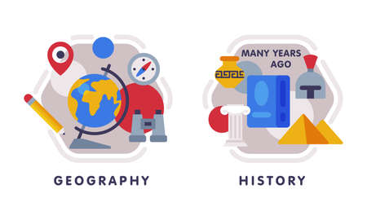










English
This half term we looking at the gothic novel Wind in the Wall. The focus will be on writing in first person, creating dialogue, character descriptions and using language of formality and time to create atmospheric scene settings
Geography
This half term, there is a focus on mapping and using atlases fluently to find information about places. We will be analysing topographic maps to form 3D structures.
Music
In Music, we will be exploring campfire songs in preparation for our Residential.
PSHE
Our unit focuses on ourselves being healthy developing an understanding of how we stay motivated and deal with emotions when pressured.
Maths
In the run up to SATs, we will continue revising the most fundamental areas of maths including four operations and fractions, decimals and percentages. We will also cover topics such as area, perimeter and volume and statistics. We will revisit our learning on converting measures and algebra.
KIRF focus: equivalence between fractions, decimals and percentages. Recalling prime numbers to 50.
PE
In indoor PE we will be returning to a gymnastics module with a focus on using the apparatus.
In outdoor PE, we begin our topic of striking and fielding with a focus on the game of Rounders – hopefully in the sunshine on the field!
Computing
In computing we be exploring Python programming, focusing on syntax, nested loops and logic errors.
Year 6
Spring Term 2
Science
We will be learning about ‘Energy: Circuits, batteries and switches.’ We will Develop our knowledge of circuits from Year 4, learn about the effects of changing voltage and understand how switches contribute to different devices.
DT
We are block teaching our DT this half term to fully immerse ourselves in the topic. We will be designing a prototype for a playground using natural and recycled resources.
How you can support your child at home
Daily reading and discussion of the text, asking questions about the characters, plot and setting.
TT Rockstars to secure quick recall of key multiplication and division facts.
Hit the Button- a free online maths game to help with quick recall of multiplication and division facts.
Spelling of Year 5 and 6 words.
Supporting homework set on Fridays as part of SATs revision
RE
We will be having discussion-based sessions on our ‘Big Question ‘What can be done about racism? Can religion help?
MFL
In French we will be recap our learning of the French curriculum through games and songs.

