Slide 1
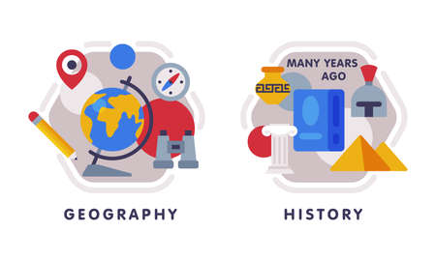



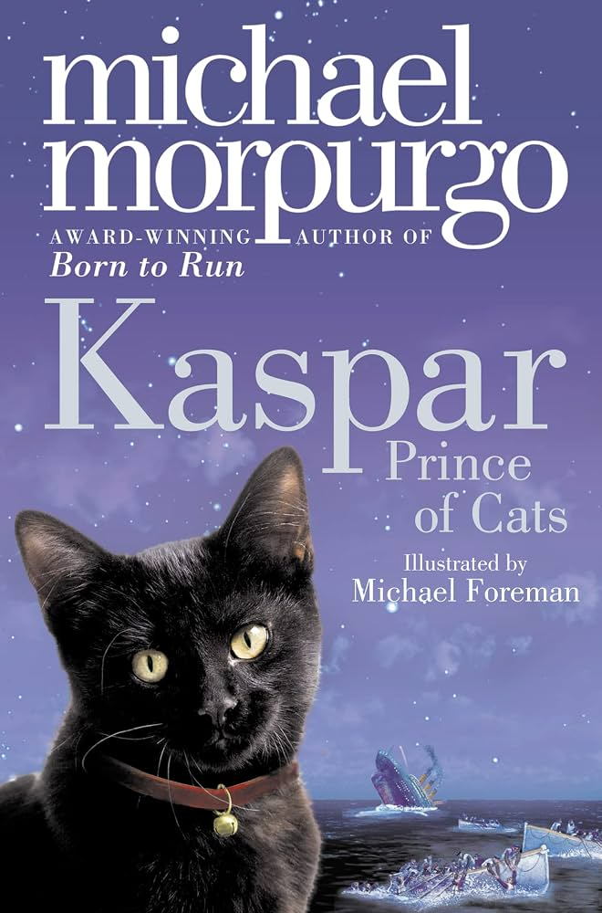








English
Our class text is called, “Kaspar Prince of Cats” by Michael Morpurgo. We will look at character development and how historical events were recorded.
Music
Pupils explore how music can be created using loops and repeated patterns. They experiment with rhythm, tempo and layering sounds, using digital tools to compose, edit and remix music into their own creative compositions.
History
We will be exploring the question ‘What did the Greeks ever do for us?' We will explore inventions throughout history and how that still impacts us today.
PSHE
Our unit focussed on 'Changing me'. Exploring self-image, body changes, puberty, changing emotions and preparing for greater independence
Maths
We will be focussing on negative numbers, converting units and volume. By the end of the year we will also be working on our arithmetic and reasoning style questions too.
Computing
Pupils will explore how the Mars rover operates by programming its movements, following instructions and collecting and transmitting data. They develop their understanding of how computers process information and how data is transferred between devices.
PE-
In gymnastics we will create complex and well-executed sequences that include a full range of movements (from autumn and spring term).
In outdoor PE we will focus on athletic style movement, looking at skills and techniques to improve performance.
Year 5
Summer Term 2
Science
Our new topic is Animals: Human timeline
& making connections. We will explore how humans experience different life stages, and the development that comes with each of these.
RE
Our unit is called, “What matters most to humanists and Christians? We will discuss how religious views affect choices and daily life.
DT
Our unit focuses on food and nutrition, including developing a recipe, taking inspiration by local produce and farming in our area.
How you can support your child at home
Daily reading and discussion of their ZPD books, asking questions about the characters, plot and setting.
Times Tables Rockstars
Hit the Button - Quick fire maths practise for 6-11 year olds
Consolidate Year 5 and 6 spelling words (both reading and spelling)
MFL
In French, the children will be exploring the vocabulary of ‘My home', learning descriptions of houses and becoming French estate agents!

