Slide 1
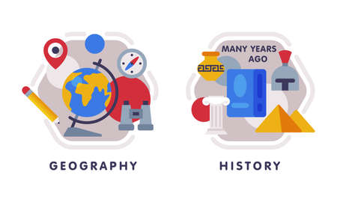












English
Our class text is called, “Hidden Figures” by Margot Lee Shetterly. We will look at the Space race against the backdrop of segregation in USA. Our topic will look at the impact of 4 black women on the development and achievements of NASA. We will explore a variety of sentence types , the use of parenthesis and non-fiction writing.
Geography
We will be exploring the question ‘What is life like in the Alps?” We will use a variety of geographical mapping resources to locates and describe the features. Our focus location is Innsbruck which we will compare to Redditch. We will also be conducting a public opinion survey.
Music
This topic will be inspired by the Egyptians. The children will learn to sing and play a song about the Egyptians and improvise their own music, writing this down using hieroglyphs and music notation.
PSHE
Our unit will focus on dreams and goals. Setting personal goals, overcoming challenges, developing resilience and working together to achieve success.
Maths
We will be continuing to focus on fractions. We will practise the skills of adding and subtracting a variety of fractions, including improper fractions and mixed numbers. We will also consolidate our knowledge of equivalent fractions as a fundamental skill to help in future maths questions.
Computing
Our topic in Computing for Spring year 1 will be investigating ‘Selections in physical computing.’
PE-
In dance we will create motifs and sequences based on the stimulus of ‘Tudors’ inspired by 'Six'.
In outdoor PE we will focus on the sport of netball, considering different points of play for a variety of positions, attacking and defending strategies and the role of tactical play.
Year 5
Spring Term 1
Science
Our new topic is all about ‘space’. We will explore our solar system, what causes seasons, days and nights on planet Earth, as well as exploring the moon phases. You can start to observe the moon and see how it is changing each night!
RE
Our unit is called, “Why do Christians believe Jesus is the Messiah?” where we will explore Christian’s relationships and beliefs about Jesus.
How you can support your child at home
Daily reading and discussion of their ZPD books, asking questions about the characters, plot and setting.
Times Tables Rockstars
Hit the Button - Quick fire maths practise for 6-11 year olds
Consolidate Year 5 and 6 spelling words (both reading and spelling)
Log onto Writer’s Toolbox to have a go at editing and uplevelling your writing, or have a go on the practice activities.
Art
Our unit focuses on using and applying a range of drawing skills within the theme of retro-futurism. Our focus artist is Teis Albers.
MFL
In French, the children will learn how say where they live and give directions in French.

