Slide 1


Welcome to Year 6! We are so excited to partner with you during this milestone year, as we celebrate your children's primary school journey and prepare them for the big leap ahead. Our focus this year is all about fostering independence, encouraging students to take ownership of their learning, and building the essential organization skills they will need for secondary school. Above all, we are dedicated to nurturing their self-belief, ensuring every child leaves us with a confident self-image and the resilience to thrive in their next chapter. Together, let's make their final year unforgettable!

Slide 2
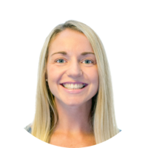
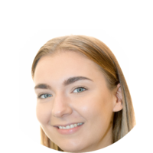

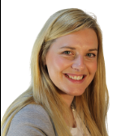
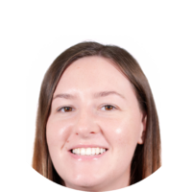
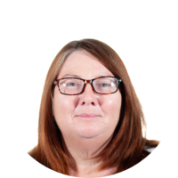
Meet the Year 6 team
Mrs Biddle – Teacher of 6CB
Year 5 and 6 Phase Leader
Miss Clifton – Teacher of 6EC/CT on Monday, Tuesday and Friday
Assistant Head
Miss Taylor – Teacher of 6EC/CT on Wednesday and Thursday.
In 6CB on Tuesday.
Mrs Broome- Teaching Assistant
Mrs Waite – in 6CB on Fridays, and across the cohort on Thursdays
Mrs Dean – supporting across the cohort Monday - Wednesday

Slide 3
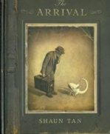









Texts we will be reading:
Our PE days will be:
Indoor- Friday
Outdoor- Monday
Our History and Geography topics will be:
What does the census tell us about our local area?
Why does the population change?
What was the impact of WW2 on Britain?
Where does our energy come from?
Unheard histories: Who should go on the bank note?
Can I carry out an independent fieldwork enquiry?
We will be going on our Residential trip to Robinwood, Wrexham in March, RAF Cosford in January.
We will be preparing to sit our SATS.

Slide 4
Roles and responsibilities for pupils in Year 6
Setting a good example to ALL
Prefects
Head pupils
Assembly monitors
Library monitors
Computer monitors for assemblies
KS1 Reading Buddies

Slide 5
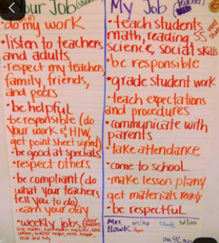
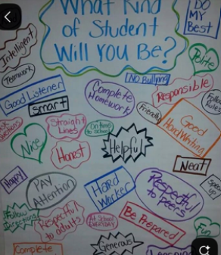
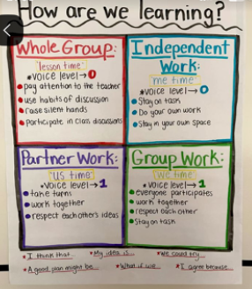
Classroom rules / Year 6 expectations

