Slide 1

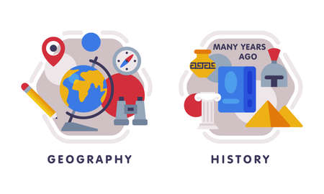










English
Our class text continues to be Wind in the Wall, followed by The Remarkables. We will be exploring differences in levels of formality to write a formal letter and develop a character description choosing appropriate grammatical structures and language for purpose and audience.. We will be revising all elements of spelling, punctuation and grammar in preparation for our KS2 SATS.
History
Our key question: Who should appear on a bank note?
We will be considering lesser known significant figures from British history and drawing on the life of Sir David Attenborourgh as to why he is a significant character in Living history and why he should be on a bank note.
Music
The theme for our music is.
Composing and performing ready for our end of school production and encompassing all prior skills learned; harmony, melody, beat and individual/group performances!
PSHE
Our unit will focus on physical health and mental wellbeing; understanding healthy choices and habits and what affects feelings, considering how we can express them.
Computing
We will be Learning about the Internet of Things and how it has led to ‘big data’.
Learning how ’big data’ can be used to solve a problem or improve efficiency. .
Maths
We will be focusing on shape and space a revision in preparation for SATs..
PE- Monday and Friday
In gymnastics we will be using the vault and developing our skills in using this with a sequence. Outdoor, we will be doing athletics including running, jumping and throwing events.
Year 6
Summer Term 1
Science
Our new Science unit ‘Circulation and Health’ will explore the heart and circulatory system through models and enquiries and considering how lifestyle choices affect our health.
RE
Our big question is ‘What can be done about racism? Can religion help?’. We will learn about teachings on equality and respect, study examples of people challenging prejudice, and reflect on how we can live well together in a diverse society.
Art
Our Art unit will be exploring Dan Fenelon and his work. Children will be recreating their own ceramic art piece inspired by his works.
How you can support your child at home
Daily reading and discussion of the text, asking questions about the characters, plot and setting.
TT Rockstars to secure quick recall of key multiplication and division facts.
Hit the Button- a free online maths game to help with quick recall
Hit the Button - Quick fire maths practise for 6-11 year olds
Spelling of Year 5 and 6 words.
MFL
In French we will be recapping our French knowledge from across our Key Stage 2 learning journey.

