Slide 1

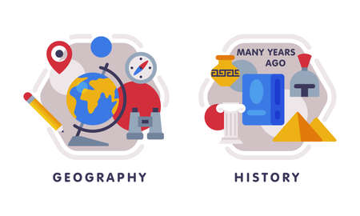



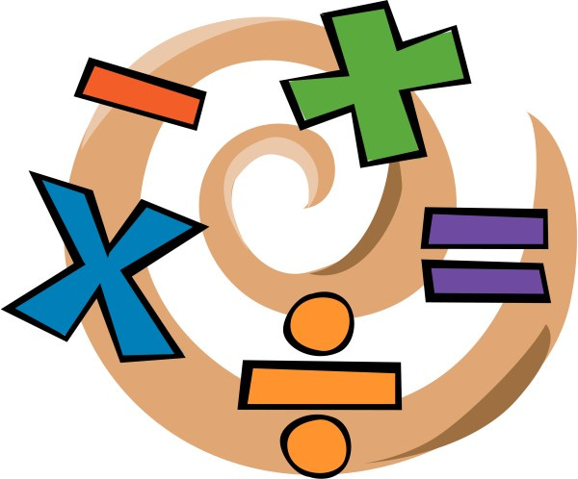


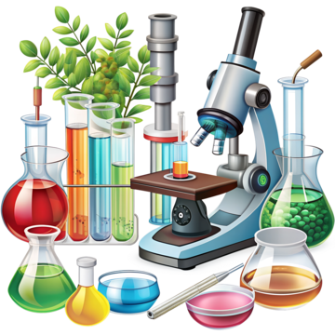

English
Our class text is called, “The Bear and the Piano” and we will be exploring a range of sentence types for Letters and reports. We will be recapping word classes and using conjunctions to extend sentences. We will also be securing our understanding of apostrophes for contractions and possession.
Music
This unit will help the children develop an understanding of structure by exploring and ordering rhythms.
History
“What is a Monarch?” In this unit we explore our current monarch and reflect how William the Conquer became king of England. We will be visiting Dudley Castle to enrich our learning experience of this topic.
PSHE
Our unit will focus on physical health and mental wellbeing;. We will be finding out why sleep is important, how to keep our teeth healthy, medicines and keeping healthy and how to manage our feelings.
PE- Tuesday and Wednesday
Indoor P.E. we will be focusing on indoor games such as bench ball and badminton.
Outdoor, we will be focusing on outdoor team games and practising our skills such as dribbling, kicking and hitting.
Maths
We will be focussing on multiplication and division. Children will explore equal groups, arrays, sharing and grouping, as well as doubling and halving, using practical activities to build their understanding.
Year 2
Summer Term 1
How you can support your child at home
Daily reading and discussion of the text, asking questions about the characters, plot and setting.
TT Rockstars to secure quick recall of key multiplication and division facts- 2s, 5s, 10s
To practise counting in 3s
Hit the Button- a free online maths game to help with quick recall- numberbonds, addition and subtraction number facts
Key spelling of Year 1 and 2 Common Exception Words
Spelling of germination, bulb, fruit, coastline, ocean, physical, feature, human
Developing their understanding of telling the time across the day.
RE
Our unit is called, “What is the Good News Jesus Brings?” where we will explore what Christians believe are the teaching of the Bible .
Science
Our new topic is about plants and their reproduction. We will be describing the life cycle of a flowering plant and carrying out tests to investigate plant structure and function.
DT
Our unit focuses on exploring levers, linkages and pivots to construct and assemble a moving monster!

