Slide 1
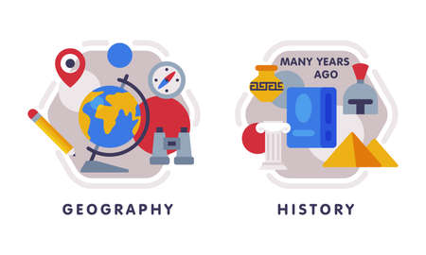

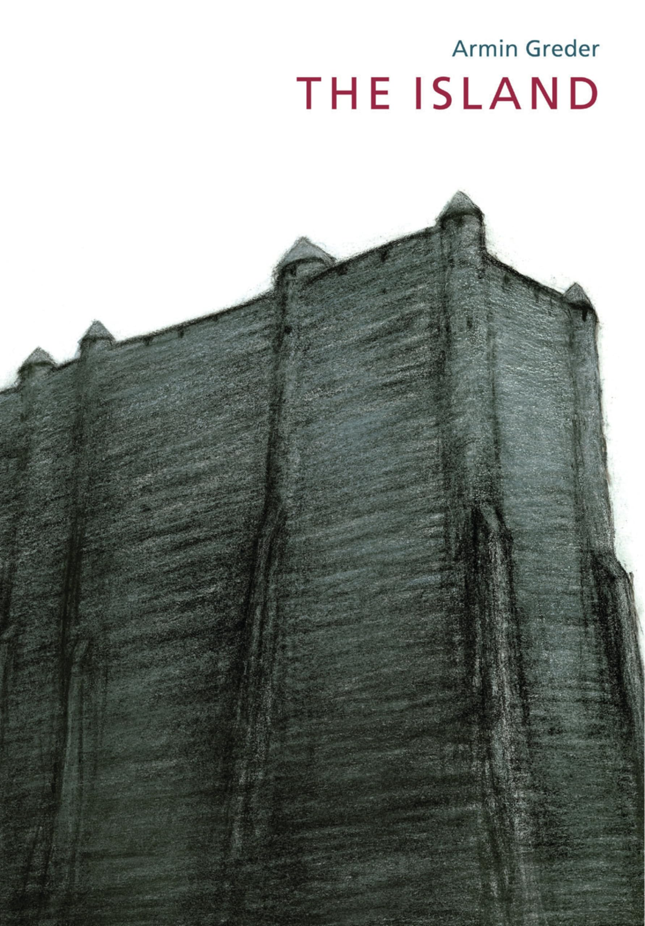









English
Our class text is called, 'The Island’ by Armin Greder. We will be exploring the themes hostility, hospitality and prejudice as we read the text and consider the newcomer’s feelings throughout the story. The children will do a range of writing including diary entries, dialogue and other narratives.
Geography
We will spend a couple of weeks finishing of our Tudors History topic before starting Geography. We will be exploring the question ‘Why are Oceans matter?' With a focus on pollution and The Great Barrier Reef.
PSHE
Our unit will focus on r healthy habits and personal identity. We will discuss topics such as sleep habits, sun safety and medicines as well as recognising individuality and
different qualities;
Computing
In this animation unit we will explore the fundamentals of stop motion animation, creating our own animated sequences, that convey movement and storytelling effectively.
PE- Monday and Wednesday
In dance we will create motifs and sequences based on the style ‘Country’ dance.
In outdoor PE we be looking at games using the “Sport Education Model” which encourages children to develop their key roles in sports, allowing for developments in responsibility, teamwork, sportsmanship and leadership.
Maths
We will be focussing on statistics, shapes, position and direction. This includes rules of: angles on a straight line, angles in a triangle and angles in a quadrilateral.
We then will move onto decimal consolidation, where we will explore place value including new decimal work with multiplying decimals and compliments to 1.
Year 5
Summer Term 1
Science
Our new topic is about forces and space: imbalanced forces. We will be learning about Gravity, Air and Water resistance, Friction and levers, pulleys and gears.
RE
Our unit is called, “How do Christians decide how to live? “What
would Jesus do?” where we will explore aspects of Christianity and how their faith affects different decision makings in their lives.
Art/ DT
Our unit focuses on to develop skills in creating interesting portrait drawings using words, experimenting with materials and techniques, and constructing self-portraits that represent aspects of themselves.
Our Artist focus will be Chila Kumari Singh Burman.
How you can support your child at home
Daily reading and discussion of their ZPD books, asking questions about the characters, plot and setting.
Times Tables Rockstars
Hit the Button - Quick fire maths practise for 6-11 year olds
Consolidate Year 5 and 6 spelling words (both reading and spelling)
MFL
In French, the children will be learning the vocabulary related to homes and estate agents. They will design a bedroom and learn about the position of objects.

