Slide 1
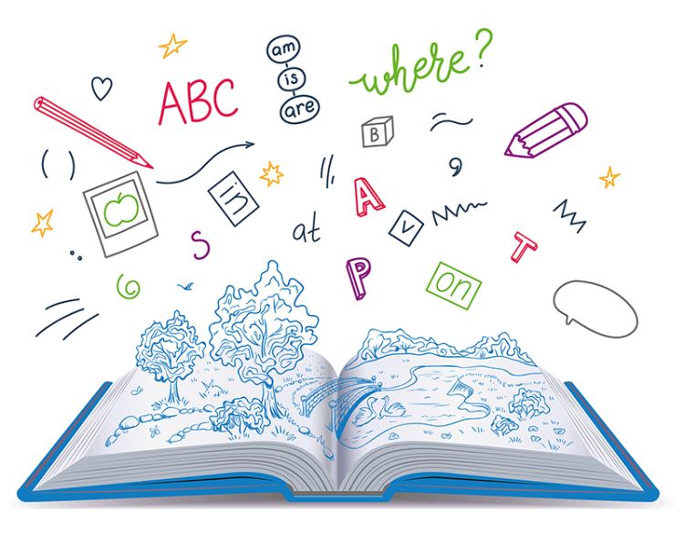


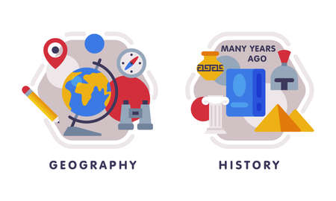
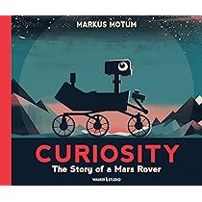







English
Our class text is called, “Curiosity” by Markus Motum. We will look at writing information pieces of texts and begin to create our own blueprints for a Mars rover.
Computing
We will be exploring how to program micro:bits this half term, creating interactive projects with sensors, variables and conditional statements.
PSHE
Our unit will focus on job interests and aspirations.. We will explore career choices, workplace stereotypes and goals.
History
We will be exploring the question ‘What was life like in Tudor England?’ We will be exploring the reigns of Henry VIII, Elizabeth I and some other notable monarchs. Our visit to Tudor World in Stratford-Upon-Avon will help to immerse us in the topic.
Maths
We will be continuing our focus on Multiplication and division, as well as starting to look at fractions again We will practise the skills of multiplying and dividing fractions.
PE-
In gymnastics we will build on our sequences based on focus of balances, rolls and jumps, with floorwork and incorporating apparatus.
In outdoor PE we will focus on outdoor adventurous activities (OAA) of orienteering. This will involve map reading, navigating courses and developing effective communication and teamwork.
Year 5
Spring Term 2
Science
Our new topic is about life cycles – focussing on a range of living things. We will explore how life is formed for mammals, plants. birds, insects and reptiles.
RE
Our unit is called, “Why is the Torah so important to Jewish people.” We will discuss beliefs about God, the 10 Commandments and Kosher rules.
DT
Our unit focuses on designing and creating our own pop-up story books. We will conduct market research on our audience and relate the book to them.
How you can support your child at home
Daily reading and discussion of their ZPD books, asking questions about the characters, plot and setting.
Times Tables Rockstars
Hit the Button - Quick fire maths practise for 6-11 year olds
Consolidate Year 5 and 6 spelling words (both reading and spelling)
MFL
In French, the children will be building on their 'In my town', learning from the Autumn term, giving and following directions.

