Slide 1


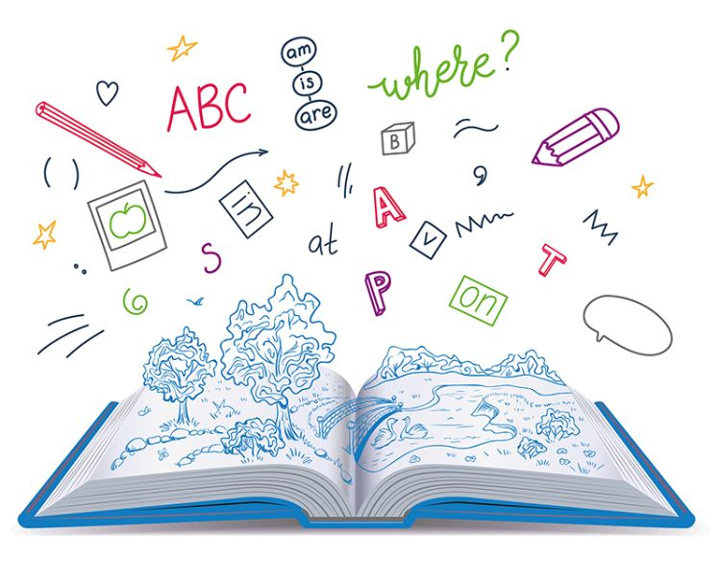
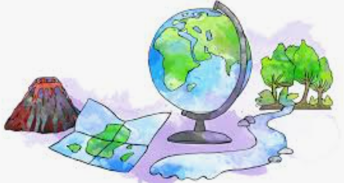


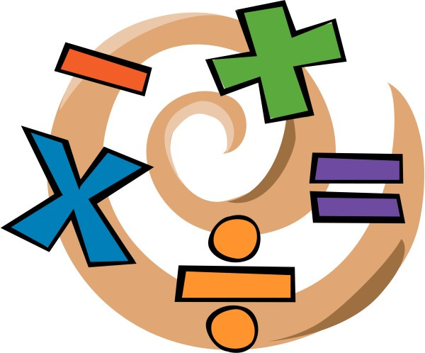
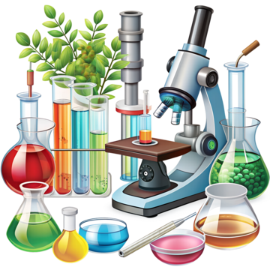



English
This half term in English, we will be using the book The Story of Tutankhamun as our focus text. Through exploring this fascinating account of ancient Egypt, pupils will develop and strengthen key reading and writing skills, including research, note-taking, and organising information. As we learn more about the Egyptians and their way of life, children will work towards the final outcome of writing their own non-chronological report about Ancient Egypt, using facts and features they have studied throughout the unit
History
This half term in history, Year 4 will be exploring the fascinating world of Ancient Egypt through the Kapow Primary scheme of work. Children will learn about where and when the Ancient Egyptians lived, why the River Nile was so important, and what life was like for people during this time. They will also discover the significance of pharaohs, pyramids, and mummification, as well as how historians use artefacts to understand the past. Through engaging activities and discussions, pupils will develop their historical knowledge and enquiry skills while gaining a deeper understanding of this ancient civilisation.
Music
Children learn to create and perform rhythmic patterns using body percussion (such as clapping and stamping) while keeping a steady pulse. They also learn to play simple melodies on tuned percussion instruments like glockenspiels and combine these with rhythms to perform and compose music in groups
PSHE
This half term in PSHE, children will learn about what makes a community and the shared responsibilities people have within it. They will also explore how personal data can be shared and used, and develop their understanding of making sensible decisions about money, including how to use it and keep it safe.
Maths
In this term, children will become increasingly confident with times tables and number facts up to 12 × 12. They will continue to understand the link between multiplication and division. We will then be moving on and focusing on length and perimeter and finally moving on to look at fractions.
RE
During this half term, we will be exploring the question, ‘Why do Christians call the day that Jesus died, Good Friday?’
Year 4
Spring 2
Science
This half term, Year 4 will be learning about sound and vibrations. Children will explore how sounds are made, understanding that vibrations travel through a medium such as air to reach our ears. They will investigate how different objects produce sounds, how pitch and volume can change, and how sound travels over distance. Through practical investigations and discussions, pupils will develop their scientific enquiry skills while building a clear understanding of how sound works in the world around them..
PE
Our outdoor PE session this half term will focus on developing accuracy, control and coordination through a range of target games. Pupils will have the opportunity to take part in activities such as boccia, archery and footgolf, each designed to build precision, teamwork and strategic thinking in a fun and engaging way. In indoor PE, children will focus on gymnastics, developing a range of skills such as balances, jumps and travelling movements. They will use a variety of gymnastics equipment to practise control, coordination and sequencing movements.
DT
Children explore how structures are designed and built to be strong and stable. They will investigate different frame structures and materials before designing and making their own pavilion model, using techniques such as creating strong joins and adding decorative cladding. They will also evaluate their designs and finished structures based on how well they meet the design criteria.
How you can support your child at home
Spelling and reading of Year 3 & 4 words using games such as silly sentences.
Regular use of Times table rockstars
Daily reading
If possible, taking your child swimming.
MFL
In French lessons this half term, we will be developing pupils’ understanding of numbers from 30 to 50 while extending their language skills through topics such as sports and hobbies. Children will learn to talk about different sports and activities, expressing what they like and dislike, and build confidence in describing their hobbies. There is a continued emphasis on using language to express personal preferences clearly and accurately in a range of spoken activities.
Computing
Children will learn how data can be collected, recorded and analysed using weather information. They explore different ways to present data digitally, such as charts and tables, and use this information to identify patterns and answer questions about the weather.

