Slide 1

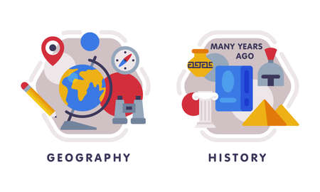










English
In English this half term, we will we exploring a range of poetry. We will identify write and learn different styles including- haikus, cinquains and classic poetry.
Geography
Our next unit of Geography is called- Why do people live near volcanoes?
Continuing from our learning on Pompeii, we will explore the what, where and why of volcanoes and their eruptions.
Music
The theme for our music is pentatonic melodies. We will explore accurately notate and play a pentatonic melody before working as a group to perform a piece of music.
PSHE
Our next unit will focus on different jobs and skills; job stereotypes and setting
personal goals.
PE- Tuesday and Friday
In gymnastics we will explore- floor work, benches, tabletops, box and
Springboard.
In outdoor PE, the children will plan, develop and play games of their own invention.
Maths
In Maths this half term, we will be
Looking at measurement including mm, cm and m. We will convert between these units of measurement and move on to looking at perimeter of shapes.
Computing
Our computing this half term is looking at the roles that inputs and outputs play on computers. We will explore what some of the different components inside a computer are and how they work together.
Science
Our next unit focuses on light and shadows. We will look at natural and man-made light sources, discuss how to keep our eyes safe from the sun and examine how and why shadows are made.
Year 3- Spring 2
RE
Our unit is called,
“How do festivals and family life show what
matters to Jewish people?’. We will explore Jewish celebrations like Rosh Hashanah and Yom Kippur.
How you can support your child at home
Daily reading and discussion of poetry, asking questions about the similes, metaphors or alliteration.
TT Rockstars to secure quick recall of key multiplication and division facts for 3, 4 and 8 times tables.
Discuss how reading for pleasure looks in your family.
Hit the Button - Quick fire maths practise for 6-11 year olds
Spelling of Year 3 and 4 words using different colours.
DT
Our unit focuses on wearable tech. We will explore and use microbit technology to create our own electronic bracelets/
MFL
We will continue to learn about the following topics- How old are you?
Months of the Year
Numbers to 30
When is your birthday?
Days of the Week

