Slide 1


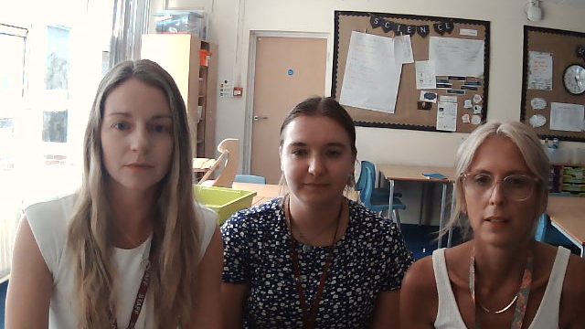

Slide 2

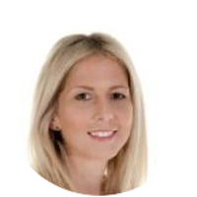
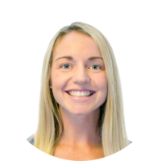
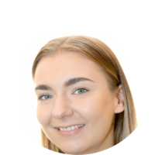
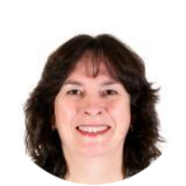
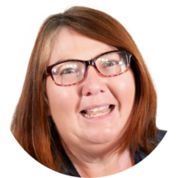
Meet the Year 6 team
Mrs Biddle – Teacher of 6CB
Year 5 and 6 Phase Leader
Miss Clifton – Teacher of 6EC/CT on Monday, Tuesday and Friday
Assistant Head
Miss Taylor – Teacher of 6EC/CT on Wednesday and Thursday
In 6CB on Tuesday
Mrs Allen – Teaching Assistant (Wednesday-Friday)
Mrs Dean – Teaching assistant (Monday, Tuesday)

Slide 3
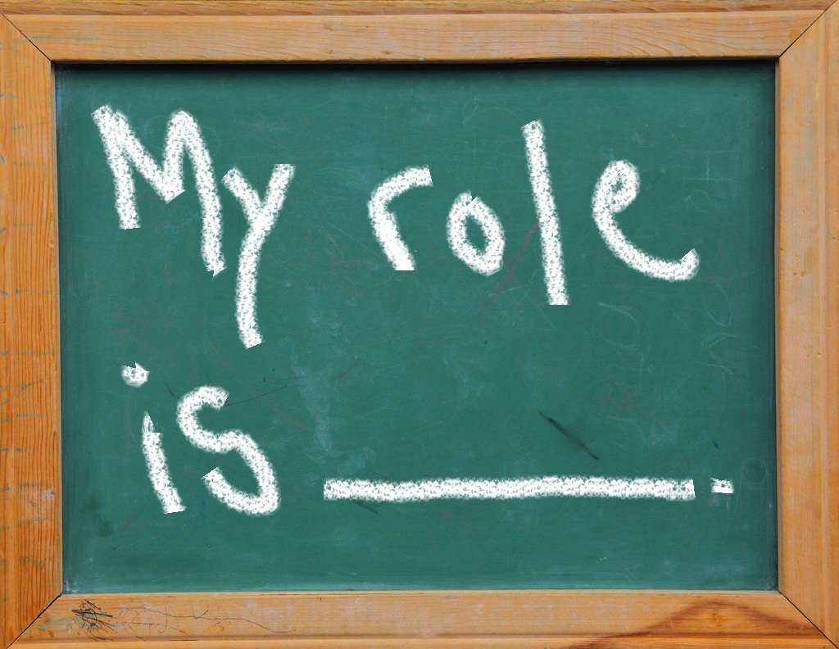
Roles and Responsibilities in Year 6
Setting a good example to ALL
Prefects
Head pupils
Assembly monitors
Library monitors
Computer monitors for assemblies
Ambassadors – Values, Science, Music

Slide 4
Behaviour / Expectations in Year 6.
Following school values.
Always being a good role model to all.
Helping the younger children.
Follow our classroom rules.
Wearing correct uniform.
Having the correct equipment.

Slide 5

Upcoming Events and Visits (dates TBC)
MacMillan Coffee morning
Local area fieldwork
Transition workshops with Studley High and Ridgeway Secondary
Robinwood Residential (23rd – 25th March - £50 deposit due Friday 18th July)
End of year performance

Slide 6

End of KS2 Assessments
Monday 11th May – Thursday 14th May 2026 (no holidays during this week please)
Reading x1 papers
Grammar punctuation and spelling x2 papers
Mathematics x3 papers (1 arithmetic, 2 reasoning)
Writing is teacher assessed by building a portfolio of their best work

Slide 7


Homework
Reading at least 3 times a week and record in homework diary
1x Maths weekly
1x English weekly
Homework is set on a Friday
To be returned the following Thursday
Could be paper based or digital (Showbie or Writer’s Toolbox)

Slide 8


