Slide 1
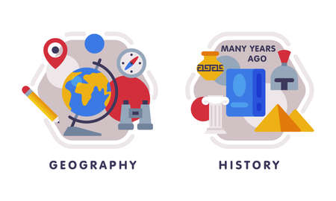










English
We will be looking at the texts Rose Blanche linked to our topic WW2 and a gothic horror called Wind in the Wall. The focus will be on writing in first person, creating dialogue, character descriptions and using language to create atmospheric scene settings.
History
Our key question: is ‘What was the impact of WW2 in Britain?’. Focus will be on the causes of the war, the phases of the Battle of Britain and the impact it had. The accuracy and reliability of sources will be analysed.
Music
In Music, we will be looking at songs of WW2. In this unit we will look at popular songs during WW2 and learn these, focusing on our pitch and notation skills.
PSHE
Our unit will be valuing diversity: challenging discrimination and stereotypes.
Maths
We will be continuing our work on fractions and identifying equivalence between fractions, decimals and percentages. We will also be learning some algebra, how to convert measures and manipulating decimals.
PE
In indoor PE we will be 'War-time Dance' creating motifs drawing on the moves from the Jitter Bug, Swing and Jive.
In outdoor PE, we will be doing orienteering through ‘outdoor adventurous activity’ (OAA). This includes map reading, navigations, using markers, orienteering self and others, and setting up orienteering challenges.
Computing
In computing we will focusing on 'Data Handling- Big Data' to develop knowledge and understanding of how bar codes work and RFID works.
Year 6
Spring Term 1
Science
We will be learning about ‘Light and Reflection’. We will look at how light travels and how we see things from reflections. We will also discover that shadows have the same shape as the object blocking the light because light cannot bend around it.
How you can support your child at home
Daily reading and discussion of the text, asking questions about the characters, plot and setting.
TT Rockstars to secure quick recall of key multiplication and division facts.
Hit the Button- a free online maths game to help with quick recall of multiplication and division facts.
Spelling of Year 5 and 6 words.
Supporting with specific weekly homework given on Fridays and to be returned on Thursdays.
Art
We are block teaching our Art this half term to get fully immersed into the topic of street art. The children will create their own mural designs using 1-point perspective and scaling, inspired by art by Edgar Müller.
RE
Our ‘Big Question’ this half term is ‘Why do Hindus want to be good?’.
We will explore what karma, dharma, samsara and moksha are and how these links to Hindus choices and actions.
MFL
In French we will be continuing our learning on schools and look at how to express our preferences. on subjects taught in school.

