Slide 1

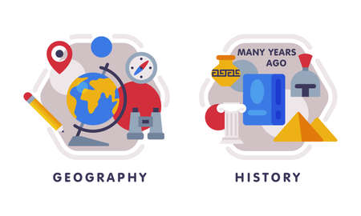






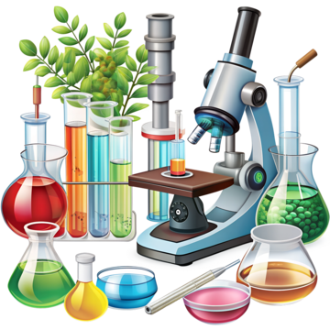



English
At the start of Autumn 2 we will be looking at the poetry ‘Flanders Field’ where we will unpick and learn the poem. Throughout Autumn 2, we will be focusing on the text ‘Stormbreaker’ We will be
Geography
Our key question: is “Why does the population change?”
Music
In Music, we will be continuing our learning on Dynamics: Fingals cave. We will then be exploring music from the past.
PSHE
Our unit will continue our focus on relationships and attraction to others. In addition, managing pressure and consents in different situations.
PE
In indoor PE we will be exploring floorwork and benches in gymnastics, building well-executed sequences and travelling and balancing in more advanced ways.
In outdoor PE, we will focus on. Invasion games building skills in passing, receiving, attacking, defending and strategic game-play
Maths
We will be continuing our learning on multiplication and division. Starting on fractions, including equivalent fractions, adding and subtracting fractions (simple and mixed numbers) comparing fractions, multiplying and dividing fractions and solving fractions of an amount. We will also focus on measurement; converting units, looking at metric and metres, kms.
Computing
In computing we will focus on AI, where we will be Exploring what AI is and how it generates text, images and code. Also looking at how to use it safely and effectively.
Year 6
Autumn Term 2
Science
We will be learning about Living Things: Evolution and Inheritance; we will be exploring variation and inheritance in different living things and how observations and fossil evidence have led to the theory of evolution.
How you can support your child at home
Daily reading and discussion of the text, asking questions about the characters, plot and setting.
TT Rockstars to secure quick recall of key multiplication and division facts.
Hit the Button- a free online maths game to help with quick recall of multiplication and division facts.
Spelling of Year 5 and 6 words.
Supporting with specific weekly homework given on Fridays and to be returned on Thursdays.
RE
Our ‘Big Question’ this half term is ‘What does it mean to be Humanist in Britain today?’ We will identify some of the core values of Humanists, how they put their beliefs and values intro practice.
Art/DT
In DT, we will be focusing on textiles where children will learn how to make a waistcoat for teddy/cuddly toy.
MFL
In French we will be focusing on what a typical school day is like and locations that can be found in the school setting.

