Slide 1
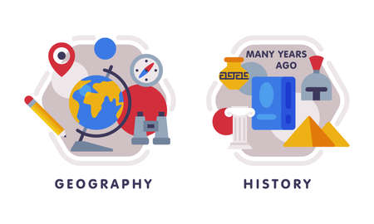


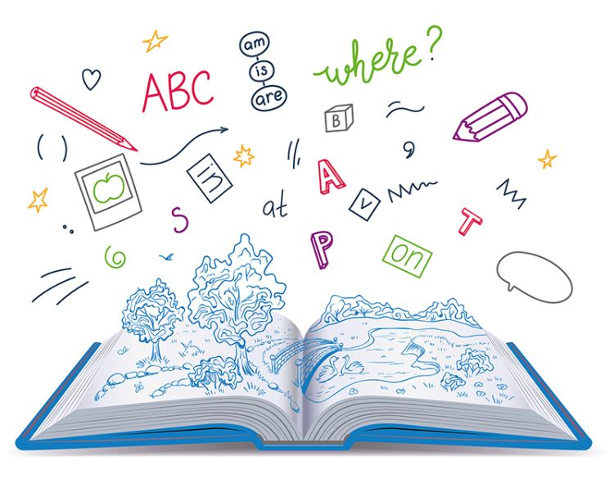
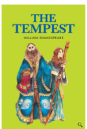








English
Our class text is called, “The Tempest” by William Shakespeare. We will look at script writing and begin to create our own playscripts.
History
We will be exploring the question ‘How did the Maya civilisation compare to the Anglo-Saxons?' We will build on our History topic in Year 4 and use the skills of comparing and contrasting.
Music
We will be continuing with our instrumental unit on recorders. Children will secure their confidence with the notes G, A and B and focus on playing with accuracy and clarity.
PSHE
Our unit will continue to focus on relationships; managing peer influence, feeling safe and recognising prejudice and discrimination.
Maths
We will be focussing on Multiplication and division, as well as starting to look at fractions We will practise the skills of finding factors and multiples. We will also consolidate our times tables as well as mental methods.
Computing
We will be programming music this half term, to create different sounds, beats and melodies which we will put to the test in Battle of the bands contest!
PE-
In gymnastics we will create sequences based on focus of balances, rolls and jumps, with floorwork and apparatus.
In outdoor PE we will focus on striking and fielding in cricket, utilising coaching specialisms from Worcestershire County Cricket.
Year 5
Autunm Term 2
Science
Our new topic is about materials – focussing on properties and changes. We will explore how different materials have different properties such as conductivity, as well as reversible and irreversible reactions.
RE
Our unit is called, “What does it mean to be Muslim in Britain today?' We will discuss how religious traditions and celebrations impact daily life.
DT
Our unit focuses on electrical systems, in particular, making a doodler. Children will be a part of the designing, making and editing process of their own doodler.
How you can support your child at home
Daily reading and discussion of their ZPD books, asking questions about the characters, plot and setting.
Times Tables Rockstars
Hit the Button - Quick fire maths practise for 6-11 year olds
Consolidate Year 5 and 6 spelling words (both reading and spelling)
MFL
In French, the children will be exploring the vocabulary of 'In my town', learning places and landmarks within a town and comparing Redditch with places in France.

