Slide 1




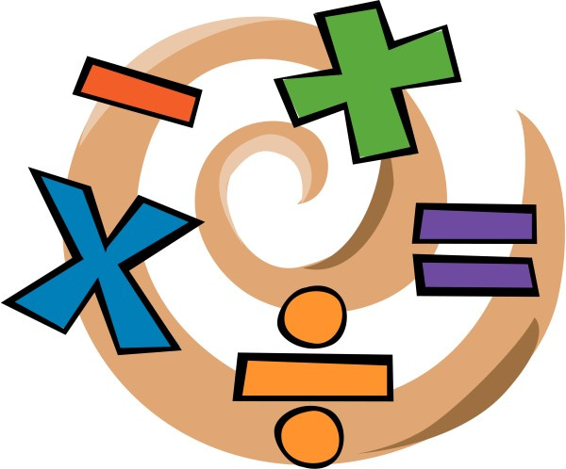
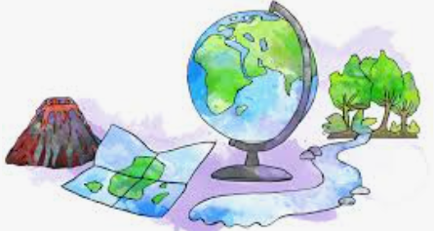


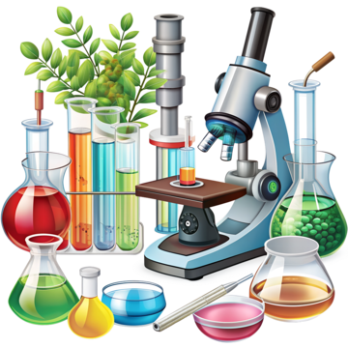




English
Our text is ‘Baker by the sea’ by Paula White. During our time reading this book the children will learn how to write a set of instructions and create a brochure style piece of writing. We will look at sequencing instructions, using imperative verbs, bullet points and headings and sub-headings.
Geography
Our new topic for Geography is 'Are all settlements the same?'
In this unit, children explore different types of settlements, from villages to cities, and discover how and why they develop. They learn about the features of settlements, how land is used, and what makes places suitable for living and working. Through map work, field work and comparisons of UK and global examples, pupils investigate how location, resources, and transport influence settlement patterns. By the end, children understand that settlements vary in size, purpose, and layout, and can explain how human and physical factors shape where people live.
Music
This half term, we continue our instrumental focus. We are learning about Indonesian music, discovering the features Gamelan music including the Slendro scale and cyclical rhythmic patterns. We are identifying traditional gamelan instruments, learning about the concept of an octave and exploring how different timbres are used in gamelan music.
PSHE
Our unit will focus on positive friendships including hurtful behaviour, managing confidentiality and managing risks online. We will also be respecting differences and similarities with sensitivity.
Maths
We will continue our focus on number and place value up to 4 digits. This will include developing methods for the four operations; addition, subtraction, division and multiplication. There will be a big push on developing their timestable knowledge up to 12x in preparation for their Multiplication Check at the end of the year.
RE
This term we will be continuing to explore the question ‘What is the Trinity and why it is important to
Christians?’. Before moving onto
‘What do Hindu’s believe God is like?’
Year 4
Autumn 2
PE-
In PE, the children will continue to learn about how to demonstrate good sportsmanship and how to stay fit and healthy. They will participate in a range of invasion games building the fundamental PE skills of throwing and catching, movement and fine and gross motor skills.
Science
We will be learning about electricity and circuits. In this unit, children explore what electricity is, how it works, and how it powers everyday appliances. They will build simple circuits using wires, bulbs, switches, and buzzers, learning how each component functions. Through investigations, children will discover which materials are conductors or insulators. By the end, children understand how electricity flows, how to use it safely, and its importance in daily life.
Computing
This half term we will learn how the internet is used. Children will learn;
Understand the need to be thoughtful when working on a collaborative document.
Use comments to suggest changes to a document and understand how to resolve comments.
Use a variety of different slide styles to convey information, including images and transitions.
Create a Google Form with a range of different question types that will provide different types of answers, e.g. text, multiple choice or numerical values.
Export data to a spreadsheet, highlighting data, using conditional formatting and calculating averages and sums of numbers.
DT
This half term our learning will be directly linked to our Science. The children will identify electrical products and explain why they are useful. They will also evaluate a range of existing torches and design a functional torch for a target audience.
MFL
We will be continuing to recap on our knowledge learnt in Year 3. Embedding basic classroom phrases including instructions and demands. We will continue to focus on our phonic knowledge and what the children learnt in year three, including colours and parts of the body.
How you can support your child at home
Spelling and reading of Year 3 & 4 words using games such as silly sentences.
Regular use of Times table rockstars
Daily reading
If possible, taking your child swimming.

