Slide 1

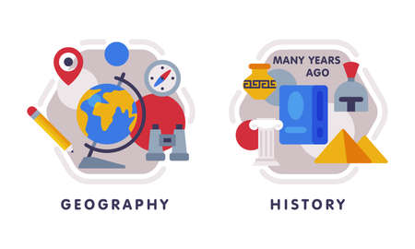











English
Our text this half term is called
‘Escape From Pompeii’. We will explore and write- Setting descriptions, diaries, letters, thought bubbles.
Before planning and writing for our main outcome which will be a newspaper report.
Music
The theme for music is. learning to play the Ukulele! The children will focus on learning the names of the components and developing simple chord shapes and rhythm patterns.
History
Our question is-Why did the Romans invade and settle in Britain? We will explore the reasons for invading, the Celtic response and life in Roman Britian.
PSHE
Our unit will focus on rules, responsibilities and rights.
Maths
In Maths, the children will be continuing to multiply and divide as well as using arrays to calculate the solutions to problems using multiples of 2, 5 and 10
Sharing and grouping problems based on the 2, 4 and 8 times-tables.
Computing
Learners will be able to log in and out of email.
Send a simple email with a subject plus ‘To’ and ‘From’ in the body of the text., edit an email. Children will also learn about online safety, specifically how messages in e mails might make the recipient feel.
PE- Tuesday and Friday
In dance we will create individual, paired and group dance sequences inspired by The Roman culture and way of life!
For outdoor PE, we will explore invasion games (e.g. 4 vs 4 keep ball, skittleball, adapted netball/ basketball, adapted games, tag rugby etc.)
Year 3
Science
We will be studying rocks and soils; causes of erosion and the effects of chemicals such as vinegar, weakening down of rocks as well as describing the work of a palaeontologist.
RE
Our unit is called, “How do festivals and worship show what matters to Muslims?’ We will examine the five pillars of Islam and special times of year such as Ramadan and Eid.
Art
Our unit focuses on Sculpture and 3D. We will explore, manipulate and create 2D and 3D shapes. We will examine the work of Andy Goldsworthy.
How you can support your child at home
Daily reading and discussion, asking questions about the characters, plot and setting.
TT Rockstars to secure quick recall of key multiplication and division facts.
Spelling of Year 3 and 4 words.
Developing their understanding of telling the time to the nearest quarter of an hour.
MFL
The children will learning to read the days of the week and months of the Year in French. They will also learn to say the phonic sound ‘ch’ in French.

