Slide 1
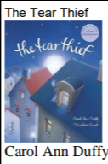
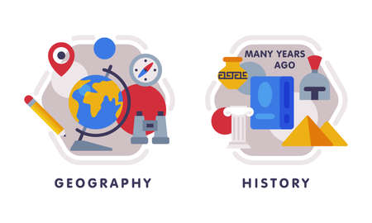











Music
The theme for our music is.
English
We will explore the Tear Thief by Carol Ann Duffy. The children will create a shared poem, diary entry, persuasive poster, letter of explanation. We will build up skills before writing our main outcome: Newspaper Article
Geography
Our topic for this half term is-
Who lives in Antartica? We will locate using a range of maps, examine the climate and discover who lives in Antartica.
PSHE
Our unit will focus on
PE- Tuesday and Thursday
In dance, we will be moving our bodies like robots! We will create funky dances and improvise robotics dances.
Outdoor PE= We will explore a range of invasion games (e.g. 4 vs 4 keep ball,
skittleball, adapted netball/ basketball,
tag rugby etc.)
We will also be inventing games with rules and leading others.
Maths Add 2-digit and 3-digit numbers
Subtract a 2-digit number from a 3-digit number
Estimate answers
Inverse operations across all 4 operations (add, subtract, multiply and divide)
Computing: We will revisit internet and online safety in week 1, we will learn about the internet being a vast network and the parts of a network needed for a website to work. Children will also recognise the role of the cloud in storing data.
Year 3
Autumn 2
Science
How you can support your child at home
Daily reading and discussion of the text, asking questions about the characters, plot and setting.
TT Rockstars to secure quick recall of key multiplication and division facts.
Hit the Button- a free online maths game to help with quick recall
Hit the Button - Quick fire maths practise for 6-11 year olds
Key spelling rules we are focussing on this half term include: ………..
Spelling of Year 3 and 4 words
Developing their understanding of telling the time across the day.
RE
Our unit is called, “What is it like for someone to follow God?” We will learn about the Old Testament people of God and how they lived their lives. We will learn the story of Noah, considering what it was like for him to follow God We will consider why following God might sometimes feel hard for believers.
DT
Our unit focuses on Structures: constructing a building. We will examine the features of castles before planning and building junk models of our own.
MFL

