Slide 1


Year 2

Slide 2
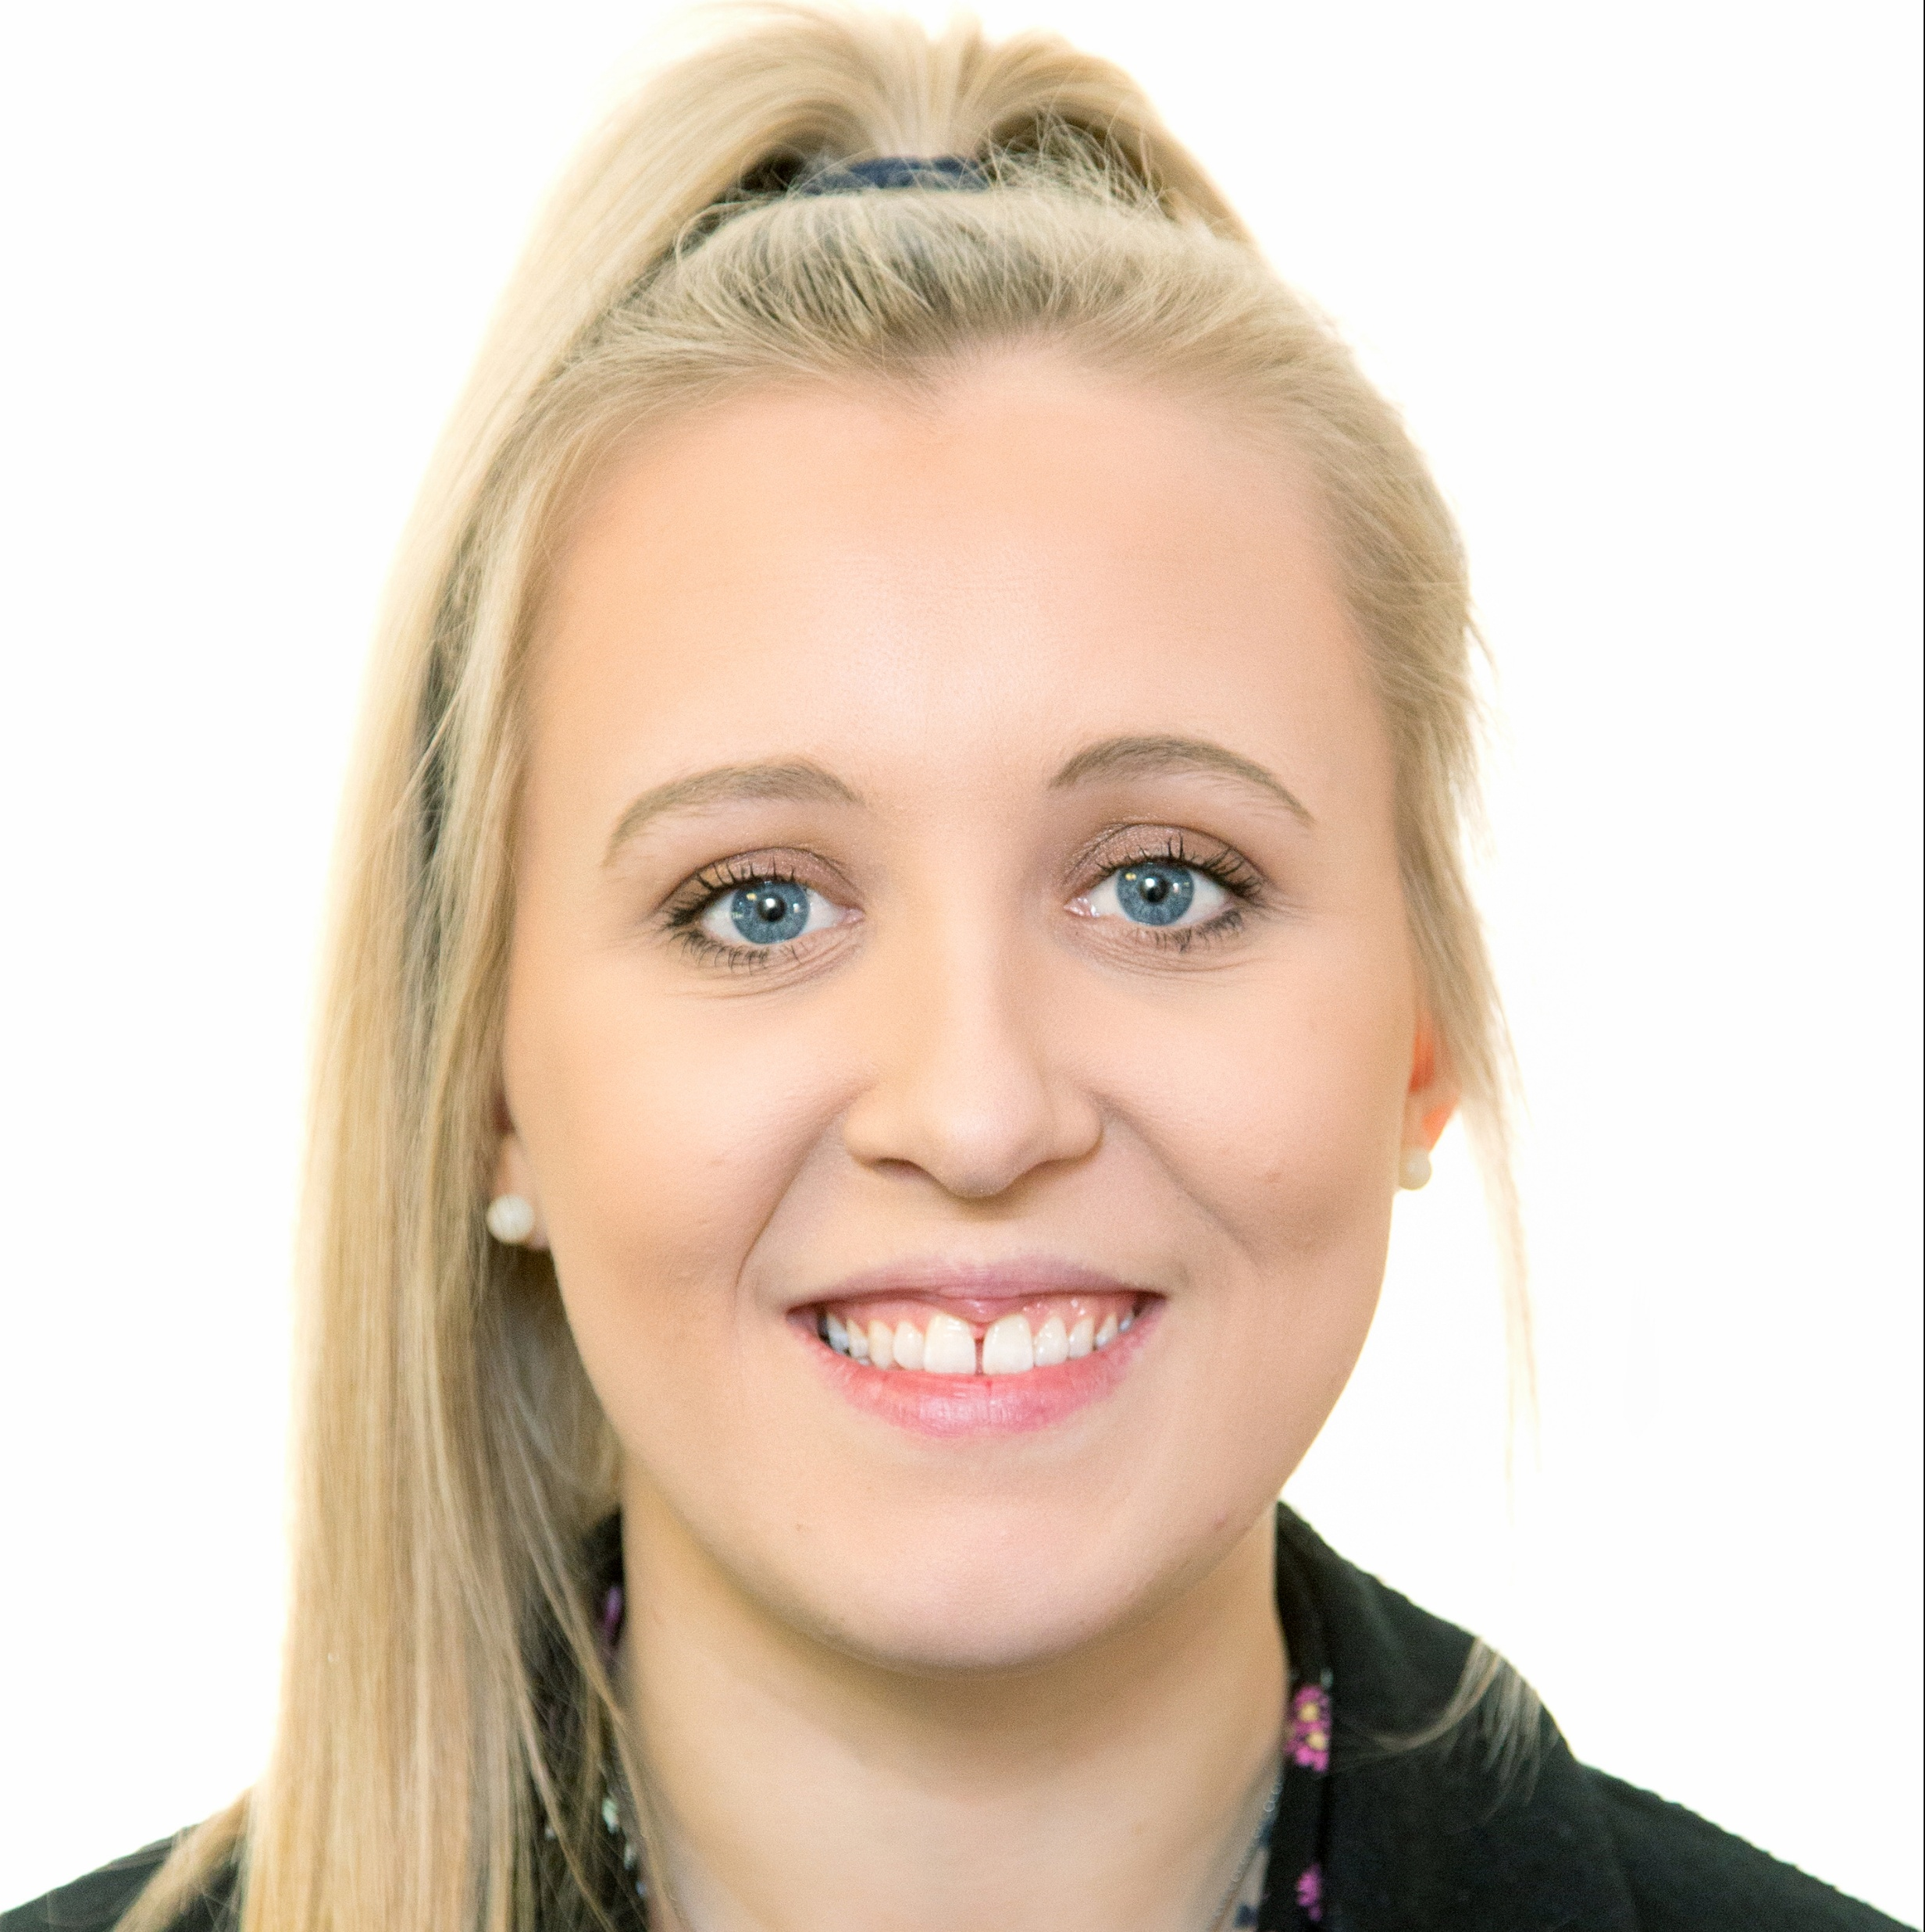
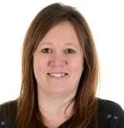
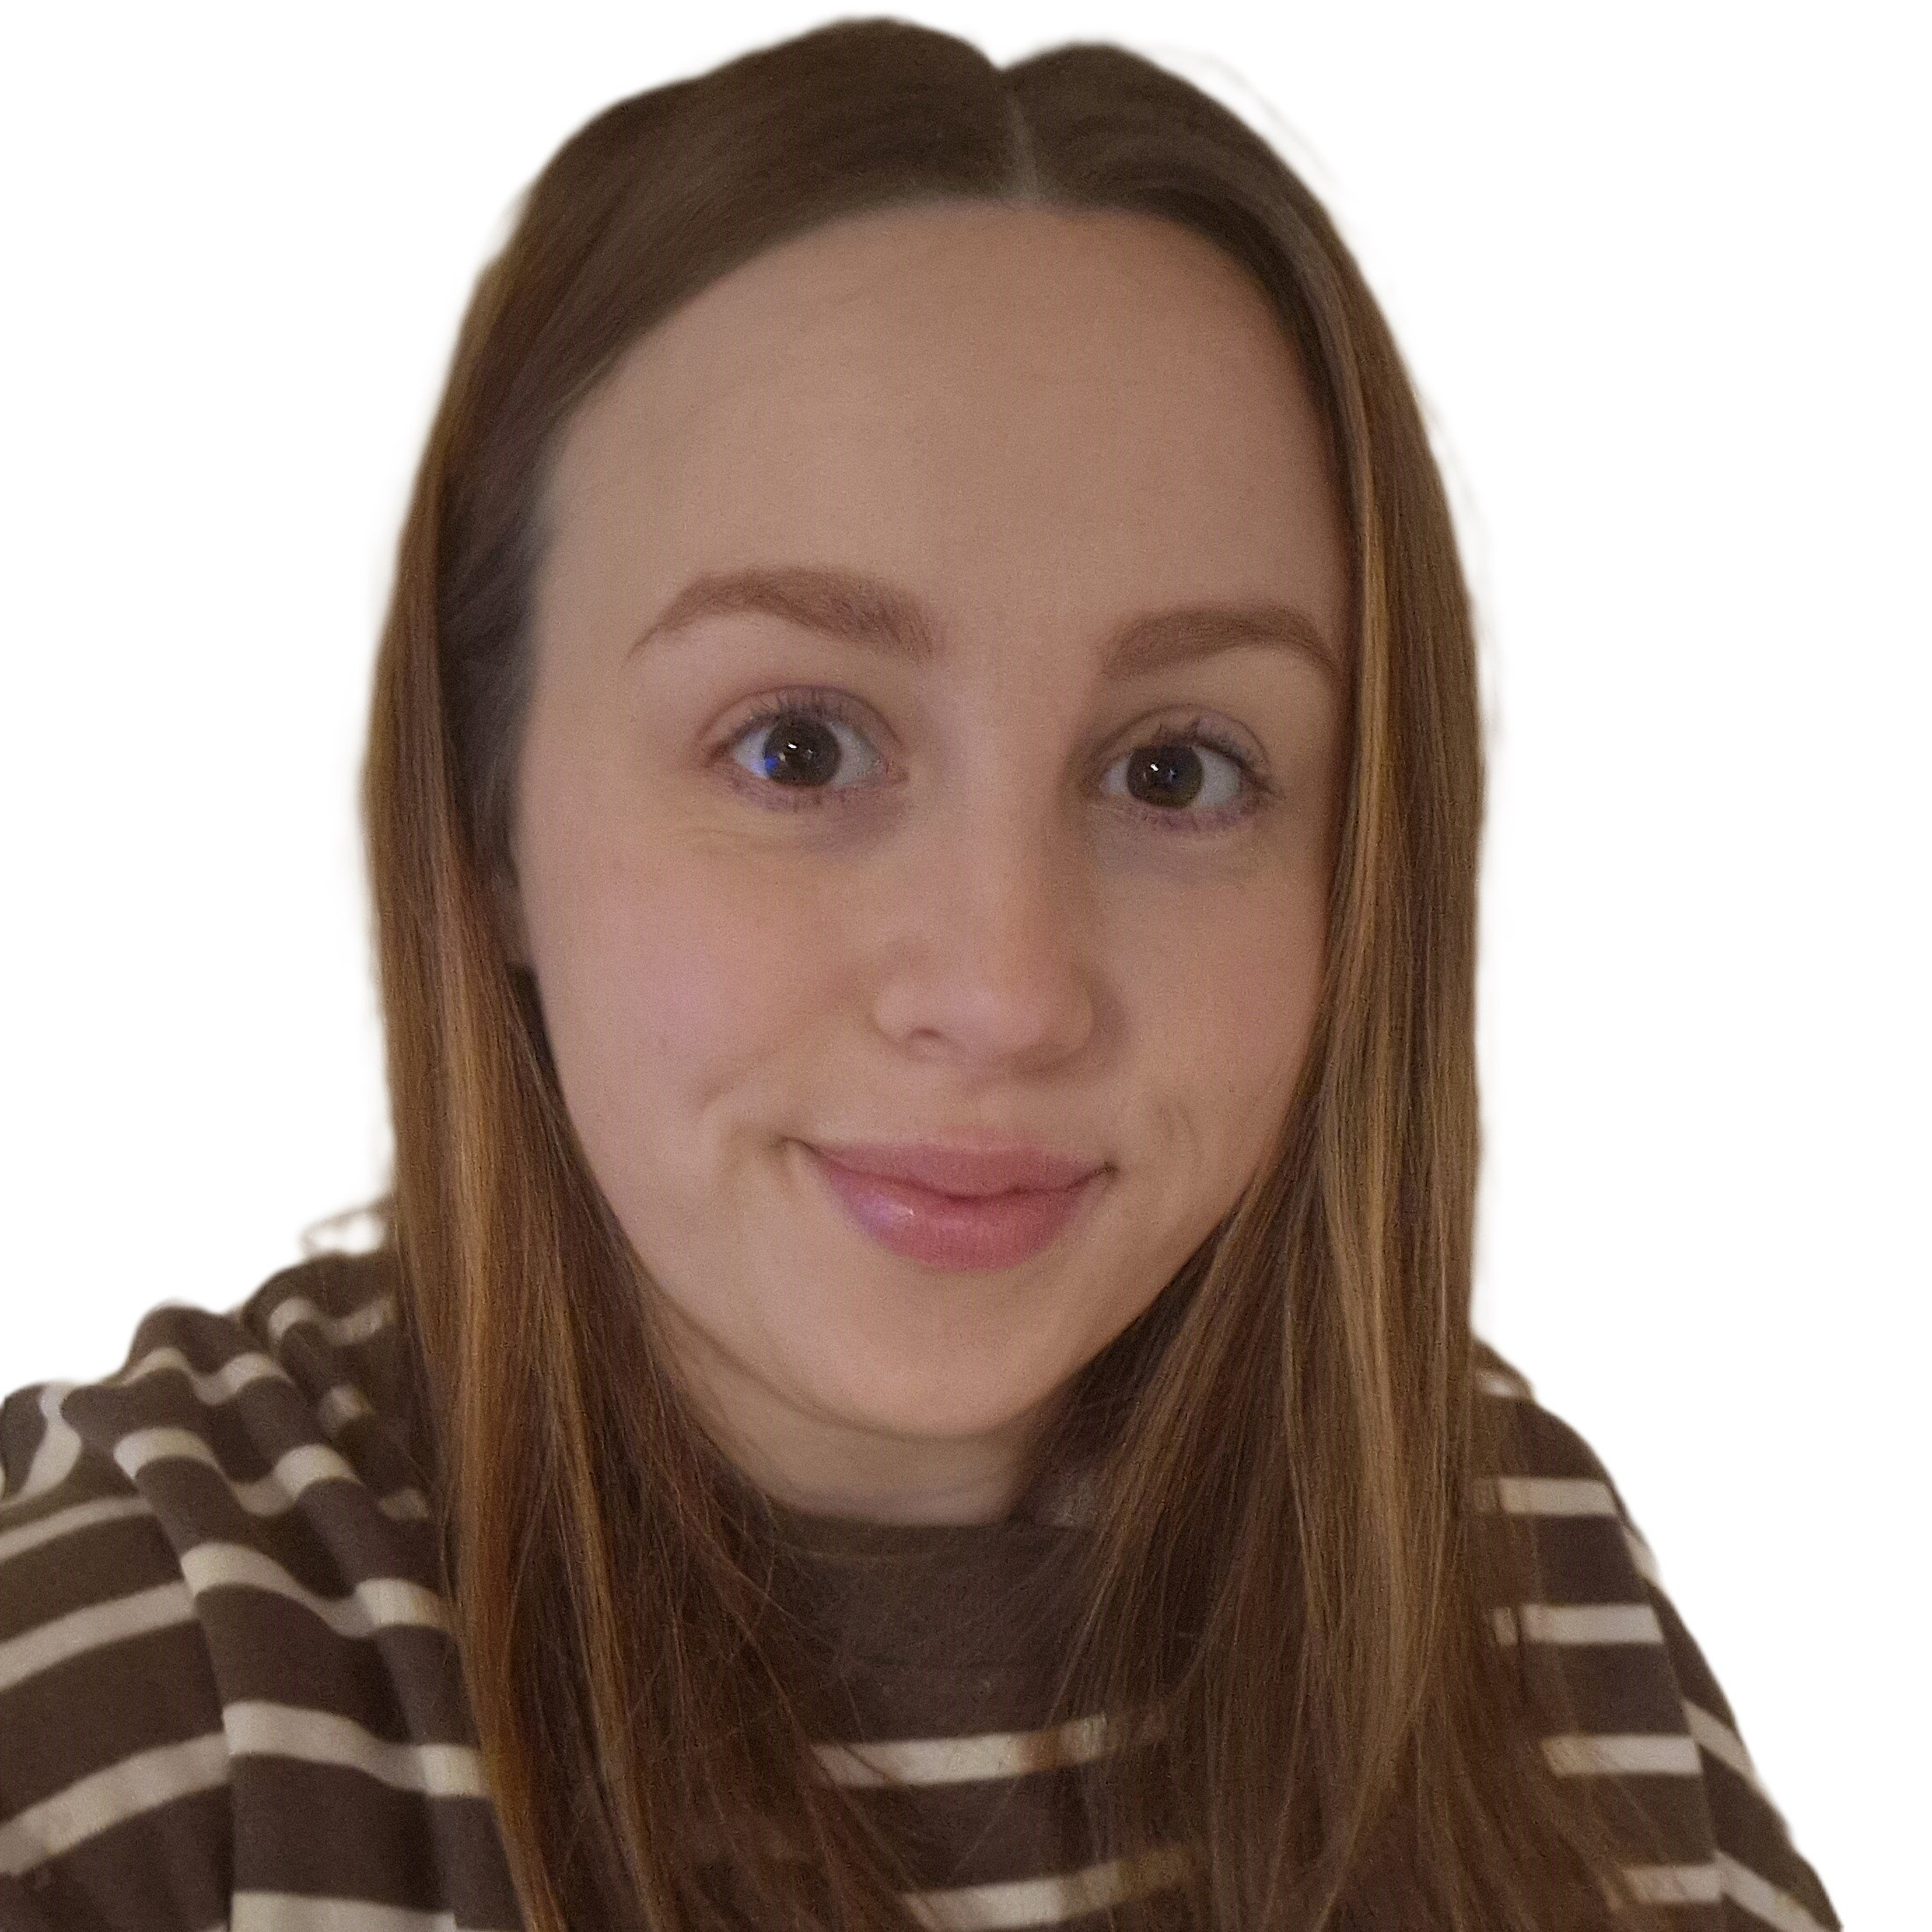
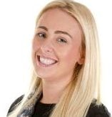
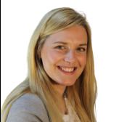
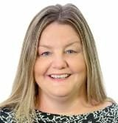
Our team
Miss Moseley
Mrs Rhodes
Miss Byrne
Miss Robinson
Mrs Broome
Mrs Battey

Slide 3

Behaviour
Children are expected to follow the Webheath Way at all times, as well as our class charters.
Class charters will be made during our first week back in September. This allows the children to have an important role in creating our class rules.
Positive behaviour will be noticed and praised consistently; we will also assign class jobs to help children develop responsibility and take pride in their classroom.

Slide 4
Learning at home
Children will continue to bring home a weekly ‘reading for pleasure’ book for you to share and enjoy with your child.
In addition, they will bring home their Book Club book which matches their phonetic ability to celebrate their reading practise throughout the course of the week in ‘Book Club’.
Other ways to support your child's learning at home include practising handwriting, working on spellings and using Times Table Rock stars.
Book bags only to be bought into school. We do not have room to store large school bags.

Slide 5
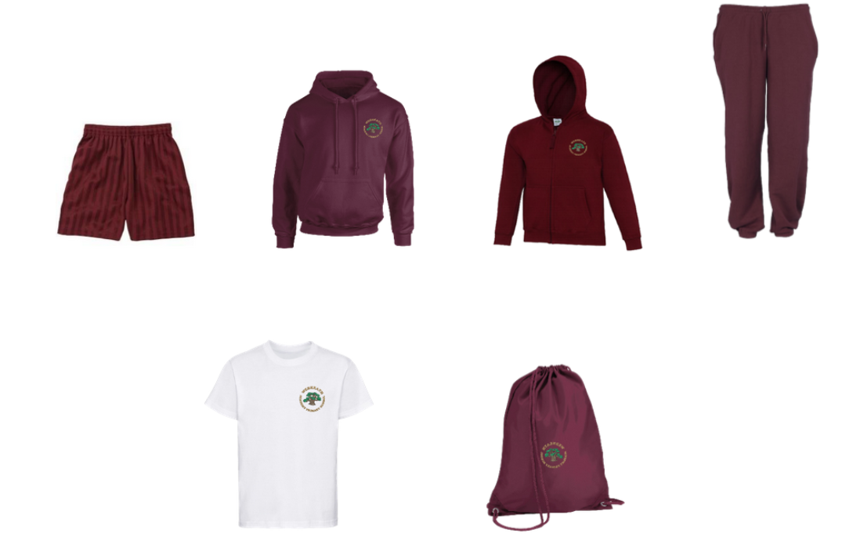
PE
We have PE twice a week (indoor and outdoor).
Please remember to bring your child into school wearing their kit on these days. Also ensure earrings are removed and hair is tied up.

Slide 6
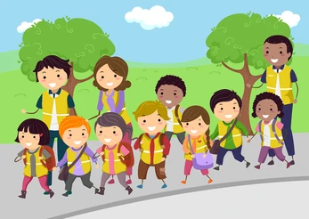
Trips and enrichment
Trips and enrichment provide excellent opportunities to further develop and deepen your child’s learning.
In year 2 we will offer a variety of carefully planned experiences that compliment our curriculum and spark curiosity, these will include;
Reading cafés
A local walk to Morton Stanley Park
A castle trip
A Victorian School day
And many more to be confirmed.

Slide 7
We look forward to the next year ahead with you all.
Any questions or queries don’t hesitate to get in touch.

