Slide 1
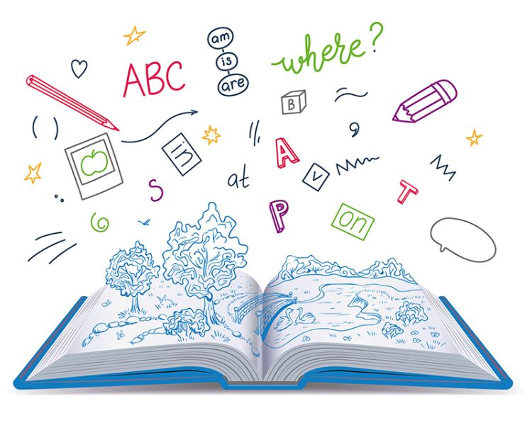
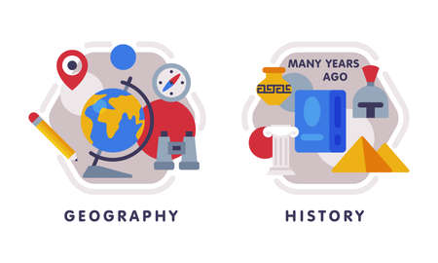







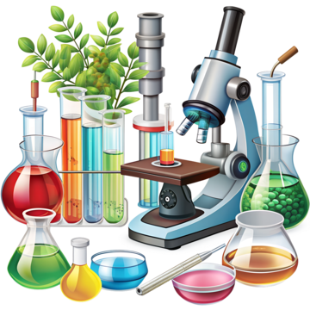

English
We will be reading the book 'Wolves' by Emily Gravett, and using this as a basis for our writing tasks. We will continue to focus on sentence coherency, capital letters, full stops and adjectives.
History
In History, we will be exploring our question 'How was school different in the past?' Children will develop an understanding of what school was like 100 years ago, identifying features that are similar and different.
Music
We will be starting our instrumental unit based around musical storytelling. Children will learn how events, actions and feelings in stories can be represented by pitch, dynamics and tempo.
PSHE
We will be learning all about relationships. Children will explore how they are similar and different to others.
Maths
In maths, we will be studying addition and subtraction. Children will develop their fluency of the fact families within 10, 20 and 100, compare number sentences and work on securing their accuracy when additing and subtracting 1 and 2-digit numbers
Computing
We will be learning about programming this half term. Children will learn about algorithms and debugging to solve problems and make their code more efficient.
PE-
Indoor - Dance – We will be dancing to the theme of 'cultures around the world'
Outdoor – We will be exploring key fundamental concepts of balnce, agility and coordination. This will be with our body as well as beginning to explore the use of equipment.
Year 2
Autumn Term 2
Science
Our topic for this half term is 'microhabitats'. We will be learning all about minibeasts. Children will have chance to ask questions using scientific enquiry to find out the answers. They will identify and classify minibeasts, perform a minibeast hunt, investigate woodlice and discover all about the job of a botanist.
How you can support your child at home
Daily reading and discussion of the text, asking questions about the characters, plot and setting.
Practising weekly spelling lists.
TT Rockstars to secure quick recall of key multiplication and division facts- 2s, 5s, 10s
To practise counting in 3s
Hit the Button- a free online maths game to help with quick recall- numberbonds, addition and subtraction number facts
Key spelling of Year 1 and 2 Common Exception Words
Using LetterJoin to practice handwriting
Developing their understanding of telling the time across the day.
Art In art, we will be studying a unit called 'sculptures and 3D'. Children will learn to shape and decorate clay, create a pinch pot, design and make a clay tile with house features.
RE
Our investigation question for this half term is 'Why does Christmas matter to Christians?' Children will explore Christianity and the meaning of Christmas.

