Slide 1

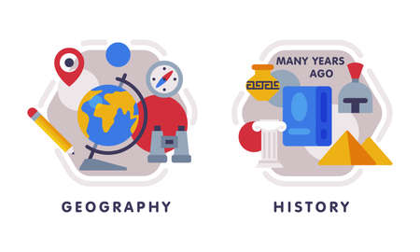









English
We will be reading the book 'The Bear under the stairs' and using this as a basis for our writing tasks. We will continue to focus on sentence coherency, capital letters, full stops and adjectives.
Geography
In Geography we will be investigating hot and cold places. Children will learn the names of the continents and oceans and discover some of the coldest places on earth!
Music
We will be starting our unit on 'Call and response' with the theme of animals. Children will learn about sound patterns and dynamics.
PSHE
We will be learning about relationships. We will begin by identifying how we keep ourselves safe and then move on to friendships, managing secrets and identifying hurtful behaviour.
Computing
Keeping safe and using our equipment at Webheath – Children will learn the rules for using technology and the internet. Children will also be learning what a computer is and how to log on.
Maths
In maths, we will be securing our place value knowledge within 100. Children will develop their fluency in the 4 operations and apply this to reasoning tasks.
PE-
Indoor - Dance – We will be dancing to the theme of 'cultures around the world'
Outdoor – Agility, balance and co-ordination using body and objects.
Year 2
Autumn Term 1
Science
Our topic for this half term is 'Living things and their habitats'. Children will learn about a variety of habitats and begin to understand food chains within them
How you can support your child at home
Daily reading and discussion of the text, asking questions about the characters, plot and setting.
Practising weekly spelling lists.
TT Rockstars to secure quick recall of key multiplication and division facts- 2s, 5s, 10s
To practise counting in 3s
Hit the Button- a free online maths game to help with quick recall- numberbonds, addition and subtraction number facts
Key spelling of Year 1 and 2 Common Exception Words
Spelling of germination, bulb, fruit, coastline, ocean, physical, feature, human
Developing their understanding of telling the time across the day.
DT
Linking to our English text 'The bear under the stairs', we will be looking at structures and designing a chair for baby bear.
RE
Our investigation question for this half term is 'Who is a Muslim and how do they live? Children will learn about the Islamic faith.

