Slide 1








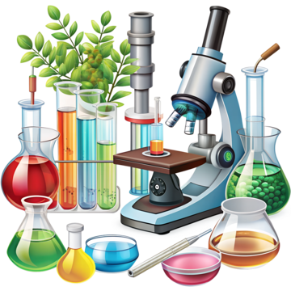


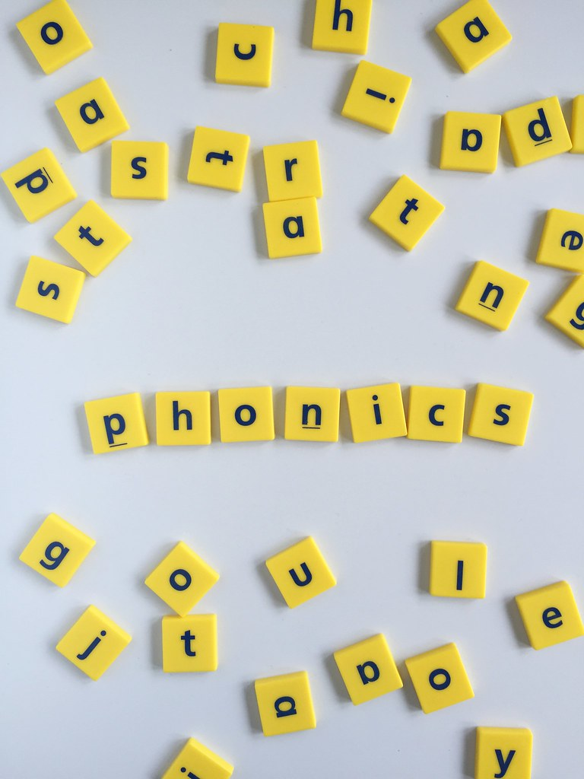
English
Our class texts are called; The true story of the three little pigs and Naughty Bus. We will be writing labels and simple sentences and beginning to punctuate our sentences with a capital letters and full stops. We will be practicing our letter formation especially our capital letters.
PSHE
We will be discussing Safe Relationships, unpicking what it means to keep something private, different types of touch and how they make us feel, how to respond and about asking for and seeking permission.
Geography
Within the unit “What is it like here?” we will be exploring maps, using them to identify where we are located and understanding features on maps. We will then be learning to draw our own to represent our school.
Music
In our unit called “Tempo”, we will be using our bodies and instruments to listen and respond to pieces of music with fast and slow speeds; learning and performing a rhyme and a song focussing on fast and slow.
PE
In gymnastics we will explore different ways of travelling, jumping, rolling and balancing. We will begin to combine these into sequences.
We will use rolling, hitting, jumping, catching and kicking skills in isolation, beginning to explore different equipment such as tennis racquets and hockey sticks.
Maths
In Maths we will be exploring addition and subtraction within 10, including number bonds to 1. This will be looking in detail at fact families and part whole models. We will also begin exploring 2D and 3D shapes- naming them and identifying properties.
Computing
Following on from our online safety unit we will be developing our mouse skills by learning how to log in and navigate around a computer while creating digital artwork.
Year 1
Autumn Term 2
Science
Our topic is Everyday Materials. Comparing and grouping materials based on their properties. We will be making predictions and testing materials.
How you can support your child at home
Daily reading and discussion of the text, asking questions about the characters, plot and setting.
Practice reading Phase 2, 3, 4 and 5 tricky words.
Practice organising themselves e.g. zipping coat up
Spelling of Year 1 tricky words
Practise basic sewing skills- running sticks, back stick, threading a needle and tying a knot.
Naming and exploring shapes within the home- introducing how many vertices, edges and faces 3D shapes have.
Learning number bonds to 10.
Add 0 or 1 to any number.
DT
We will be designing puppets, learning how to join fabrics together using glue, staples and pins. We will also begin exploring sewing skills and how to use decoration to make a finished product look effective and appealing.
RE
Our unit is called What do Christians believe God is like? Looking at the Parable of the Lost Son.
Phonics
We will begin to read and spell words with the suffix –es, -er, - est, -ed. Practicing our blending skills and spelling along with beginning to learn some new tricky words.

