Slide 1
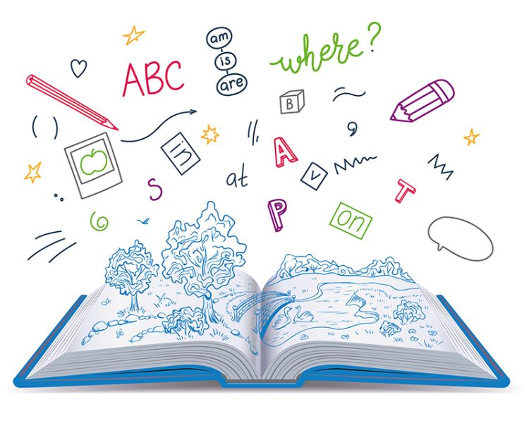
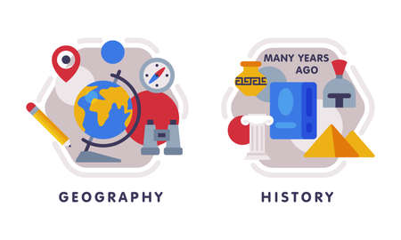

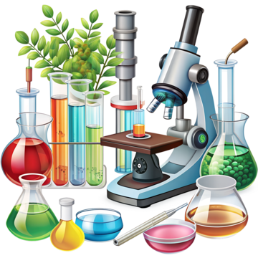






Understanding the World
Travelling Tuesday
Travelling Tuesday covers Geography, History and Science. This half term we will be exploring some new countries, learning how shadows are made and deciding whether things are from the present or the past.
RE
Our question for this half term will be “Where do we belong? We will be looking at different places where we belong and learning about how people belong to different communities.
Literacy
This half term, our texts will include Goldilocks and the Three Bears, The Magic Paint Brush and Little Red Riding Hood. We will be exploring the texts in different ways to enhance our reading and writing skills.
Physical Development
Gross Motor
In PE, we will be moving onto gymnastics. In our sessions the children will have the opportunity to explore movements such as travelling,, jumping, balancing and rolling using different parts of their bodies at varying levels and speeds.
Fine Motor
The children will be securing their handwriting skills, ensuring their letters are correctly formed.
Phonics
In phonics, we will be learning our vowel digraphs in addition to reading and writing words using the phonemes that we learnt last term. We will be learning more tricky words too.
Personal, Social and Emotional Development
This term we will be continuing to help the children with their independence both as learners and caring for themselves. We will be learning about oral hygiene and healthy eating.
Reception
Spring Term 1
Maths
This term we will be developing our understanding of numbers to 10, including counting up to 10 objects accurately ,recognising and ordering the numerals and exploring the different compositions of numbers within ten.
How you can support our child at home
Continue with lots and lots of practise of sounds inside your child’s sound box
Practise, practise reading and writing tricky words
Continue reading books for pleasure every day and talk about the text, asking questions about the characters and what is happening in the story
Board games are a great way of practising maths skills. Dice will encourage your child to recognise the number from the dots (subitising). They are really helpful for counting the number of spaces you can move accurately and for recognising digits to ten.
To complement our topic, encourage your children to about different places that they belong– we always love to see photos of children continuing their learning at home!
Expressive Art and Design
We will have the opportunity to use different media to explore mark making and colour mixing. Children will have the opportunity to develop creative skills through exploration and experimentation.
Music : We will be listening to a range of music, learning new songs and creating sound stories.
Communication and Language
This term the children will continue to develop their language skills by using our role play areas, taking part in discussions and answering q questions. We will be extending their vocabulary by exploring different texts.

