Slide 1
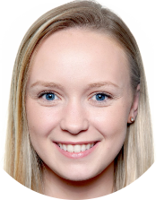

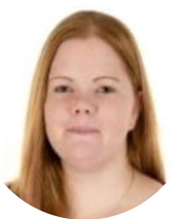



Welcome to Year 4!
Miss Harris
Y4 Class teacher
We are the Year 4 team and we are really excited to work with your children this year. Continuing to expand their knowledge and love of learning through an exciting and active curriculum.
Miss Evans
Y4 Class teacher
Mrs Mackin
Teaching assistant
Mrs Wakeman
Teaching assistant
Mr Mellor
LKS2 Phase leader

Slide 2

Behaviour / Expectations in Year 4.
Following school values.
Always being a good role model to all.
Helping the younger children.
Follow our classroom rules.
Wearing correct uniform.
Having the correct equipment.
Equipment needed daily
Clear pencil case
Pencils
Blue handwriting pens
30cm Ruler
Glue stick
ZPD book – provided by school
Jotter – Provided by school.
Homework diary – Provided by school.
Home learning
Daily reading at home of ZPD book
Practise Y3/4 spelling words – provided in homework diaries.
Times table practice (TTRS)

Slide 3
Swimming
Thursday mornings
From week 2, please send children to school dressed in usual PE kit and have their swimming kit in a separate waterproof bag.
As usual, please ensure earrings are removed for all PE lessons including swimming. We are not able to place tape over earrings.
The children will be working towards being able to swim 25 metres confidently in a range of stroke and perform a self rescue.
Equipment needed
Towel
Swimming costume (no bikinis) or swimming trunks.
Hair tied up
Goggles
Swim bag
Hair brush - optional

Slide 4

Year 4 trips
Throughout year 4 we hope to provide enrichment opportunities both on and off school premises this may or may not include:
Bishops wood
Hindu temple
Morton Stanley park
Redditch Library trip
Local walks
Guest speakers
Swimming

