Slide 1
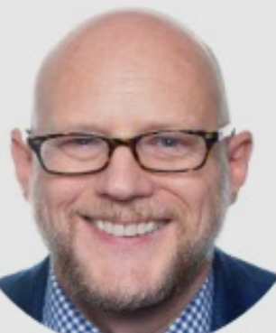
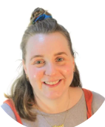

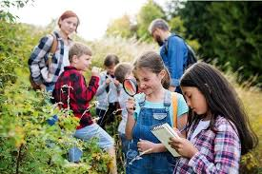


Meet the Year 3 team

Slide 2

Meet the Year 3 team

Slide 3
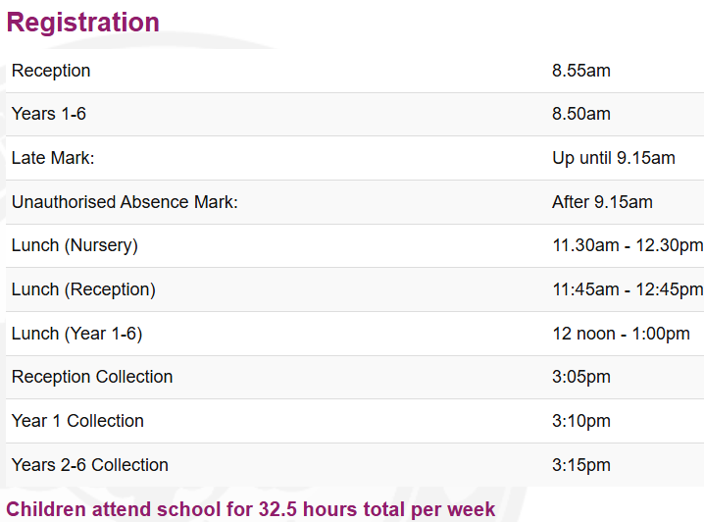

Slide 4



Behaviour expectations
Open door policy-come and speak with us (at a mutually convenient time!)
Children are above all, expected to follow our school values.
Respect Kindness Zest Nurture Integrity
Respect is a two-way street, children can expect to be spoken to with respect, in turn they must also respect the adults who work tirelessly to champion, encourage and above all TEACH them!

Slide 5
Behaviour
Open door policy-come and speak with us (at a mutually convenient time!)
Children are above all, expected to follow our school values.
Respect Kindness Zest Nurture Integrity
Respect is a two-way street, children can expect to be spoken to with respect, in turn they must also respect the adults who work tirelessly to champion, encourage and above all TEACH them!
We are very proud of our lovely school environment, so we look after it! For pupils to be successful and feel safe and happy at school, they must understand the high
Pupils should aim to:
• Respect views, rights and property of others.
• Behave safely and appropriately both in and outside the classroom.
• Co-operate in school with adults and peers.
• Work as hard as they can.
• Arrive at school on time, wearing correct uniform and suitably equipped for the day ahead
• Complete any homework set in a timely fashion and to as high a standard as possible.

Slide 6
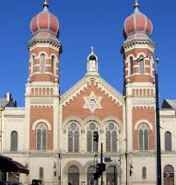
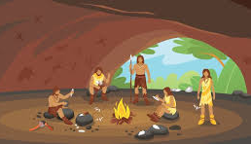
Visits

Slide 7


Slide 8
