Slide 1

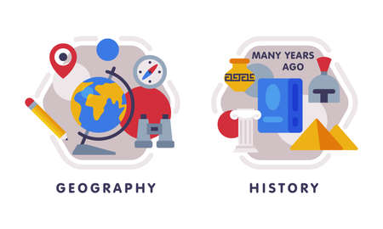










English
Throughout Autumn 1, we will using the text ‘The Arrival’ written by Shaun Tan. We will be exploring the effects of figurative language and applying the skills acquired to write letters and diary entries. Which convey a given perspective.
History
Our key question: What does the Census tell us about our local area. Here we learn what the census tells us about women, children and jobs and how the census data in the past differs to today.
Music
The theme for our music dynamics, pitch and texture using Fingal’s Cave by Mendelssohn as a driver. Here the children appraise the composer and improvise and compose their own music.
PSHE
Our unit will focus on relationships and attraction to others. In addition, managing pressure and consents in different situations.
Maths
We will be focusing on place value of number up to 1,000,000 including powers of 10 and negatives numbers. There also is a focus on the 4 operations working with numbers to 1.000,000. Included in this, the children will problem solve, explore common factors/ multiples and prime numbers.
In computing we will focus on Bletchley Park and the history of computers Discovering the history of Bletchley Park, historical figures and the importance of code breaking and passwords. In addition, internet safety.
PE
In indoor PE we will be exploring dance through the music ‘Singing in the Rain and artwork Umbrellas by Renoir.
In outdoor PE, we will focus on net and wall games and learning invasion skills.
Year 6
Autumn Term 1
Science
We will be learning about ’Living Things- Classifying Big and Small’. We draw on Carl Linneaus classification system to explore cold/ warm blooded vertebrae, invertebrate and micro- organisms.
How you can support your child at home
Daily reading and discussion of the text, asking questions about the characters, plot and setting.
TT Rockstars to secure quick recall of key multiplication and division facts.
Hit the Button- a free online maths game to help with quick recall of multiplication and division facts.
Spelling of Year 5 and 6 words.
Supporting with specific weekly homework given on Fridays and to be returned on Thursdays.
RE
Our ‘Big Question’ this half term is Creation or Science- conflicting or complimentary? Here we explore why some people believe in God and why some do not.
Art/DT
Children learn about the artists Chuck Close and Derek O Boateng. Here the children will develop photography skills and techniques to design a range of creative photographic outcomes.
MFL
In French we will be focusing on what a typical school day is like and locations that can be found in the school setting.

