Slide 1



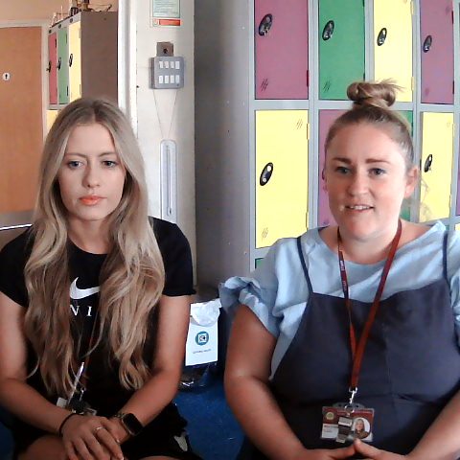
5

Slide 2


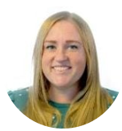
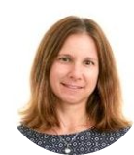

Meet the Year 5 team
Miss Steele – 5SS teacher
PE lead
Miss Green – 5KG teacher
Geography Lead
.
Mrs Greaves – Year 5 TA and phonics and reading specialist
Mrs White – Year 5 TA

Slide 3
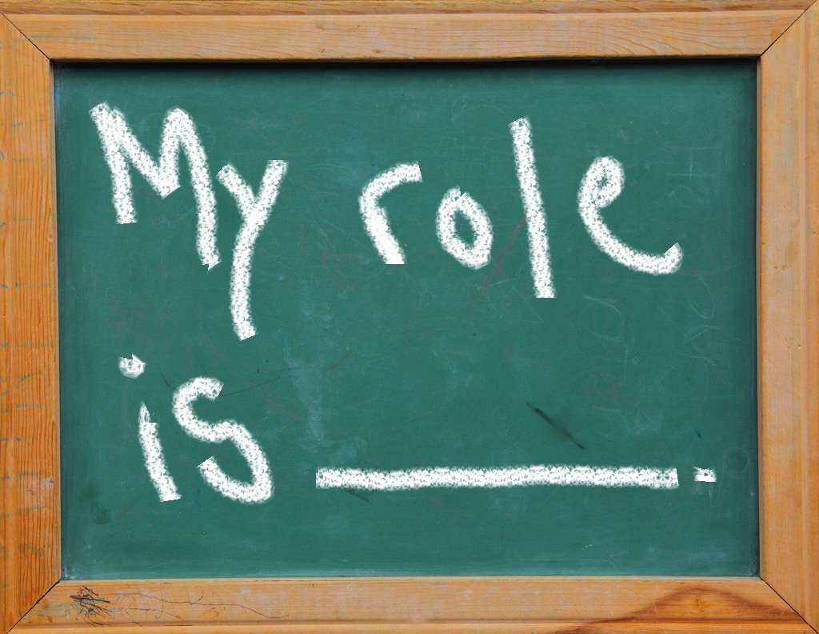
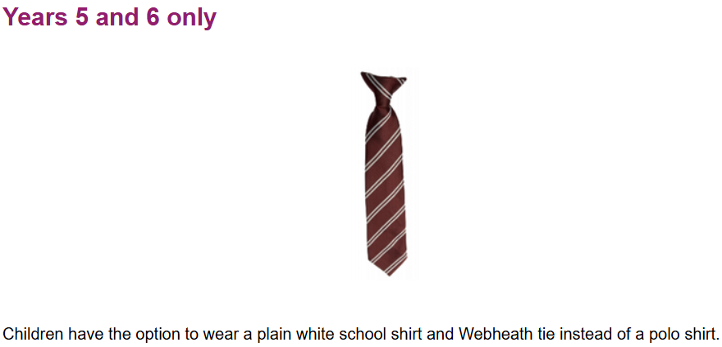
UKS2 Reminders
Uniform
Pencil cases
Earrings and PE kit
Lockers
Not to bring in toys/items from home
Mobile Phones

Slide 4
Behaviour / Expectations in Year 5.
Following school values.
Always being a good role model to all.
Helping the younger children.
Follow our classroom rules.
Wearing correct uniform.
Having the correct equipment

Slide 5

Potential Events and Visits (dates TBC)
Mary Ardens Farm
Redditch Town Centre – local questionnaire
WonderDome planetarium
Tudor World – Stratford-Upon-Avon
Arrow Valley Lake – marine environments
Local sporting events

Slide 6

Homework
Homework will be introduced during year 5, and could include:
Maths, English, Spellings, and topic work.
This could be paper based or digital (Showbie, Writer’s Toolbox or TTRS)
Please ensure that you are reading at least 3 times a week and record this in your homework diary.

