Slide 1
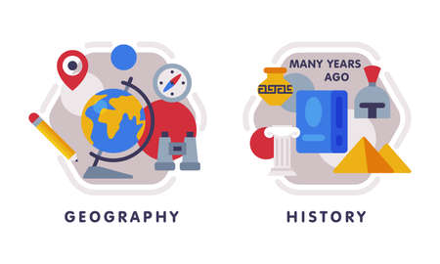












English
Our class text is called, “The Lost Thing” by Shaun Tan. We will look at fiction writing and begin to create our own narrative.
Geography
We will be exploring the question ‘Would you like to live in the desert?” We will discover the Mojave desert and its key features.
Music
We will be exploring Indian percussion music with the focus on Bollywood orgins, also looking at musical score.
PSHE
Our unit will focus on relationships; managing peer influence, feeling safe and recognising prejudice and discrimination.
Maths
We will be focussing on place value represent, partitioning and using number lines with numbers to 1,00,000. We will practise the skills of rounding and using powers of 10. We will also consolidate our written methods of addition and subtraction as well as mental methods.
Computing
Systems and searching is our topic where we will learn how to use a range of search engines, how to identify true and untrue information on the internet and understand what ‘copywrite’ means.
PE-
In dance we will create motifs and sequences based on the ‘War of the World’ soundtrack.
In outdoor PE we will focus on fundamental movements, core concepts of sport such as warm-ups, cool-downs and how the body works. We will also look at our half termly sport focus ‘tennis’.
Year 5
Autunm Term 1
Science
Our new topic is about mixing and separating materials.. We will explore how different materials can be combined in solutions through processes such as dissolving, and how we can separate materials through filtering, sieving and evaporating.
RE
Our unit is called, “What does it mean for Christians to believe God
is holy and loving?” where we will explore Christian’s relationships and beliefs about God.
Art
Our unit focuses on contemporary art and interactive installations and sculptures with a particular focus on the Chinese artis Cai Guo-Qiang .
How you can support your child at home
Daily reading and discussion of their ZPD books, asking questions about the characters, plot and setting.
Times Tables Rockstars
Hit the Button - Quick fire maths practise for 6-11 year olds
Consolidate Year 5 and 6 spelling words (both reading and spelling)
MFL
In French, the children will begin with numbers up to 100 and learn how to describe the weather, including seasons and using compass points.

