Slide 1
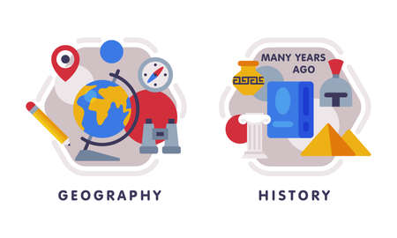



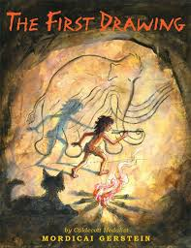








English
Our class text is called, “The first Drawing” where we will explore the Stone Age and cave paintings. We will write diary entries, explore the conventions of speech, create character descriptions and finish by writing our own historical narratives.
History
We will be exploring the question ‘Would you prefer to live in the
Stone Age, Iron Age or Bronze Age?” We will compare and contrast these periods of pre-history.
PSHE
Our unit will focus on -What makes a family; features of a family. We will also explore
personal boundaries; safely responding to others and
the impact of hurtful behaviour.
Music
Identify the key features of a ballad.
Perform a ballad using actions.
Sing in time and in tune with a song and incorporate actions. Retell a summary of an animation’s story. Write a verse with rhyming words which tell part of a story. Perform their lyrics fluently and with actions.
Maths
We will be focussing on place value represent numbers to 100
Partition numbers to 100
Number line to 4 Hundreds
Represent numbers to 1,000
place value, times tables
Computing
Learn about online safety. Use computers more purposefully Log in and navigate around a computer
Drag, drop, click and control a cursor using a mouse
Use software tools to create art on the computer
PE- Tuesday and Friday
Indoor
In gymnastics we will cover basic rolls and floor work, rolls and gymnastic movement.
Outdoor,
The children will learn about map skills and how to use a compass successfully.
Year 3
Autumn Term 1
Science
Our new topic is about animals and movement the three key functions of the skeleton (movement, support and protection). Describe a vertebrate, invertebrate, endoskeleton and exoskeleton.
RE
Our unit is called, “What do Christians learn from the creation story?” Where we will explore the Christian creation story and examine how it affects the lives of Christians.
Art
Our unit focuses on Painting and mixed media where we will examine and recreate Prehistoric painting
How you can support your child at home
Daily reading and discussion of their ZPD books, asking questions about the characters, plot and setting.
Hit the Button- a free online maths game to help with quick recall
Hit the Button - Quick fire maths practise for 6-11 year olds
Consolidate Year 1 and 2 words..
MFL
In French, the children will begin with learning where in the world is France? Then simple classroom instructions and greetings.

