Slide 1
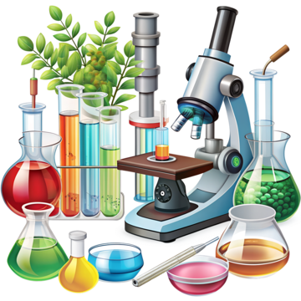
Understanding the World
Travelling Tuesday
Travelling Tuesday covers Geography, History and Science. This half term we will be thinking about people who help us, both in school and in our community.
RE
Our question for this half term will be ‘Why is the word God special to Christians?' We will explore this by beginning to think about the things that are special to us, as well as things that are special in the world.
Literacy
This half term, our texts will include The Colour Monster, The Enormous Turnip, Where the Wild Things Are and Funnybones. We will be introducing "Drawing Club' to encourage the children's imagination and creativity around stories.
Physical Development
Gross Motor
In PE, we will be participating in multi-sport activities developing our throwing, catching and movement skills such as running, jumping and skipping.
We will also be playing in our outdoor area, using large loose parts to make obstacle courses, playing in sand and water and using our balance bikes.
Fine Motor
We will be exploring with play dough, drawing lines and circles and practising our grip when holding paintbrushes, pencils and other mark making resources.
Phonics
In phonics, we will be focusing on oral word blending and segmenting, learning single letter sounds and blending these sounds to read words. We will begin to learn some tricky words that cannot be easily sounded out.
Personal, Social and Emotional Development
We will be getting to know each other and learning about our Webheath values. We will also be thinking about how we keep ourselves and others safe at school and how our behaviour can impact on those around us.
Reception
Autumn Term 1
Maths
This term we will be developing our understanding of numbers to 5, including the composition of each number. We will be counting up to five objects and using our fingers to represent a number quickly, without the need to count them.
How you can support our child at home
Lots and lots of practise of sounds inside your child's sound box
Read a book for pleasure every day and talk about the text, asking questions about the characters and what is happening in the story
Practise, practise, practise tricky words
Ask your child to count objects (to 5), recognise numerals to 5, count beyond 10
To complement our topic, encourage your children to about people who are special to them– we always love to see photos of children continuing their learning at home!
Expressive Art and Design
We will have the opportunity to use different media to explore mark making and colour mixing. Children will have the opportunity to develop creative skills through exploration and experimentation.
Music : We will be developing our listening skills by listening to different types of sounds. The children will enjoy sharing familiar songs.
Communication and Language
This term we will focusing on settling the children into Reception. We will be talking about routines and where things belong in the classroom. We will also be talking about people who are special to us, discussing why we are all special.

