Slide 1



to year 1

Slide 2
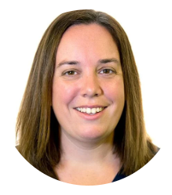
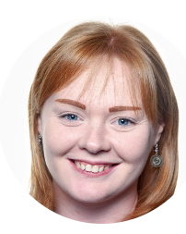
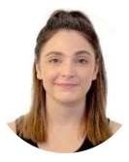
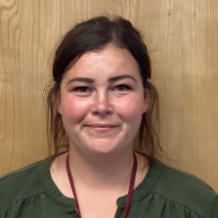
Meet the Year One team…
Miss Pettit teacher of 1ZP
Early Years Phase Leader
Miss Tyler teacher of 1FT
Key Stage One Phase Leader
Mrs Reeves
Teaching Assistant
Mrs Clarke
Teaching Assistant

Slide 3
About me …
Miss Pettit
I have been at Webheath since 2020 but have been teaching for many more years than I can remember, in both small and large settings. I really enjoy learning in the outdoors and going down to the forest, at the weekends I can often be found outside or at National Trusts. I enjoy inspiring children to read following my own love of reading. I love animals and can often be found visiting animals. My favourite animal is a penguin. I truly believe learning should be fun and I’m looking forward to our learning journey this year.

Slide 4
About me…
Miss Tyler
Within my teaching career I have taught across both Key Stage 1 and 2 and have taught at Webheath since 2023. From the age of eight, I knew I was destined to become a teacher; passionate in making every child’s school journey a happy and successful experience. I enjoy teaching the whole curriculum, but particularly, I love to read, put my maths skills into practice and be creative within art. Outside of school, I continue to show my creativity by baking and decorating cakes.

Slide 5
A typical day in Year One will include…
Phonics
English
Play to learn time
Snack
Maths
Play to learn time
Lunchtime – OPAL
Topic
Play to learn time
Children will have carpet sessions in their own classroom and during play to learn time they will free flow between both classrooms and outdoors.

Slide 6
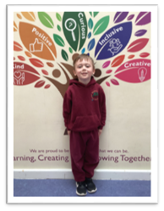
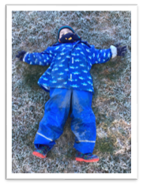
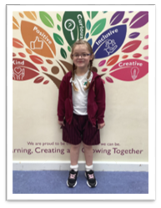
A typical week in Year One will include…
Outdoor PE
PE Kit
-Burgundy shadow stripe shorts
-White PE t-shirt (with or without logo)
-Tracksuit – zoodie or hoodie (burgundy with or without logo) and jogging bottoms
-Trainers (velcro/elastic)
Forest School
Indoor PE
Indoor PE Kit
-Burgundy shadow stripe shorts
-White PE t-shirt (with or without logo)
-Trainers (velcro/elastic)
Forest School Kit
-Set of waterproofs
-Wellies
To be kept in school as we may use
these on different days.

Slide 7
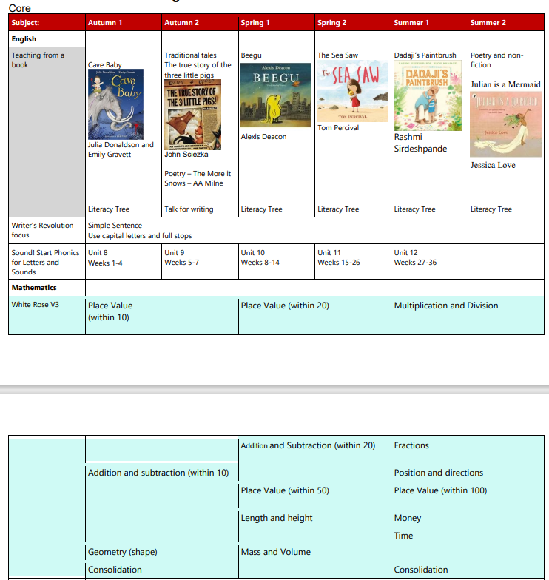
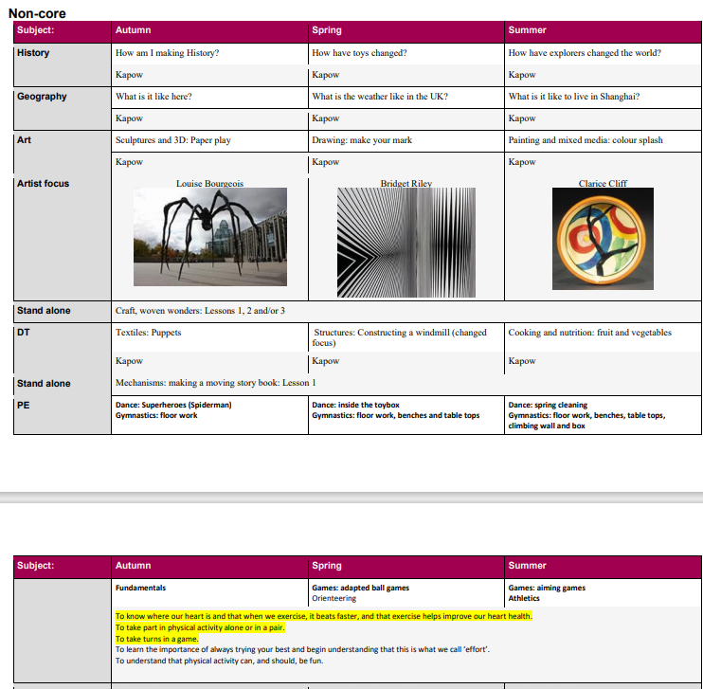
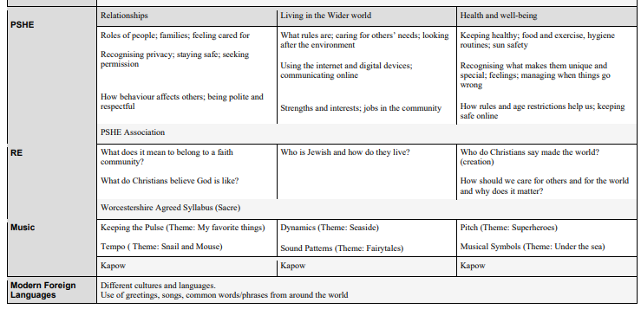
Year 1 Curriculum Overview
Can be accessed via the school website – Classes – Year 1 – Curriculum documents Year 1 | Webheath Academy

Slide 8
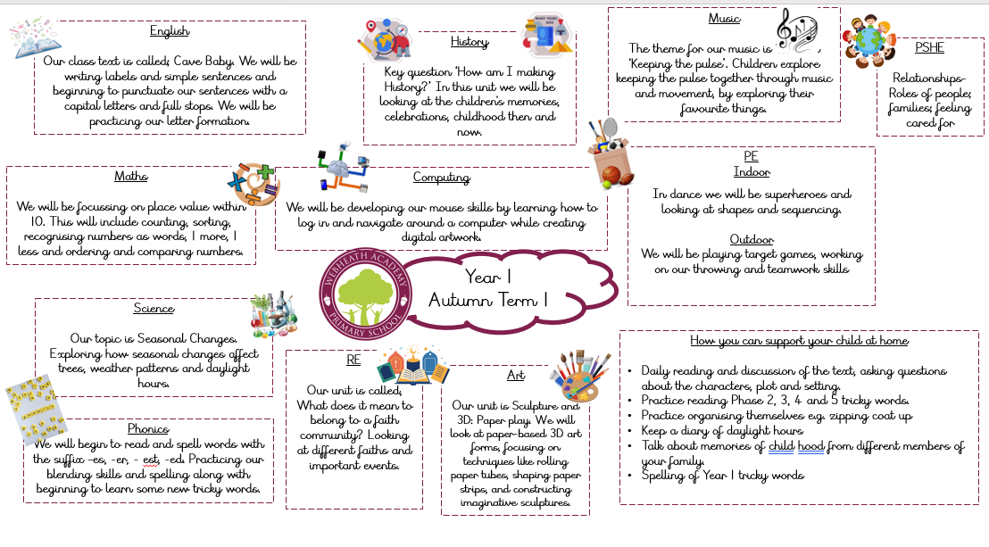
Curriculum Map – Autumn Term

Slide 9
Homework
Book club reading book will come home on a Friday. Please support your child's fluency by hearing them read it several times.
Reading for Pleasure book will come home on a Friday – this is a book for you to share with your child.
Phonics – this could be sounds or words depending on where we are in the programme.

Slide 10
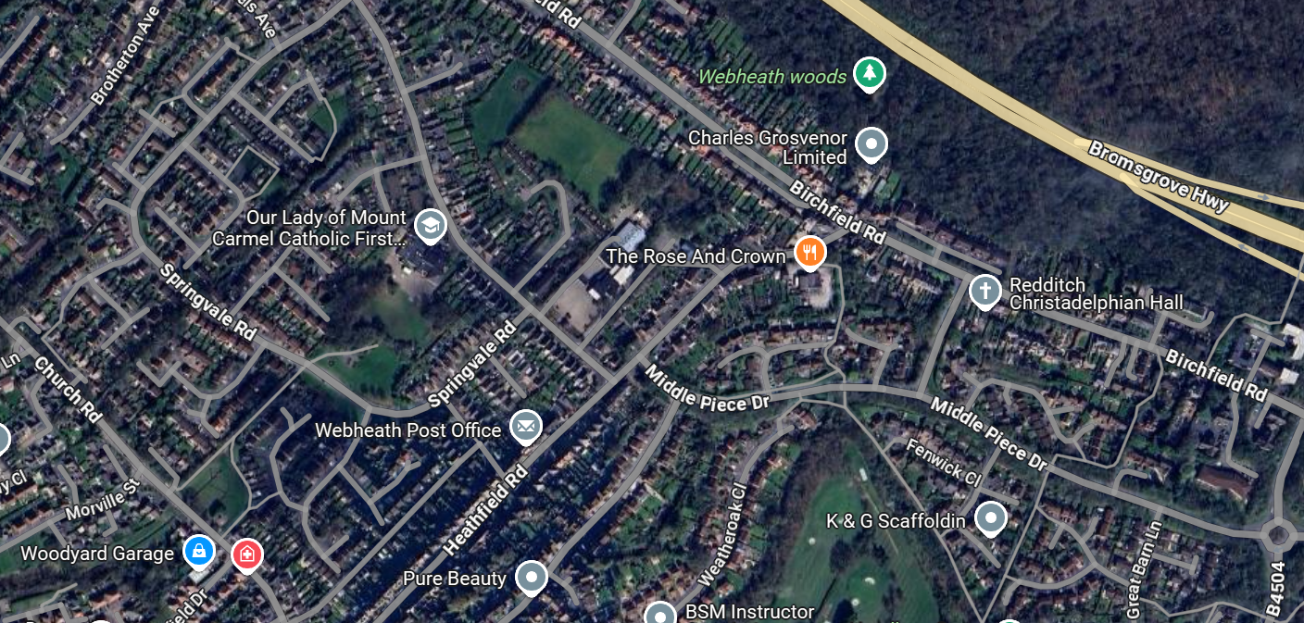

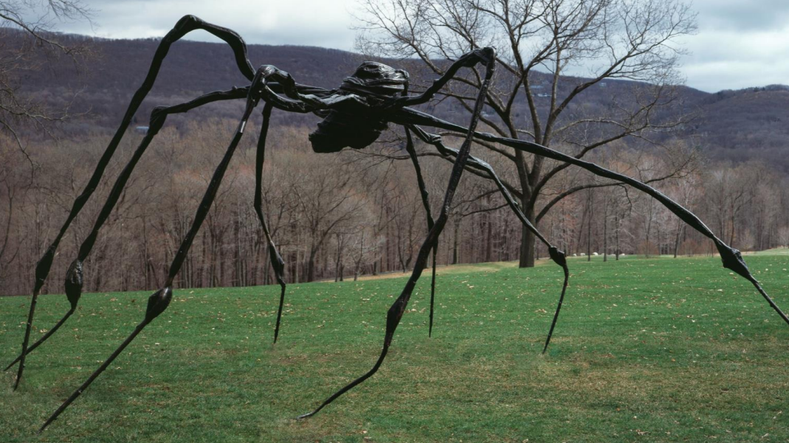
Trips – Autumn Term
Local area walk
Visitors – grandparent session
Compton Verney – Sculpture in the Park - TBC

Slide 11
We hope this has been helpful.
If you have any questions, please get in touch- we are very happy to answer any you may have.
We hope you have a great summer and look forward to welcoming you and your children into the Year 1 community in September.

