Slide 1
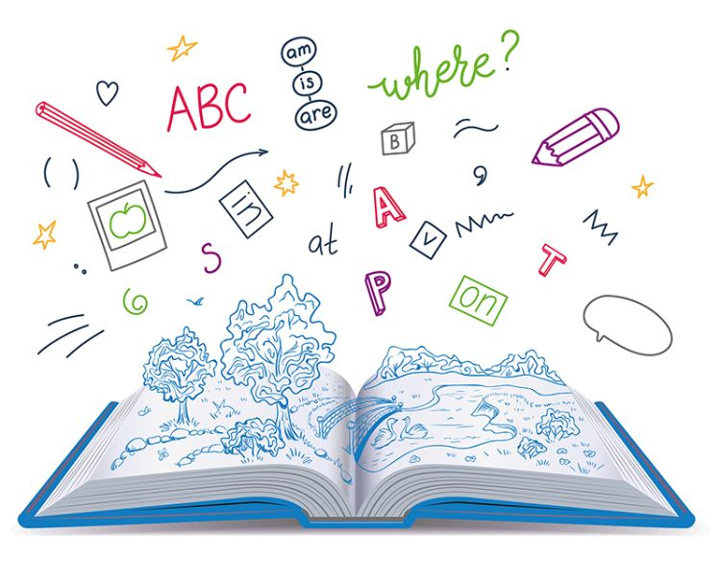










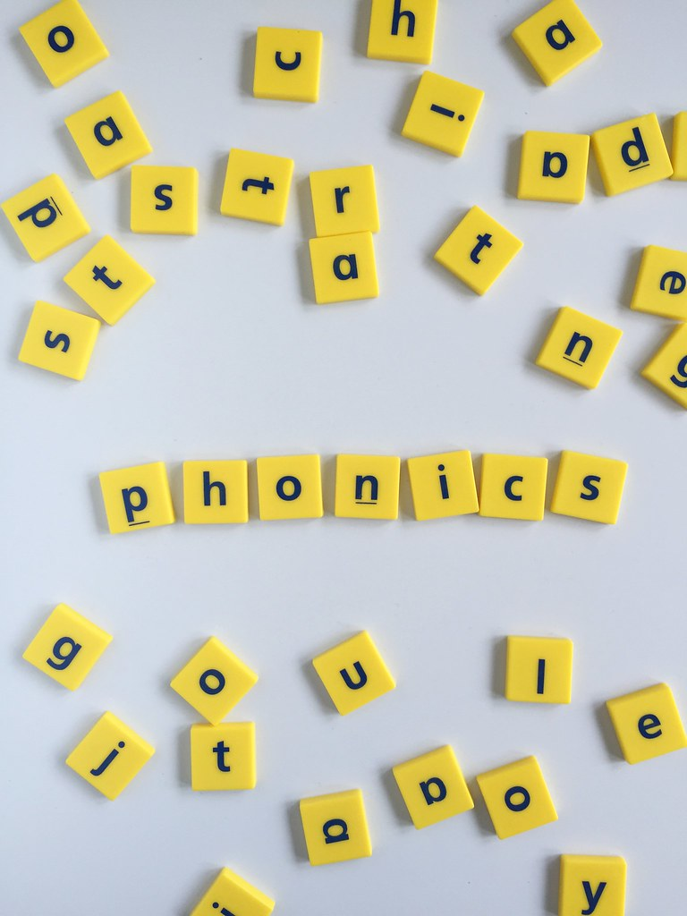
Music
The theme for our music is ‘Musical ‘Keeping the pulse’. Children explore keeping the pulse together through music and movement, by exploring their favourite things.
English
Our class text is called; Cave Baby. We will be writing labels and simple sentences and beginning to punctuate our sentences with a capital letters and full stops. We will be practicing our letter formation.
History
Key question ‘How am I making History?’ In this unit we will be looking at the children's memories, celebrations, childhood then and now.
PSHE
Relationships-
Roles of people; families; feeling cared for
PE
Indoor
In dance we will be superheroes and looking at shapes and sequencing.
Outdoor
We will be playing target games, working on our throwing and teamwork skills
Maths
We will be focussing on place value within 10. This will include counting, sorting, recognising numbers as words, 1 more, 1 less and ordering and comparing numbers.
Computing
We will be developing our mouse skills by learning how to log in and navigate around a computer while creating digital artwork.
Year 1
Autumn Term 1
Science
Our topic is Seasonal Changes. Exploring how seasonal changes affect trees, weather patterns and daylight hours.
How you can support your child at home
Daily reading and discussion of the text, asking questions about the characters, plot and setting.
Practice reading Phase 2, 3, 4 and 5 tricky words.
Practice organising themselves e.g. zipping coat up
Keep a diary of daylight hours
Talk about memories of child hood from different members of your family.
Spelling of Year 1 tricky words
RE
Our unit is called, What does it mean to belong to a faith
community? Looking at different faiths and important events.
Art
Our unit is Sculpture and 3D: Paper play. We will look at paper-based 3D art forms, focusing on techniques like rolling paper tubes, shaping paper strips, and constructing imaginative sculptures.
Phonics
We will begin to read and spell words with the suffix –es, -er, - est, -ed. Practicing our blending skills and spelling along with beginning to learn some new tricky words.

