Slide 1

Special Educational Needs Information Report
How we support children with special education needs and disabilities

Slide 2
This SEN Information report can be looked through page by page or you can use the ‘quick links’ to find answers to a specific question.

Slide 3
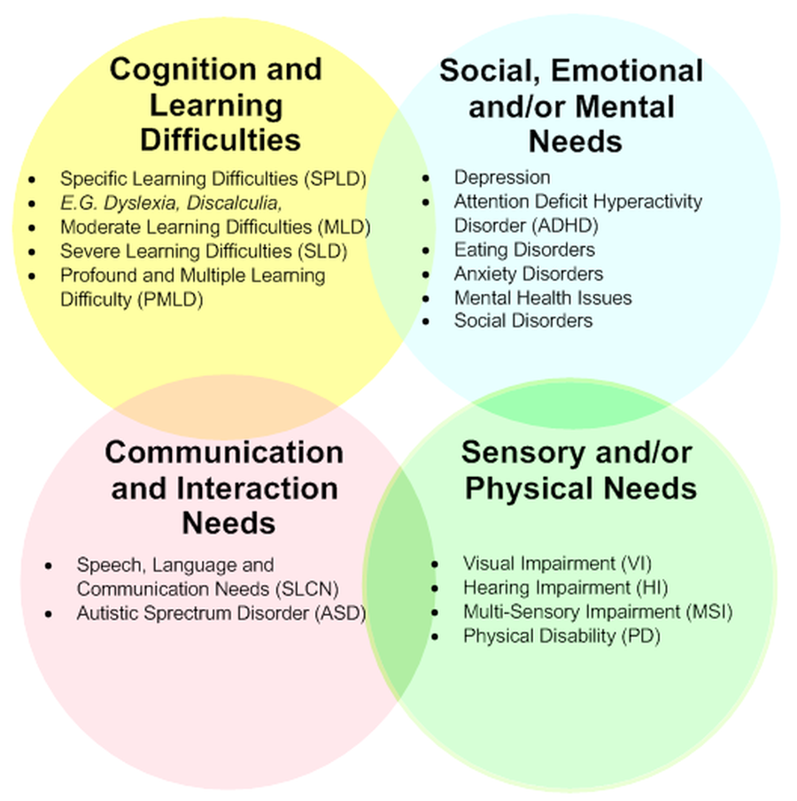
Areas of Special Educational needs
Children are identified as having SEND, when they have a significantly greater difficulty in learning than most children the same age or have a disability which prevents or hinders them from making use of education facilities of a kind provided for children of the same age in schools within the area of the Local Authority (SEND Regulations 2015). At Webheath there are children who have a range of additional needs from the four areas of need set out in the SEN (Special Educational Need) Code of Practice, 2014

Slide 4
Page 1 Quick links:
What should I do if I think my child has Special Educational needs?
How does the school know if a child needs extra help?
How will both school and I know how my child is doing?
How will school help me support my child’s learning?
How will the curriculum be matched to my child’s needs?
How are the school’s resources allocated and matched to chi...
How will the school decide the type of support my child wi...
How does the school judge whether the support has had an ...
How will my child be included in activities outside the c...
What support will there be for my child’s overall well be...

Slide 5
Page 2 Quick links:
What training have the staff supporting SEND had or what ...
How accessible is the school both indoors and outdoors?
How are parents involved in the school? How can I get inv...
How do children contribute their views about their suppor...
What specialist services are available or can be accessed...
How will the school prepare and support my child when tra...
Who can I contact for further information or to complain ...
The Local Offer
School Contact details:
What other support services can help me?

Slide 6
What should I do if I think my child has Special Educational needs?
Return to ‘quick links’
Parents/carers who are worried about their child’s learning, or who have concerns about additional needs are encouraged to discuss their concerns with their child’s class teacher.
Class teachers will liaise with the SENDCo, and meetings will be arranged to discuss concerns.
All teachers and those supporting children in their learning, are vigilant at raising concerns with parents/carers and the SENDCo. Class teachers meet with the SENDCo and Assessment Leader regularly to monitor progress, identify needs and celebrate achievement
Should parents/carers want to contact the SENDCo directly, they should do this via email or by calling the school office.
SENDCo; Mrs J Woodward
email; jwoodward@waps.shiresmat.org.uk
Tel; 01527 544820

Slide 7
How does the school know if a child needs extra help?
Return to ‘quick links’
The identification of a child needing extra help can come from staff members, parents/carers, outside agencies or the child themselves.
Class teachers and those supporting your children in their learning, work closely together to monitor progress and identify where extra help is needed.
Extra help can be in the form of adaptive, quality first teaching, group or individual 'on the day' intervention, a specific intervention programme or individual targets written in an Individual Provision Map.
For specific issues, we may choose to draw upon the advice of key consultants to further explore the SEND needs of individuals.

Slide 8
How will both school and I know how my child is doing?
In school we have a robust Monitoring and Evaluation cycle where teachers, teaching assistants, phase leaders and the senior leadership team, which includes the SENDCo, regularly monitored and reported on progress. This was done formally through termly learning walks and pupil progress meetings as well as informally.
We regularly shared progress feedback with all the children and their families via qualitative and quantitative means. For example, children received feedback as part of the teaching and learning cycle on their learning tasks. This can be to redirect or refocus, to celebrate achievement or to provide guidance on how to improve.
parents/carers were invited to open classroom events and two formal parents' evenings during the year. A written report was sent to parents/carers in July and there was the opportunity to discuss this with their child's class teacher.
In addition, the families of children on the SEND register were invited to termly Structured Conversations to discuss their child's individual targets. At these meetings we were able to review the Individual Provision Map together to decide collaboratively on the child's targets. Those children with an Education, Health & Care plan had structured conversation meetings as well as their annual review. Key workers for children who have an EHCP gave daily feedback to Parents/Carers.
Return to ‘quick links’

Slide 9
How will school help me support my child’s learning?
The individual structured conversation meetings have been an ideal opportunity for teachers and the SENDCo to share ways that parents/carers can support their child's learning. All targets were created collaboratively, and through discussion parents/carers know how they can support their child's learning both in school and at home.
Individual Provision Maps ensure we have tailored and personalised targets for those children on the SEND register and our adaptive, high quality teaching methods ensure the curriculum is accessible to all.
Homework tasks for children in KS2 were adapted for children on the SEND register and parents/carers were aware of expectations of their child.
Return to ‘quick links’

Slide 10
How will the curriculum be matched to my child’s needs?
High quality, adaptive teaching is embedded in our newly designed curriculum. Adaptive teaching methods were reviewed and developed by the Trust last year, with all teaching staff involved in continuous professional development during the year. All our teachers and teaching assistants have a clear understanding of the expectations of high-quality universal provision, and this is monitored as part of the monitoring and evaluation cycle.
Individual Provision Maps ensure we have tailored and personalised targets for those children on the SEND register and our adaptive, high quality teaching methods ensure the curriculum is accessible to all.
Return to ‘quick links’

Slide 11
How are the schools' resources allocated and matched to children’s special educational needs?
As part of high quality, adaptive teaching, teachers provide resources to match the needs of the children in their class.
In addition, the school provides a budget for the SEND department which is closely monitored and aligned to the School Improvement Plan. Specialist equipment, facilities and professionals from outside agencies are financed through the SEND budget and these are arranged as part of the Assess, Plan, Do and Review Cycle, through discussion with the SENDCo.
The Head Teacher, governors and school business manager oversee all matters of finance and we use our budget to respond to the needs of the children.
Return to ‘quick links’

Slide 12
How will the school decide the type of support my child will receive?
High quality adaptive teaching is at the heart of our provision and specific on-the-day, intervention supports learners with misconceptions.
Teachers decide on additional support within each lesson which has been provided by them or a teaching assistant and have taken place within the classroom, outside the classroom, as 1:1 provision or in a small group.
Where high quality adaptive teaching methods and in class intervention did not lead to the expected progress for an individual, additional support was sought, in consultation with the SENDCo and parents/carers.
All additional interventions were short term and monitored for impact. It was the role of the SENDCo to oversee additional interventions, and regular updates were shared with the rest of SLT and with the SEND Governor.
Additional interventions are;
*Rapid phonics, rapid reding,
*1stclass@number,
*Speech and language
*Social and emotional support.
Return to ‘quick links’

Slide 13
How does the school judge whether the support has had an impact?
Our governors play an active role in monitoring the quality of our special educational needs provision, as does the Head Teacher, Senior Leadership Team and SENDCo. We have high expectations of all our teachers in meeting a range of needs. All interventions we put in place are research informed, evidence based and measured to monitor impact. Where we feel something is not working, we are quick to respond and find alternatives through dialogue with the class, children and parents/carers Our additional support programs are overseen by the SENDCo and all our teachers are teachers of inclusion and Special Educational Needs.
Return to ‘quick links’

Slide 14
How will my child be included in activities outside the classroom including school trips?
All children are involved in all aspects of our curriculum, including learning outside the classroom.
Risk assessments are always carried out prior to activities outside the classroom, including educational visits and school trips, minimising the risk and ensuring the safety and inclusion of all. ​
During the last academic year learning outside the classroom including educational visits:-
The Botanical Gardens​
Hartlebury Castle
Tudor World
Hatton Country World
Kenilworth Castle​
Bishops Wood​
Robinwood Activity Centre ​
Morton Stanley Park ​
Vue Cinema​
Swimming ​
Local area studies
Return to ‘quick links’

Slide 15
What support will there be for my child’s overall wellbeing?
Our school provides a nurturing and caring environment for all, and our staff provide a high standard of support for the positive wellbeing of all children.
We have a Supporting pupils with medical conditions policy and medical needs have been shared on a 'need-to-know' basis, ensuring high quality care and provision as well as appropriate levels of confidentiality.
Our Positive Behaviour Policy, has been implemented by all staff, who are committed to creating an environment where exemplary behaviour is at the heart of productive learning and everyone is expected to maintain the highest standards of personal conduct, to accept responsibility for their behaviour and encourage others to do the same.
We value the child voice and seek their contributions through evaluating their achievements and progress in lessons.
the school council and Individual Provision Maps as well as in their annual report.
Many of our Lunchtime and After School clubs focus on wellbeing and all children are encouraged to
attend these.
Return to ‘quick links’
Supporting pupils with medical conditions (Shires MAT) Aut23.pdf - Google Drive
Positive Behaviour Policy 2022-2023.pdf - Google Drive

Slide 16
What training have the staff supporting SEND had or what are they having?
All staff receive regular training, at Trust level, as part of the school training offer and to meet their personal training requirements.
We regularly invest time and money in training our staff to improve delivery of high-quality adaptive teaching and targeted interventions as well as developing individual knowledge and skills.
Weekly staff meetings update on matters pertaining to special education needs and disability.
Our SENDCo is a qualified teacher and holds the mandatory National SENDCo Award. All teachers have Qualified Teacher Status and support staff have the relevant qualifications for their role. We have established relationships with professionals who support the school and all external partners we work with are vetted in terms of safeguarding. All additional services, are monitored to ensure a value for money.
Return to ‘quick links’

Slide 17
How accessible is the school both indoors and outdoors?
Return to ‘quick links’
We have a full Accessibility Plan/Policy in place and as such, we consider our environment to be fully accessible to meet the needs of our children and their families.
https://drive.google.com/file/d/1HLg6_UH186lJ7q7tH8lDRK5MsW7xOmfQ/view?usp=drivesdk
We are vigilant about making reasonable adjustments, where possible. Our policy and practice adhere to The Equality Act 2010. (https://www.gov.uk/guidance/equality-act-2010-guidance) We value and respect diversity in our setting and do our very best to meet the needs of all children.

Slide 18
How are parents involved in the school? How can I get involved?
Return to ‘quick links’
Parents/carers are encouraged to be involved in their child's education and are a valuable part of our school community.
Structured conversations for all parents/carers of children on the SEND register.
Parent/carer consultations twice a year
Open classrooms
Friends Association
Coffee mornings for parents/carers of children on the SEND register
Parent/carer questionnaires

Slide 19
How do children contribute their views about their support and who can help them?
Return to ‘quick links’
All children are encouraged to take part in 'Child Voice' activities, which include;
Evaluating their achievements and progress in lessons.
Being part of IPM review meetings and contributing to target setting.
Each class has a School Council representative who can share views at fortnightly school council meetings.
Children who are 'Looked after' regularly meet with the SENDCo /Designated Teacher to share their views.

Slide 20
What specialist services are available or can be accessed by the school?
Return to ‘quick links’
We have links with outside agencies whose expertise we have called upon in individual cases when necessary.
The expertise of outside agencies is called upon as part of the Assess, Plan, Do, Review and is collaborative decision between the SENDCo, Class Teacher and Parents/Carers.
Outside agencies used are;
Educational Psychologist – Dr D. Rouse
Learning Support Team – Chadsgrove Support Services
Complex Communication Needs Team – Chadsgrove Support Services
Mentor Link
Family Support Worker – Lisa Sinclair

Slide 21
How will the school prepare and support my child when transferring classes or schools?
Return to ‘quick links’
When transferring classes within our school, all children have a transition day in July when they spend the day with their new class teacher and those who will support them in the following year.
Children who are on the SEND register and other individuals who need additional support, spend extra time in their new classes, have photographs of their new teacher, support staff and learning environment to take home over the summer holidays.
Those children have an EHC plan or have some 1:1 support, will keep the same support for the following academic year if at all possible.
All teachers have a robust handover from the previous class teacher, they can also access SEND information on the schools OneDrive and on Arbor.
For children who are transferring to secondary school, we have particularly strong relationships with the secondary schools and offer a robust transition. During Year 6 at Webheath, all children are offered experience days at the receiving schools as well as transition days in July. Those children on the SEND register are offered additional transition experiences. We have a robust handover with staff at secondary schools and all paperwork is transferred.
For those children who transfer 'in year' the SENDCo will meet with the child's new school, to hand over all information and paperwork, we also support transition days for these children.

Slide 22
Who can I contact for further information or to complain about SEN issues?
We operate an open-door policy, so please talk to your child's class teacher in the first instance.
Further support can be gained from the Phase Leader, SENDCo, Assistant Head Teacher, Deputy Head Teacher or Head teacher.
Complaints should be made using the school complaint form which can be found on the school website.
Complaints Policy and Procedure (Shires MAT) May 23.pdf - Google Drive
Complaints Form (Shires MAT) May 23.docx - Google Docs
Return to ‘quick links’
Phase Leaders
Miss Z Pettit – EYFS
Mrs C Biddle – KS1
Miss F Tyler – LKS2
Mr M Mellor - UKS2
Senior Leadership Team
Mrs J Woodward – SENDCo
Miss E Clifton – Assistant Head Teacher
Mrs H Heffernan – Deputy Head Teacher
Mrs R Gordon – Head Teacher

Slide 23
The Local Offer
Return to ‘quick links’
In addition to the information on the school's website, parents/carers can access services through the Local Authority’s Local Offer which can be found on the Worcestershire Children First Website:
What is SEND? | Worcestershire County Council

Slide 24
School Contact details:
SENDCo
Mrs. J Woodward
Email - jwoodward@waps.shiresmat.org.uk
Tel- 01527 544820
Website - Webheath Academy | Learning, Creating and Growing Together
Return to ‘quick links’

Slide 25
What other support services can help me?
https://www.autism.org.uk/
Welcome to ASDFriendly.org
http://asdfriendly.org/
https://www.pdasociety.org.uk/what-is-PDA/about-pda
British Dyslexia Association (bdadyslexia.org.uk)
http://www.dyscalculia.me.uk/
Welcome to SENDIASS Herefordshire and Worcestershire | Worcestershire County Council
Return to ‘quick links’

