Slide 1



Sixth Form Application Guidance 2026

Slide 2

Trinity students: Your login details will be sent to your school email accounts on Tuesday 13th January. Enter details in the ‘Existing Users’ section
External students: Applications can be made from 9am on Wednesday 14th January. Log into system through the ‘External Students’ section
If you have an issue with your account then please contact the school’s IT department, itdepartment@tchs.org.uk

Slide 3
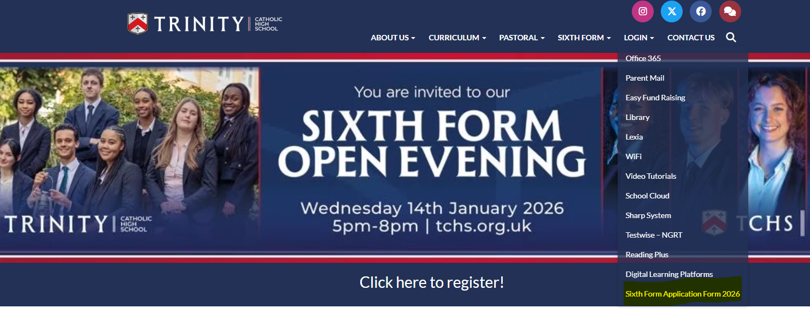
To apply click this link:
http://tchswoodford.applicaa.com/year12
Or visit our website: www.tchs.org.uk . Select the ‘login’ tab and click ‘Sixth Form Application Form 2026’

Slide 4
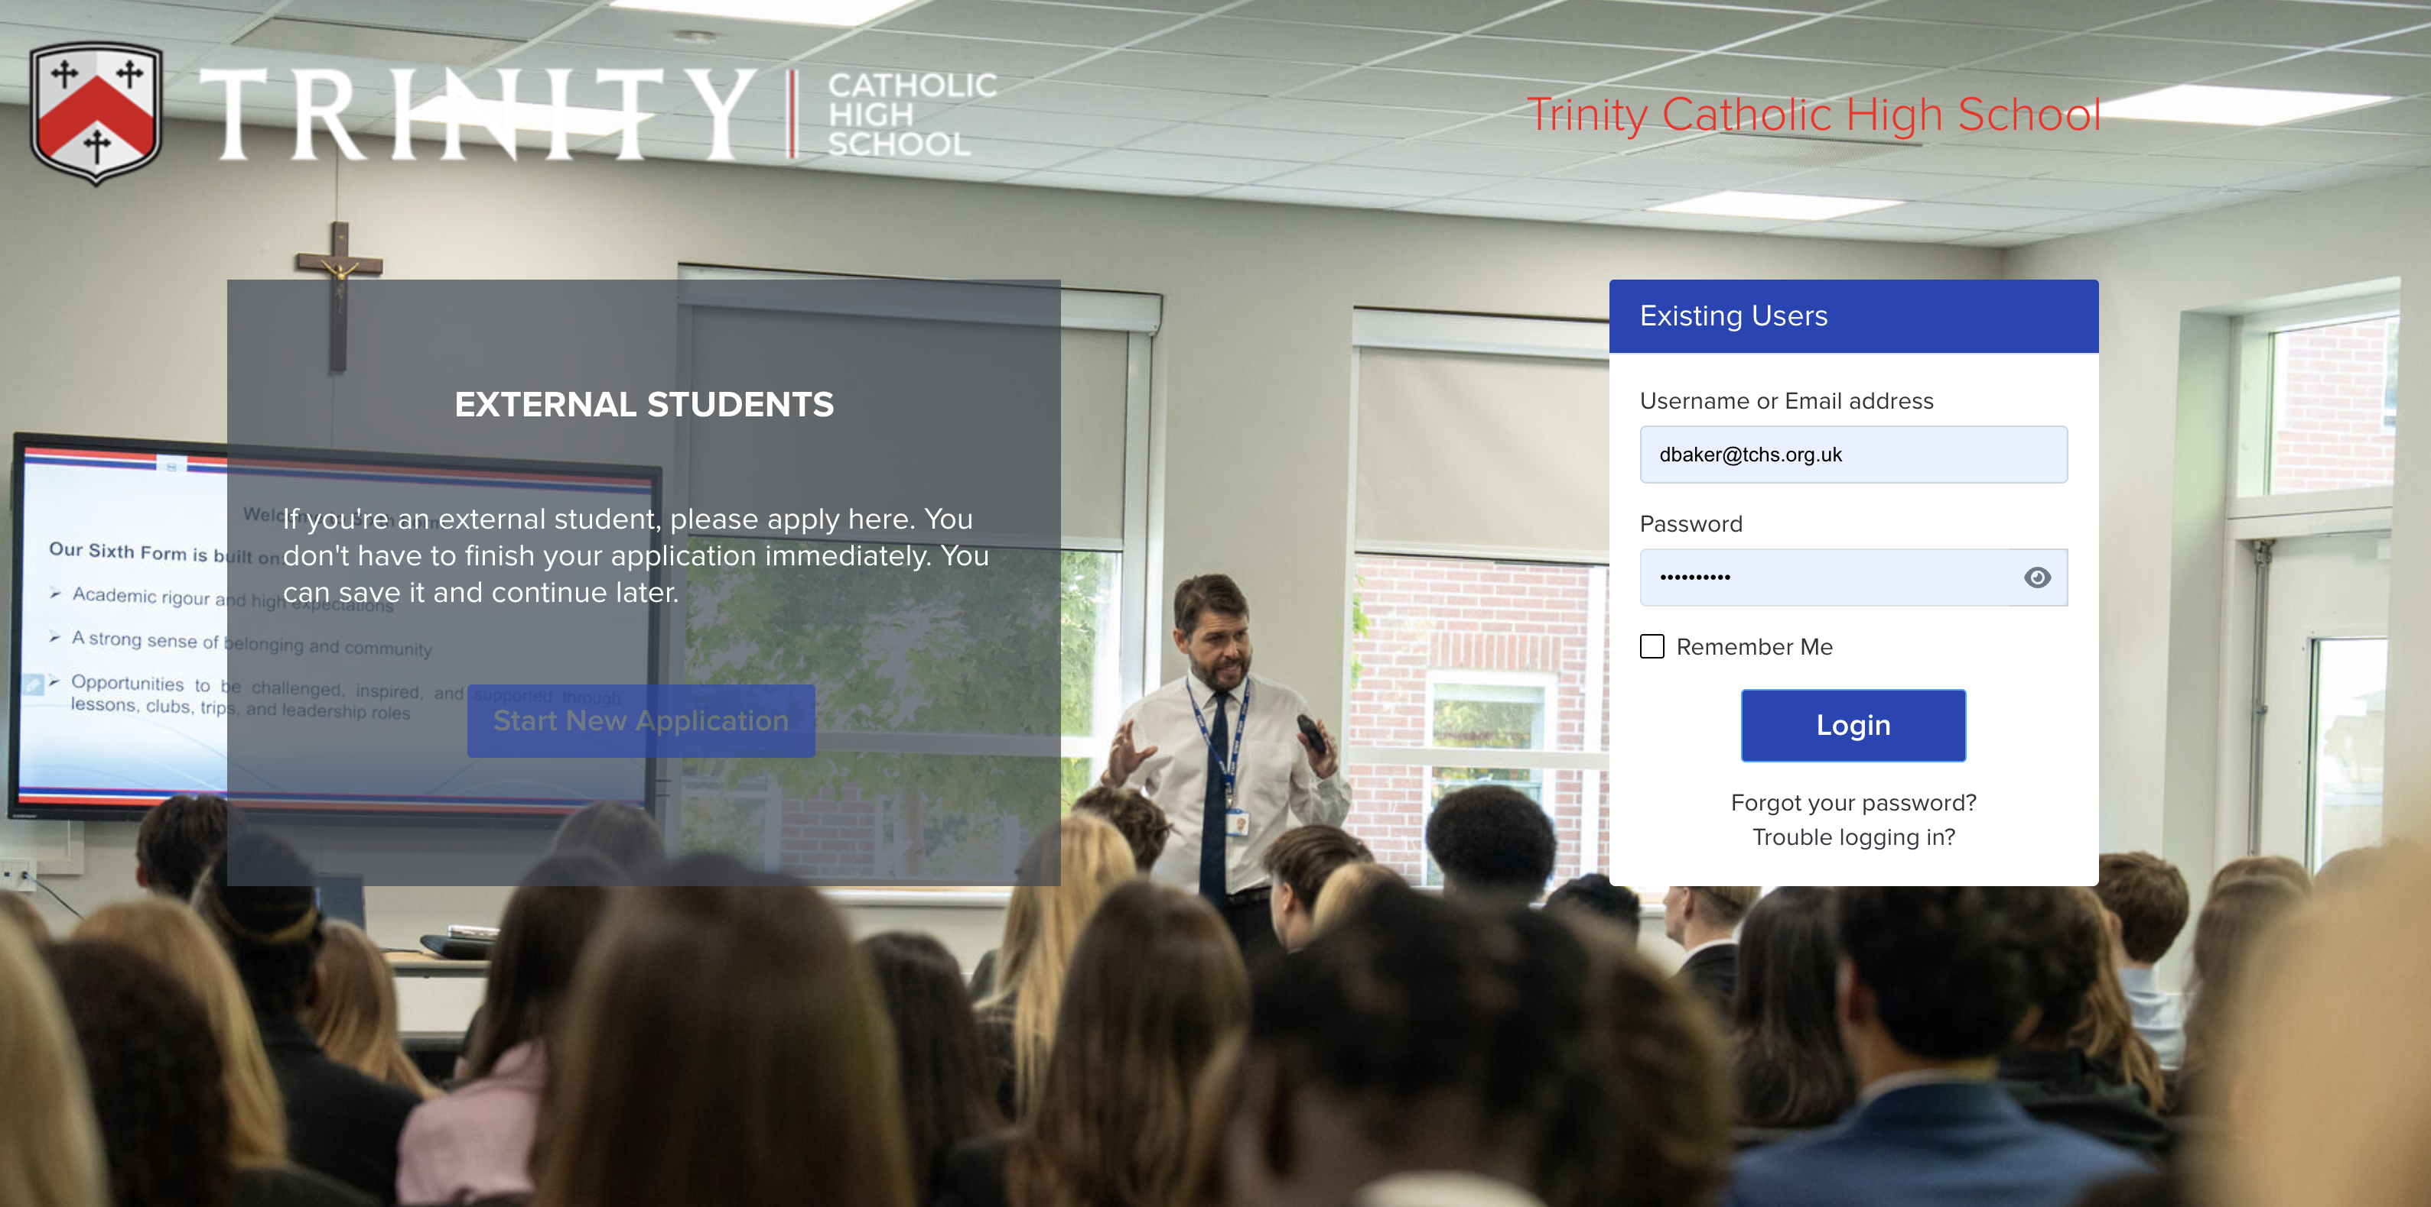

Slide 5
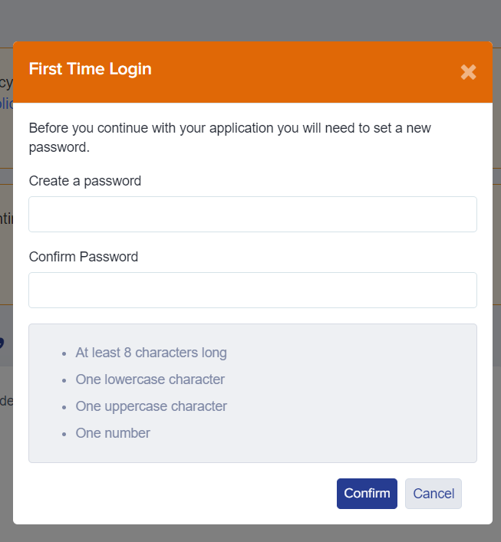
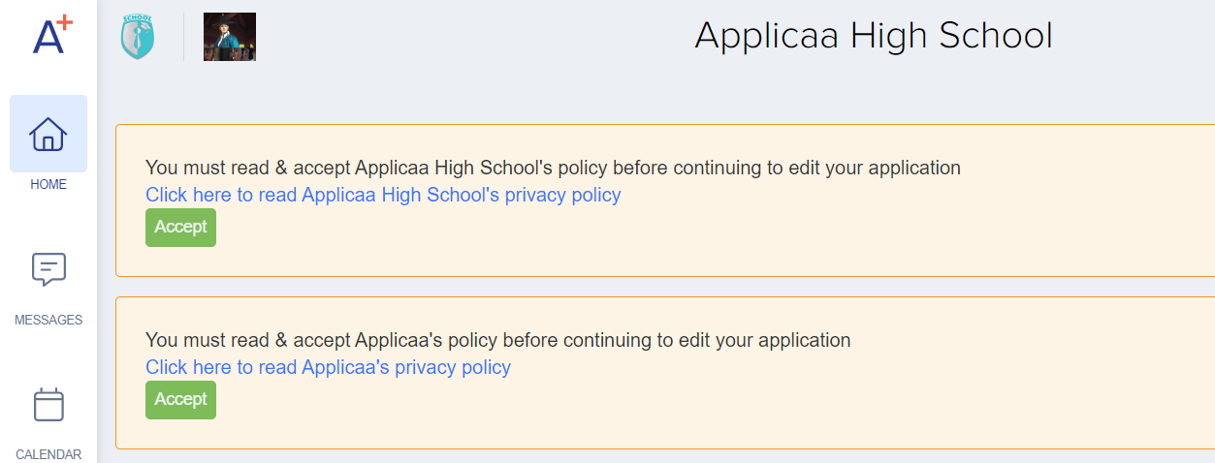
Once you’re logged in…
You will be asked to change your password before you can continue with your application
Also, please read and accept both the school and Applicaa's privacy policies

Slide 6
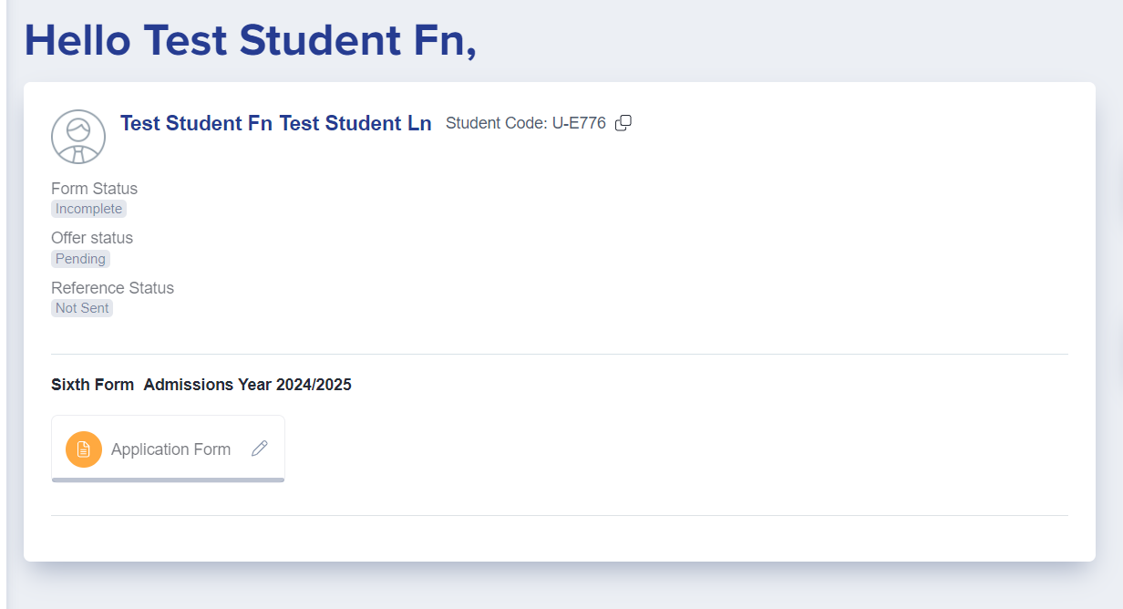
Once you’re logged in…
You will see a welcome message and the Application Form icon
Click the Application Form icon to open your application and begin completing each section
Make a note of your password (set it to something memorable!) as you will need to log in again in future to view your offer
Notes:
We need to fulfil the Mission of our school everyday if we are to make our world a better place.
The work we do is significant and changes people lives.

Slide 7
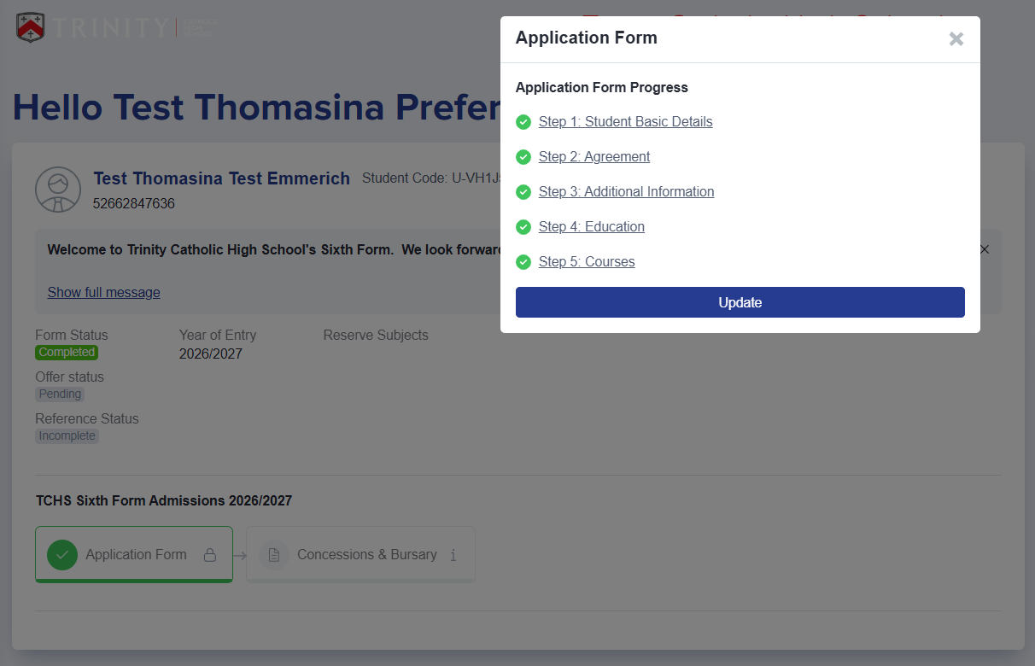
Internal (Trinity) students – Application Guidance
Notes:
We need to fulfil the Mission of our school everyday if we are to make our world a better place.
The work we do is significant and changes people lives.

Slide 8
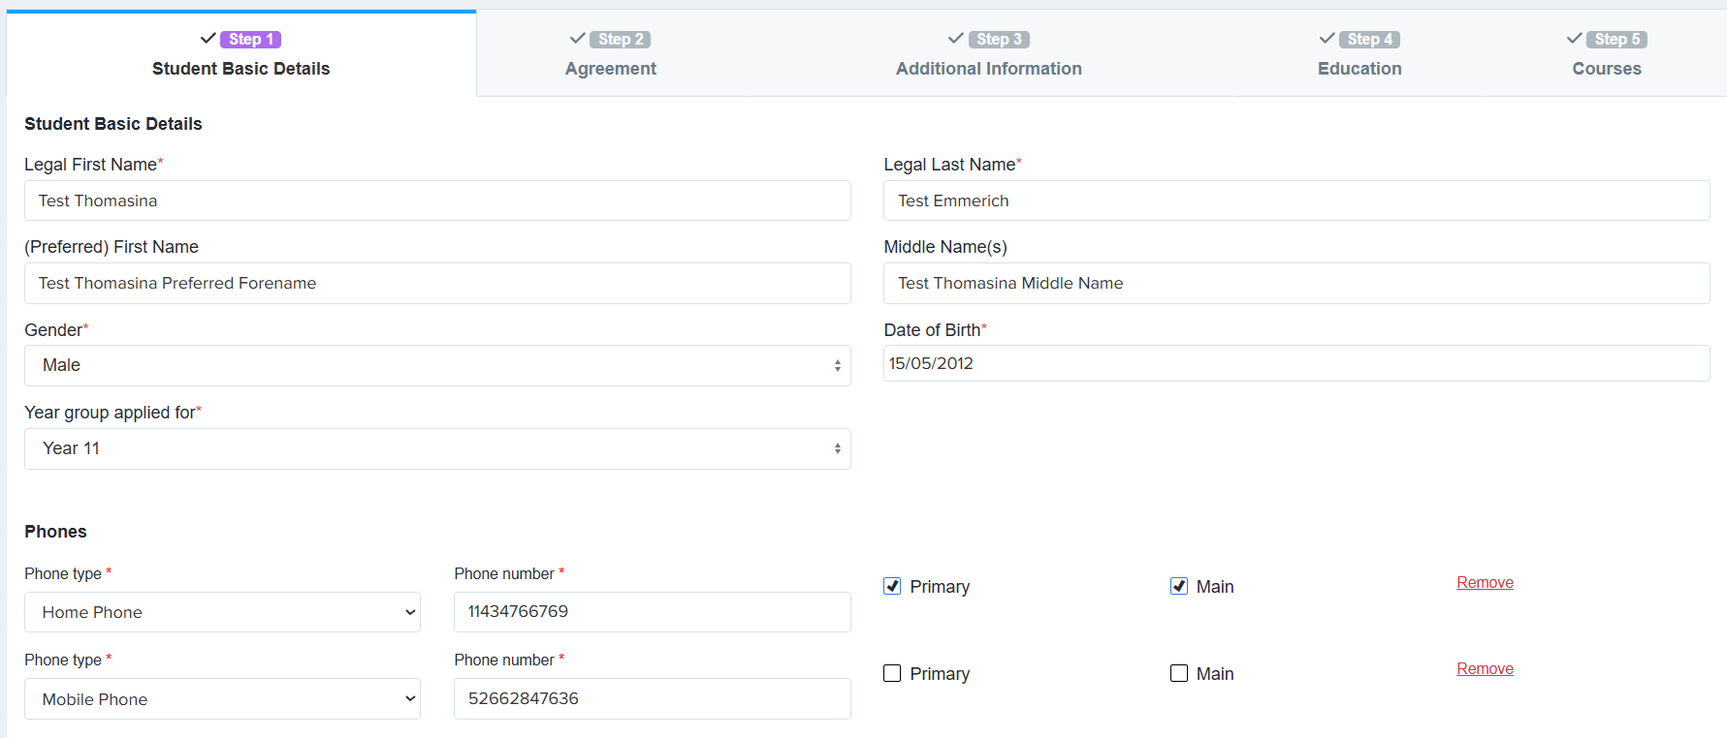
Internal (Trinity) students – Application Guidance
Notes:
We need to fulfil the Mission of our school everyday if we are to make our world a better place.
The work we do is significant and changes people lives.

Slide 9
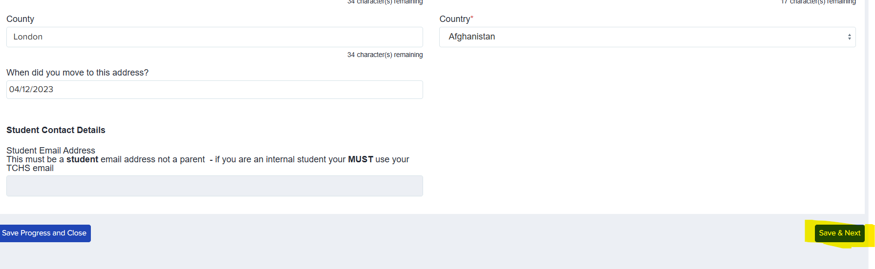
Internal (Trinity) students – Application Guidance
Notes:
We need to fulfil the Mission of our school everyday if we are to make our world a better place.
The work we do is significant and changes people lives.

Slide 10
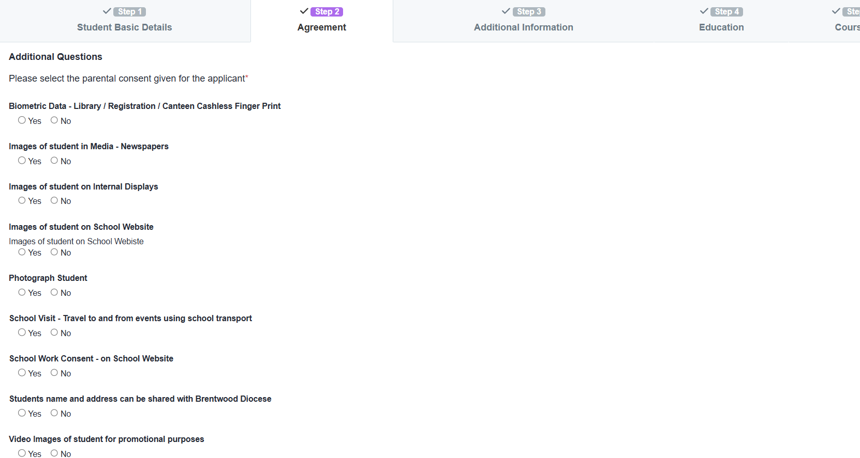
Internal (Trinity) students – Application Guidance
Notes:
We need to fulfil the Mission of our school everyday if we are to make our world a better place.
The work we do is significant and changes people lives.

Slide 11
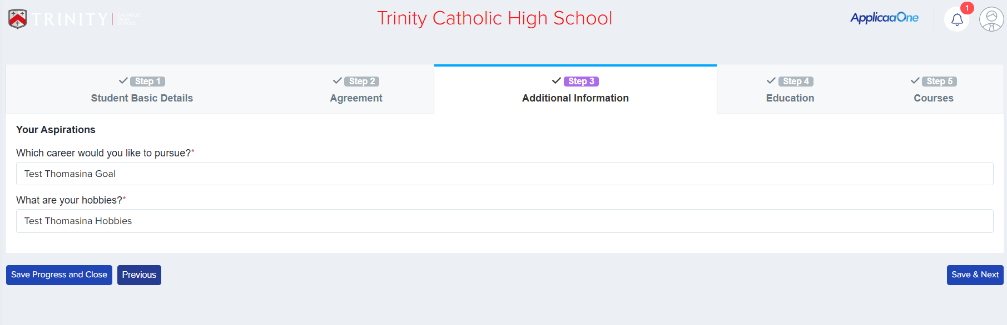
Internal (Trinity) students – Application Guidance
Notes:
We need to fulfil the Mission of our school everyday if we are to make our world a better place.
The work we do is significant and changes people lives.

Slide 12
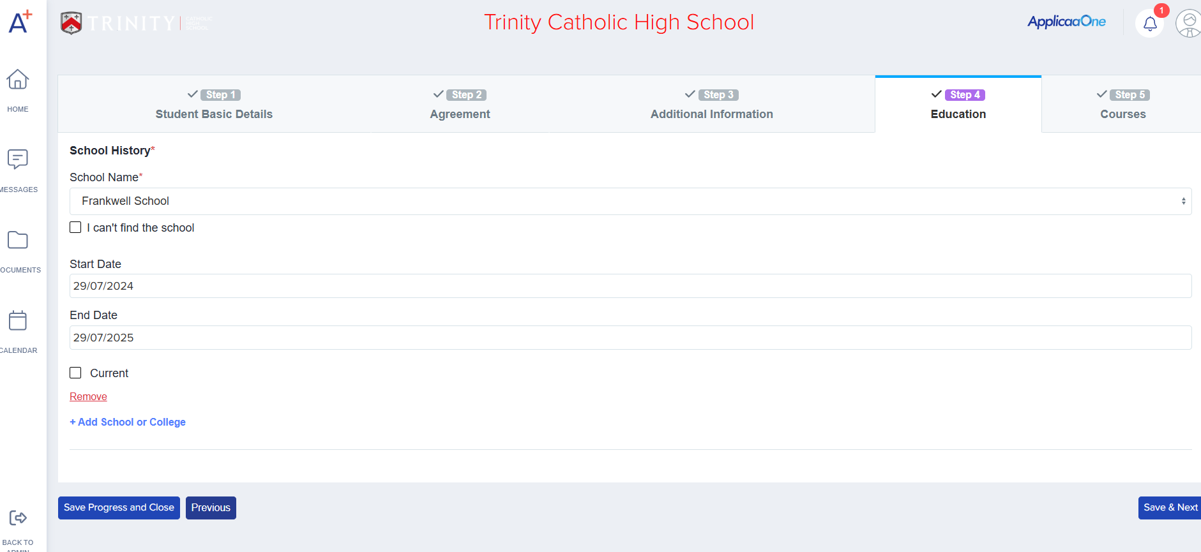
Internal (Trinity) students – Application Guidance
Notes:
We need to fulfil the Mission of our school everyday if we are to make our world a better place.
The work we do is significant and changes people lives.

Slide 13
Internal (Trinity) students – Application Guidance
Notes:
We need to fulfil the Mission of our school everyday if we are to make our world a better place.
The work we do is significant and changes people lives.

Slide 14
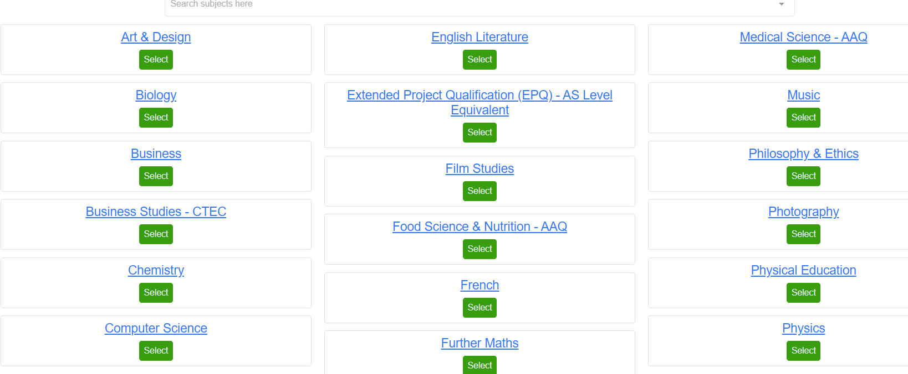
Internal (Trinity) students – Application Guidance
Notes:
We need to fulfil the Mission of our school everyday if we are to make our world a better place.
The work we do is significant and changes people lives.

Slide 15
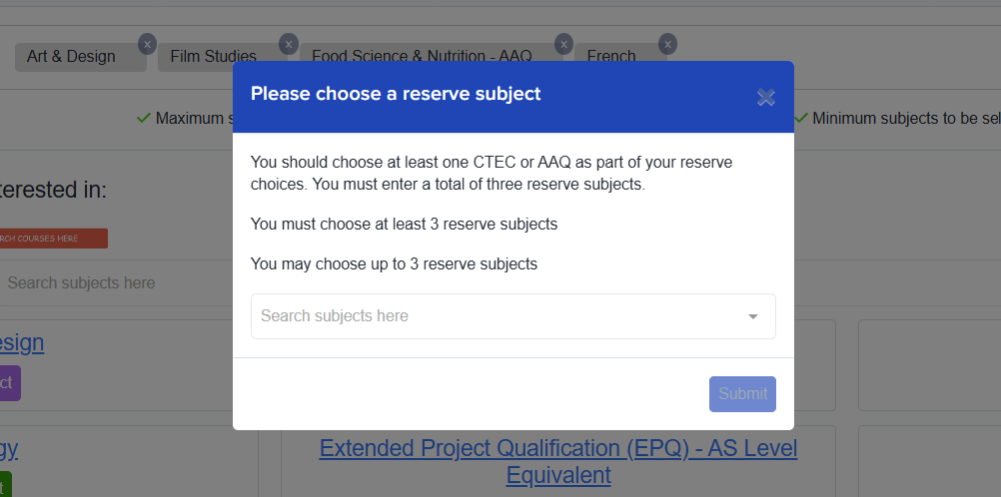
Internal (Trinity) students – Application Guidance
Notes:
We need to fulfil the Mission of our school everyday if we are to make our world a better place.
The work we do is significant and changes people lives.

Slide 16

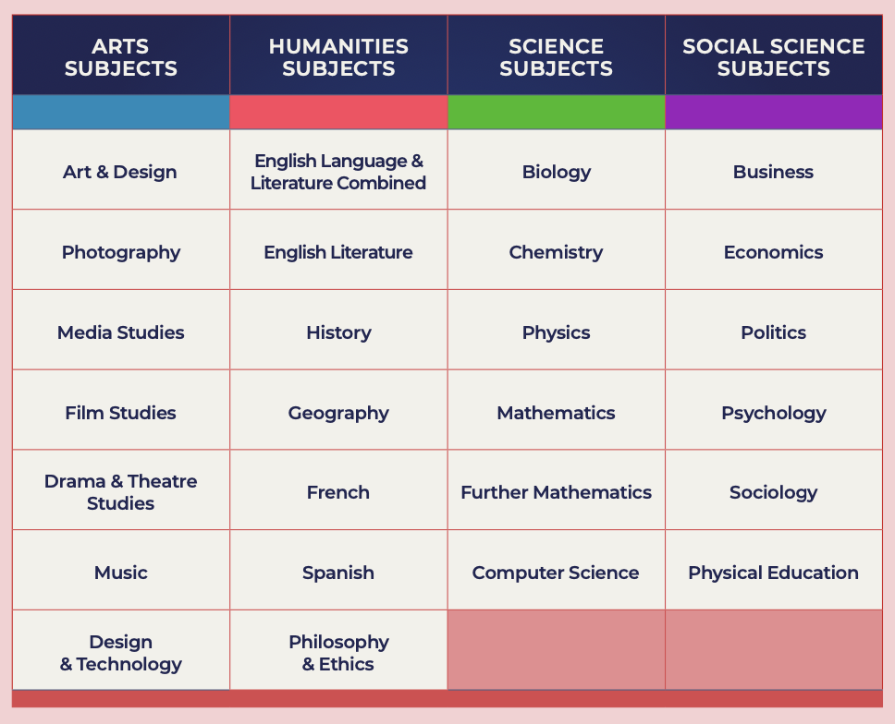
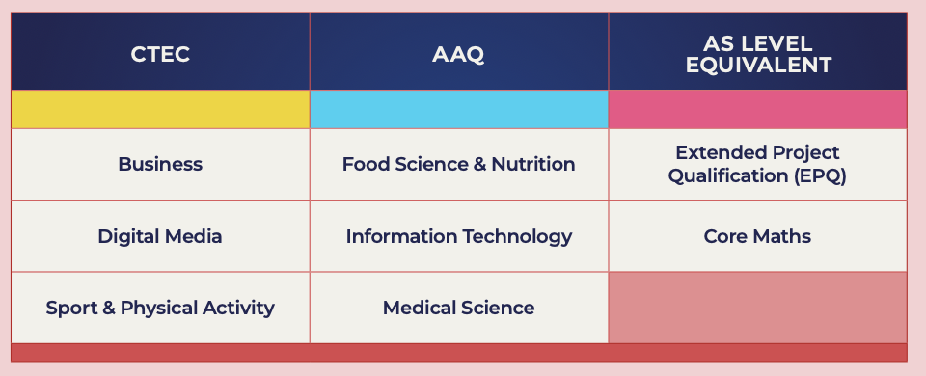
Internal (Trinity) students – Application Guidance
Notes:
We need to fulfil the Mission of our school everyday if we are to make our world a better place.
The work we do is significant and changes people lives.

Slide 17
Internal (Trinity) students – Application Guidance
 | Dates
Sixth Form Open Evening | Wednesday 14 January 2026
Online application form available | Wednesday 14 January 2026
Deadline for submitting Sixth Form application forms (Trinity students) | Friday 13 February 2026
Deadline for submitting Sixth Form application forms (External applicants) | Friday 13 February 2026
Offers made to students | Ongoing
Deadline for applicants to accept offers | Friday 1 May 2026
Induction and Taster Day | July 2026
Enrolment | August 2026
Notes:
We need to fulfil the Mission of our school everyday if we are to make our world a better place.
The work we do is significant and changes people lives.

Slide 18
If you have any questions or need any support:
Admission queries: SixthFormAdmissions@tchs.org.uk
Technical support: itdepartment@tchs.org.uk
Notes:
We need to fulfil the Mission of our school everyday if we are to make our world a better place.
The work we do is significant and changes people lives.

