Slide 1

STUDENT
SIXTH FORM ENROLMENT
FORM
“HOW –TO GUIDE”

Slide 2


STUDENT ENROLMENT
STEP 1: LOGIN
STEP 2: BEGIN ENROLMENT FORM
STEP 3: REVIEW & CONFIRM COURSES
STEP 4: SUBMIT ENROLMENT FORM

Slide 3
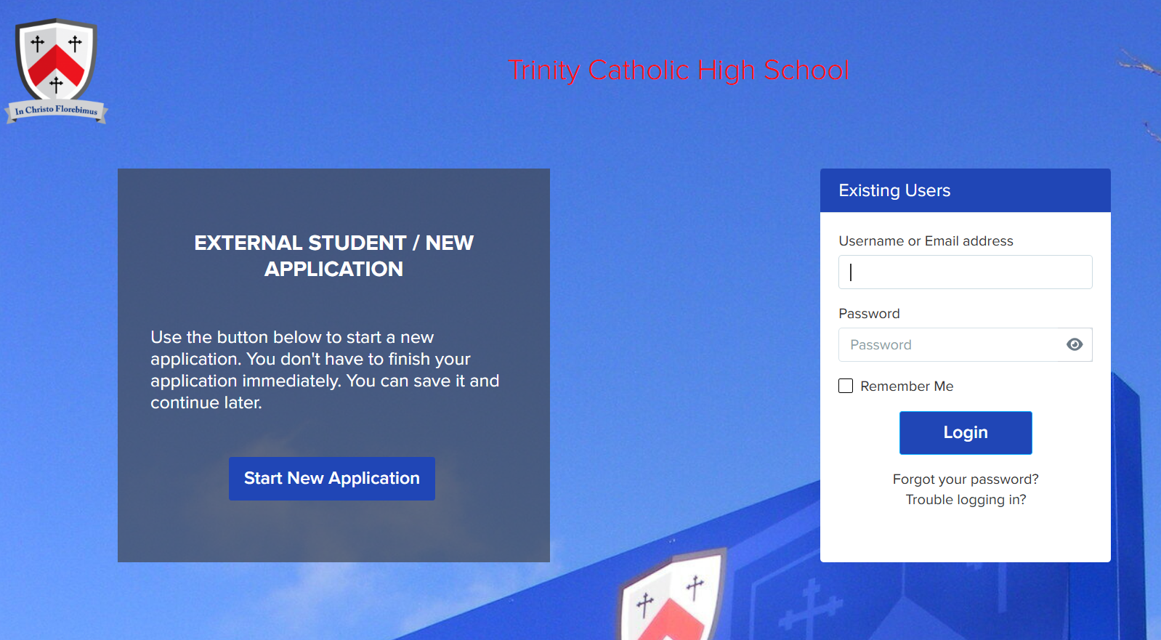
LOGIN
Go to your Admissions+ portal: https://tchswoodford.applicaa.com/year12
1
Login using your email address & password. Trinity students: Details would have been sent to your Outlook account, search for ‘Applicaa’
2
If you can’t find the details then please select the “forgot your password” link
3

Slide 4
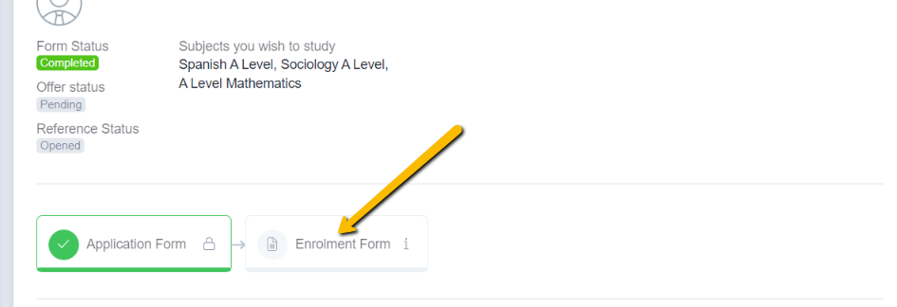

BEGIN
ENROLMENT FORM
Click to begin the enrolment phase of your application.

Slide 5
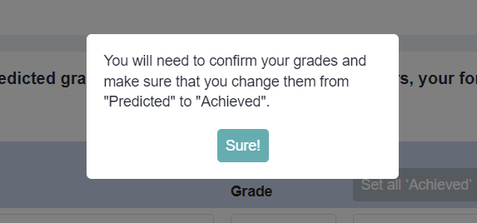
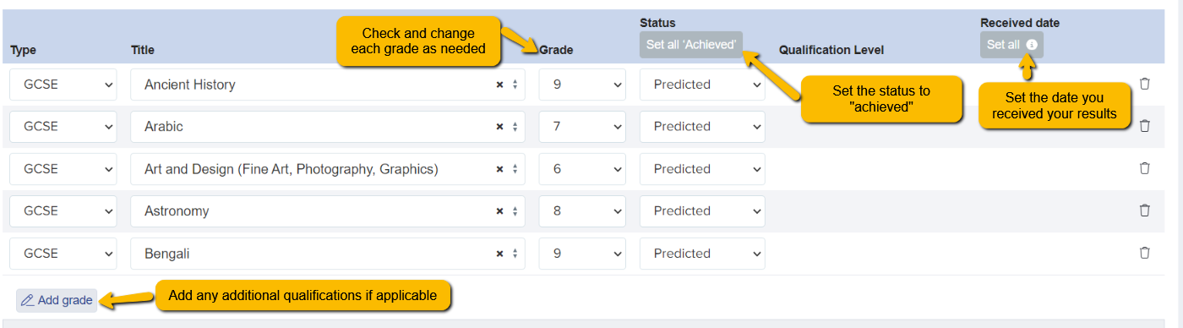
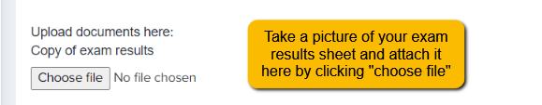
ACHIEVED GRADES
Internal students will have this section automatically set to ‘Achieved’ – no further action is required

Slide 6

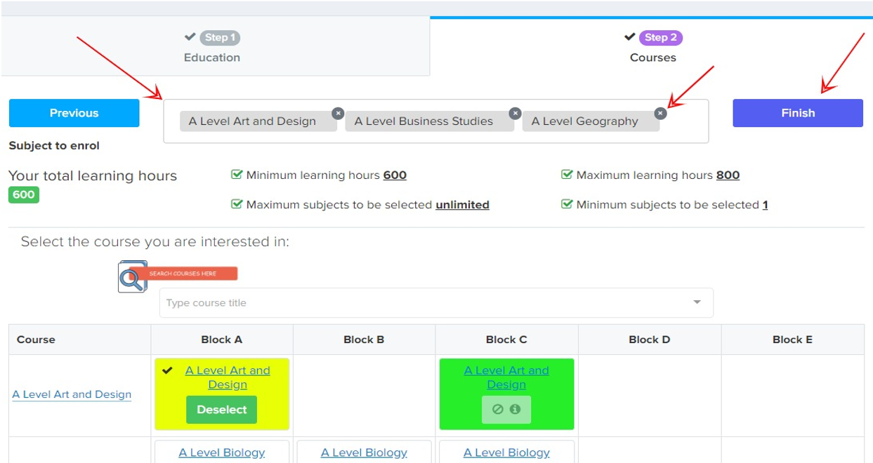
REVIEW & CONFIRM COURSES
Review and confirm the courses
you have chosen to study
1
If you would like to modify your
course choices, click the ‘x’ icon
on the course you want to
remove
2

Slide 7
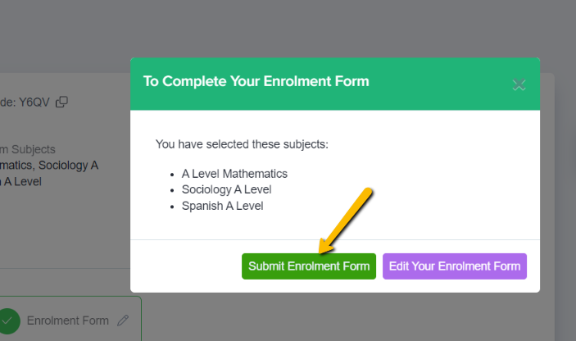
SUBMIT ENROLMENT FORM
Click ‘Submit Enrolment Form’ to save your changes and submit the Enrolment Form to the school.

Slide 8
SUPPORT
For technical support, password queries, or general guidance when using the Applicaa portal, please email: itdepartment@tchs.org.uk
For queries relating to courses, admissions, or the Sixth Form itself, please email: sixthformadmissions@tchs.org.uk

