Slide 1
Admissions+
A guide for applicants

Slide 2
Follow this link:
http://tchswoodford.applicaa.com/year12
Internal students: Your login details will be sent to your school email accounts on Thursday 28th November at 10am. Enter details in the ‘Existing Users’ section
External students: Applications can be made from 10am. Log into system through the ‘External Student/New Application’ section
DO NOT APPLY BEFORE APPLICATIONS OPEN AT 10AM ON THURSDAY 28TH NOVEMBER
If you have an issue with your account then please contact the IT department, itdepartment@tchs.org.uk

Slide 3
This is for EXTERNAL applicants only
INTERNAL applicants: Add your email address and password here and login as a Registered User

Slide 4
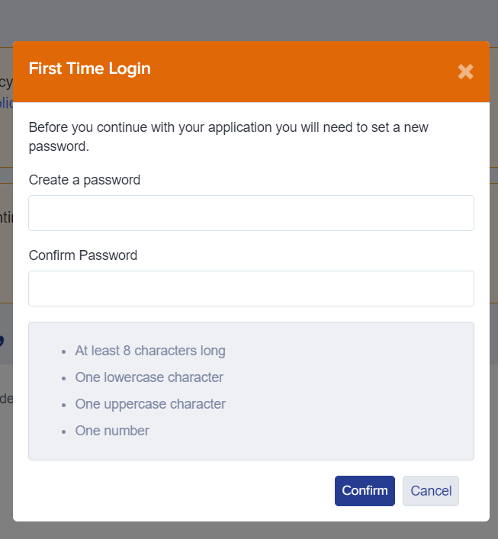
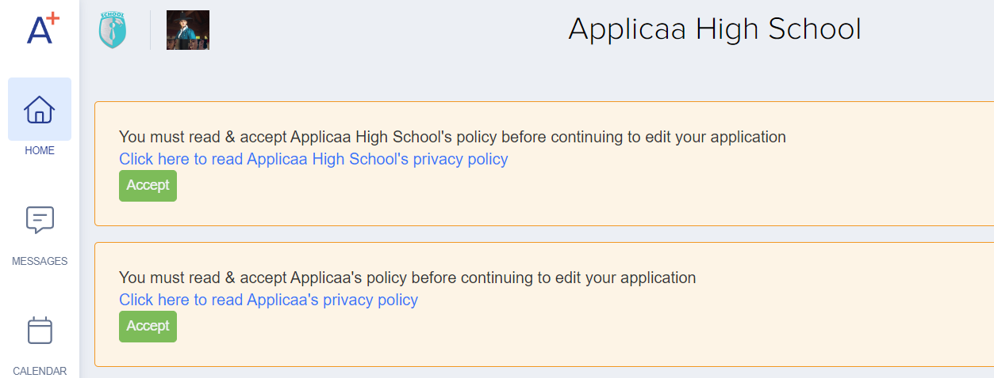
Once you’re logged in…
You will be asked to change your password before you can continue with your application
Also, please read and accept both the school and Applicaa's privacy policies

Slide 5
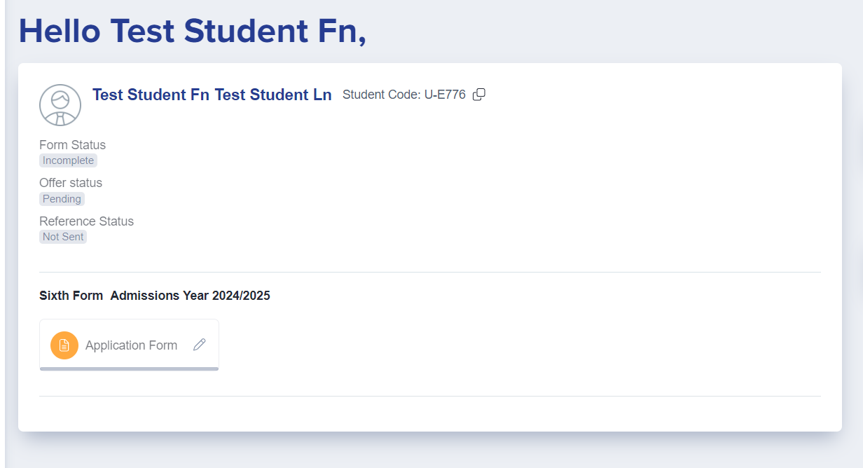
Once you’re logged in…
You will see a welcome message and the Application Form icon
Click the Application Form icon to open your application and begin completing each section
Make a note of your password (set it to something memorable!) as you will need to log in again in future to view your offer

Slide 6
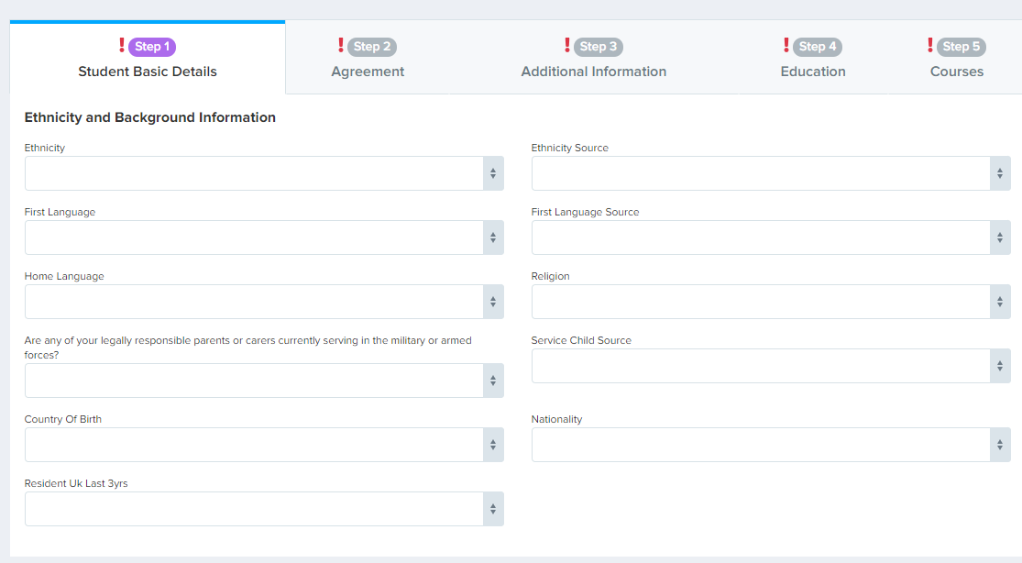
Press “save” at the end of each section
You don’t have to complete your application all in one go

Slide 7
If you have any questions or need any support:
Admission queries: SixthFormAdmissions@tchs.org.uk
Technical support: itdepartment@tchs.org.uk

