Slide 1
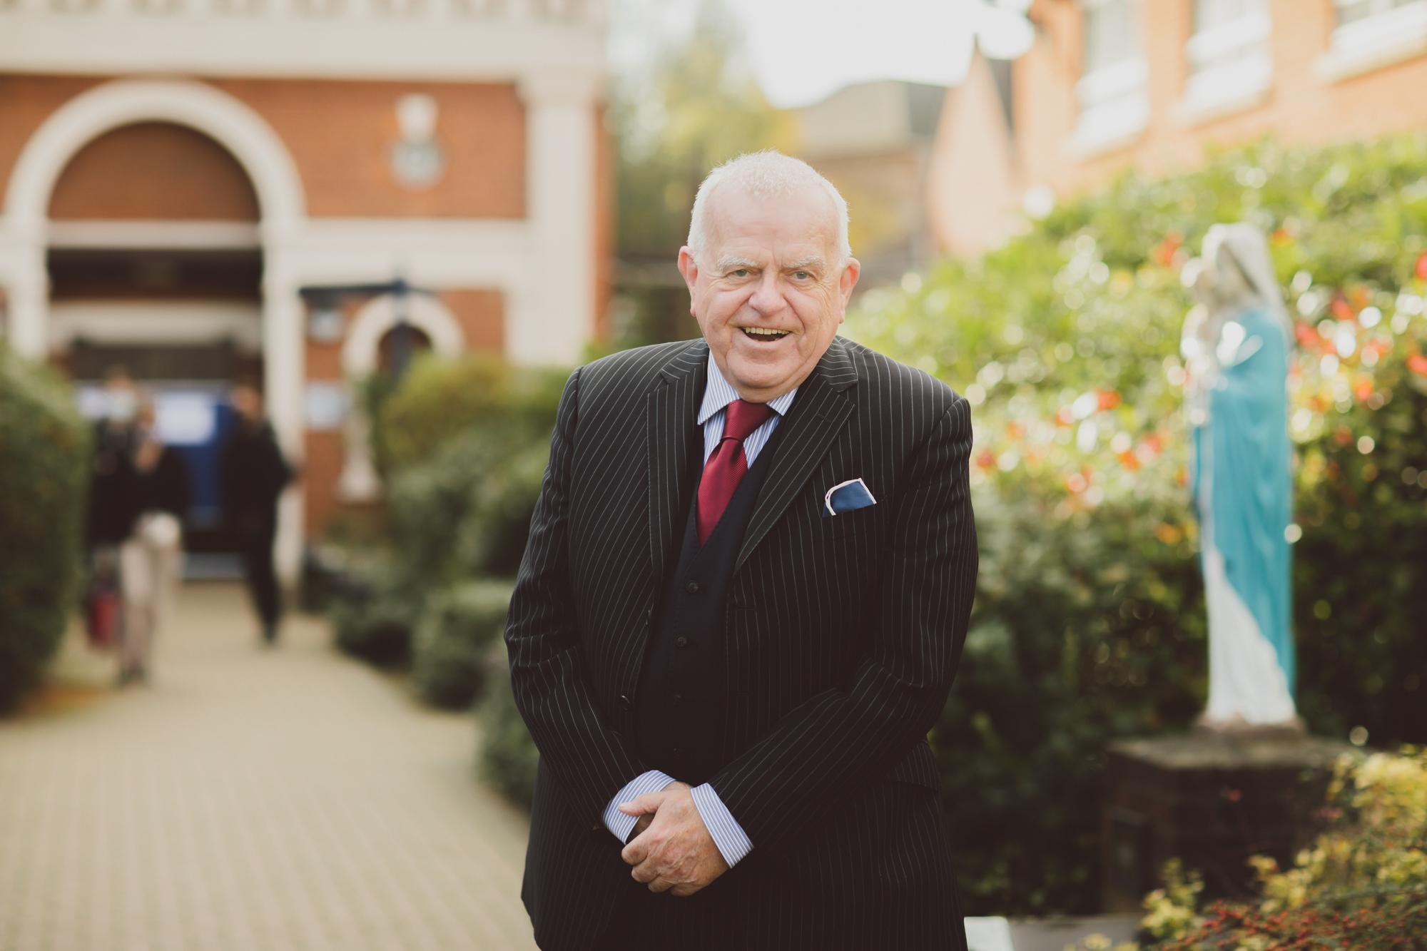
Introduction to our Higher Education Evening
Dr P Doherty OBE
Headmaster

Slide 2
Mike Nicholson
Director of Recruitment, Admissions and participation
University of Cambridge
UCAS Overview & Tips for Parents

Slide 3
Why Choose Higher Education
& Student Finance
Mr P McGrory
Head of Year 12
Assistant Head-teacher
Acting Director of Sixth Form

Slide 4
Overview
Why go on to higher education?
The importance of research
How do you choose a university and a course?
How can parents help?
Student finance
Key deadlines
Where to find out more?

Slide 5
Why Apply?
Why bother applying at all, especially when it’s…
competitive (especially at Oxbridge & Russell Groups) and
expensive (the typical cost for a three-year degree is about £55K)
stressful (there are tight deadlines and there are no guarantees you’ll even get in after all your efforts)?

Slide 6
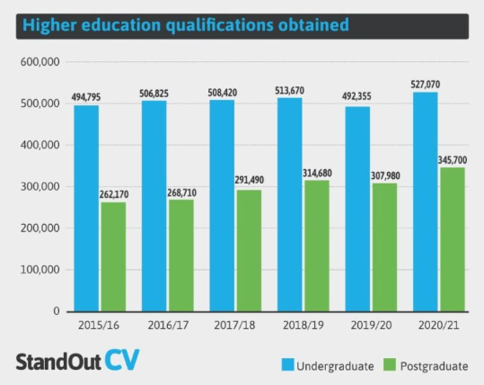
Because it’s worth it
Certain careers are now ‘graduate only’. For some students the reason for choosing Higher Education is based on necessity: certain careers will be closed to them otherwise.
Over the last ten years the number of university graduates has risen steeply. About one in three young people now has a degree or equivalent qualification
“There are an estimated 36.4 million graduates in the UK in 2023”
Non graduates are almost twice as likely to experience unemployment

Slide 7
Graduates on average earn at least 25% more per year than those who do not go to university
Graduates enjoy higher quality jobs than non-graduates
Graduates enjoy better health outcomes, by being less likely to smoke, more likely to exercise, and less prone to depression
Graduates’ children also benefit from the educational success of their parents: graduates tend to have a greater involvement with their child’s education
Graduates are more influential in the community, by being active citizens who are more likely to vote and participate in voluntary activities

Slide 8
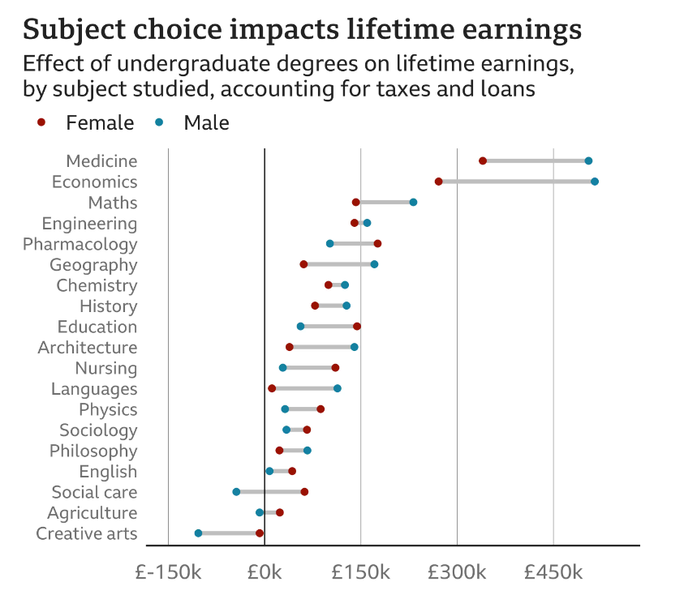

Slide 9
Degree education is formative
Degree education develops character, endurance, perseverance, commitment, and a wealth of life skills
Student life is enjoyable and fulfilling and allows people to develop life long relationships

Slide 10
In summary…
Increase potential earnings
Better career prospects
Benefit the wider community
Social and cultural reasons
More independence, self-confidence and responsibility
Personal challenge
Broadens interests and knowledge
It can be immense fun!

Slide 11
Research….
Start with unifrog at www.unifrog.org and UCAS at www.ucas.com
Find out the UCAS deadlines and any extra exams that need to be taken (UCAT, LNAT etc) – make sure your son or daughter knows which deadline and exam is relevant to them. Early applicants will have a different deadline.
Research – career options, universities, courses and minimum entry requirements. An excellent website is "Which? University” www.university.which.co.uk
Attend a UCAS event, visit or taster day – even if your son or daughter doesn’t know what they want to do, speaking to those in the know will help.
Learn from others – student videos are available to watch at ucas.tv.

Slide 12
Which university?
Which course?

Slide 13
Most people choose a university via a combination of the following, at least as a starting point
Academic reputation (e.g. grouping; league table position & correlation with ‘worth’)
Social factors (urban/rural/campus; size of university; facilities; clubs and societies)
Geography (how far is it)
Research (see pages 14-21 of Parents’ Guide; Virgin/Guardian/Times)
‘Employability’ data
Visit
There is no one-size-fits-all approach to this: be proactive, interested, open minded.

Slide 14
Separate out the idea of ‘subject’ and ‘course’
(Sometimes courses are similar but sometimes they aren’t.)
Browse
‘Heap’ Guide/other reference books
Single Honours
Joint Honours
Sandwich
3 or 4 Years
Sponsored degrees, degree apprenticeships

Slide 15
Be alert to the fact that some courses are much harder to get a place on than others.
Architecture
Dentistry
Drama
History
Law
Psychology
Consider alternative routes in / Foundation Year / variations (e.g. Ancient History or Archaeology)?

Slide 16
Other things to consider
Work experience
Finance – course fees, bursaries, travel and living costs.
Home or away
Travel – to and from home.
Town or campus style universities
Accommodation – uni halls or private residences?

Slide 17
How can parents support the research process?
Sign up to the monthly UCAS Parents’ Newsletter.
Download the UCAS Parent Guide from the UCAS website. Use Unifrog (guidance on this later).
Offer to attend open days with them as you may have a different perspective.
Financial assistance – for example, with railway tickets.
Try to remain impartial.

Slide 18
Your son or daughter can make up to five choices one application.
The 2025 applicant fee is:
£28.50 for up to five choices
When you are ready you pay and send
Applications received by the key deadlines are given equal consideration.
‘Invisibility’ – universities cannot see where else students have applied.
In 2023...
UCAS received 757,000 applications
Key features of the
UCAS scheme

Slide 19
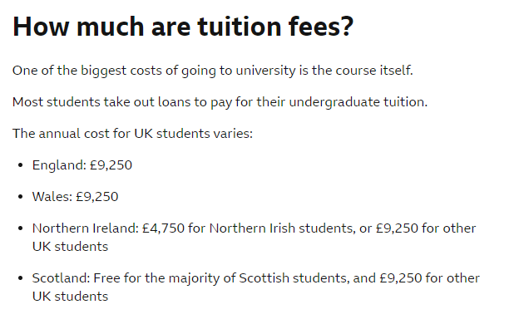
Student Finance

Slide 20
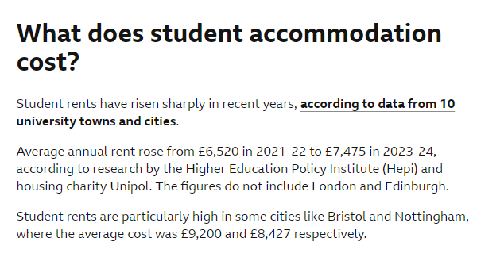
Student Finance

Slide 21
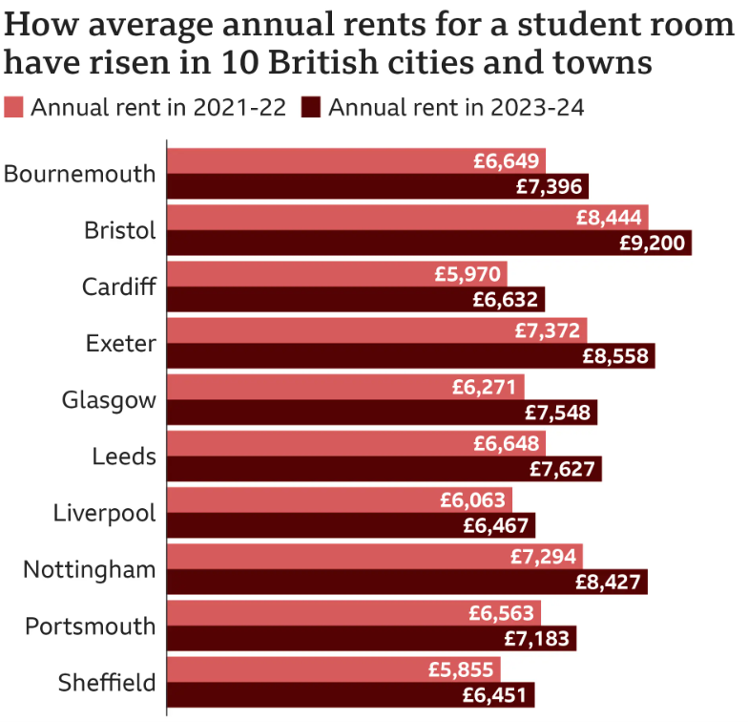
Student Finance

Slide 22
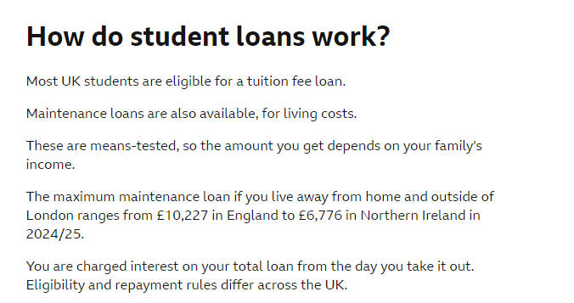
Student Finance

Slide 23
Student Finance
Since 2017 there is no longer a Maintenance Grant all maintenance is via the Maintenance Loan. See the website below for more information on student finance plus a very easy to use calculator for the maintenance loan www.studentfinance.direct.gov.uk

Slide 24
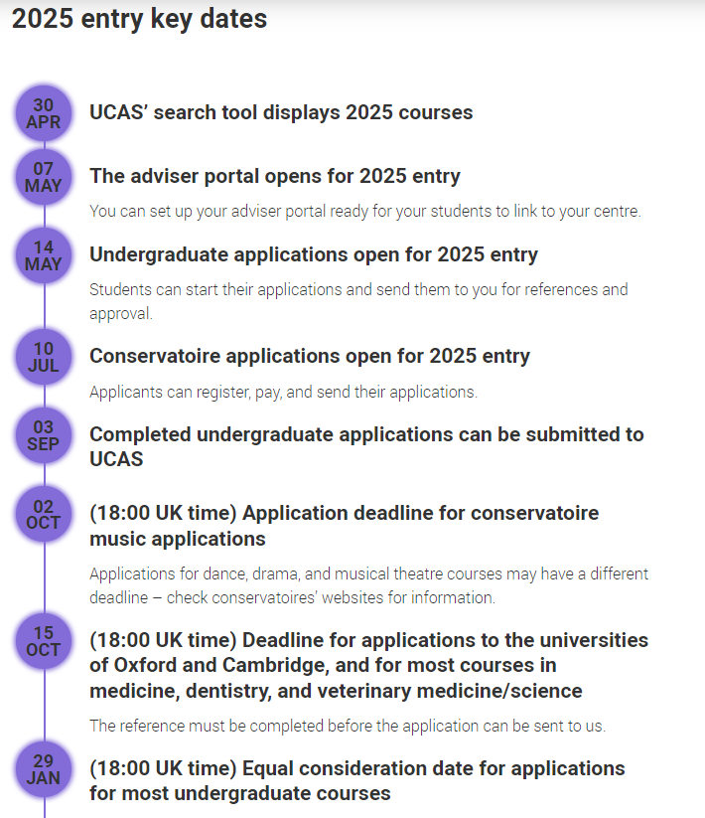

Slide 25
We are providing you with links to two booklets as follows
Trinity Catholic High School- Parents Guide to Higher Education 2024 – 2025
Access Higher Education booklet – The Journey to Higher Education

Slide 26
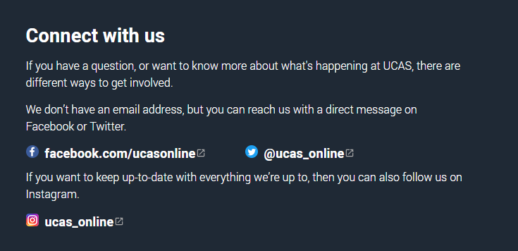
Contacting UCAS

