Slide 1
Why take a modern foreign language?
“The limits of my language mean the limits of my world”
Ludwig Wittgenstein
Philosopher + Mathematician
“One language sets you in a corridor for life. Two languages open every door along the way.”
Frank Smith
Psychologist and linguist

Slide 2
Consistently strong GCSE results
9 - 7 9 – 5 9 – 4
Trinity 40% 83% 90%
National 26% - 69%
9 - 7 9 - 5 9 - 4
Trinity 59% 81% 93%
National 26% - 71%

Slide 3
KS3 Pathways in MFL – easier to move up

Slide 4
Learning one language can help you learn many more…..
Welsh
French
German
Spanish
Mandarin
I really want to learn Arabic

Slide 5
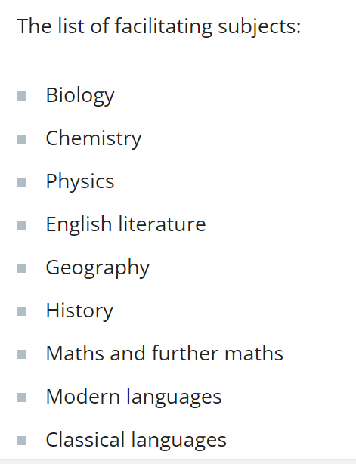
Languages are a “facilitating subject”
A list published by The Russell Group to help students choose subjects most commonly asked for in university requirements
You can pair almost any subject at university with a language and can alternatively pick up language modules when you are there.

Slide 6
Learning another language builds confidence and social skills
Me
Knowing a language is a superpower

Slide 7
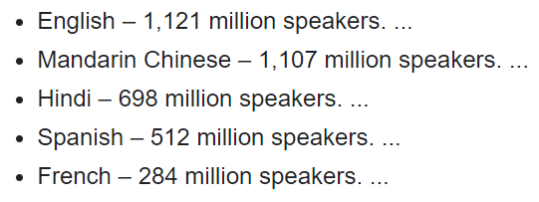
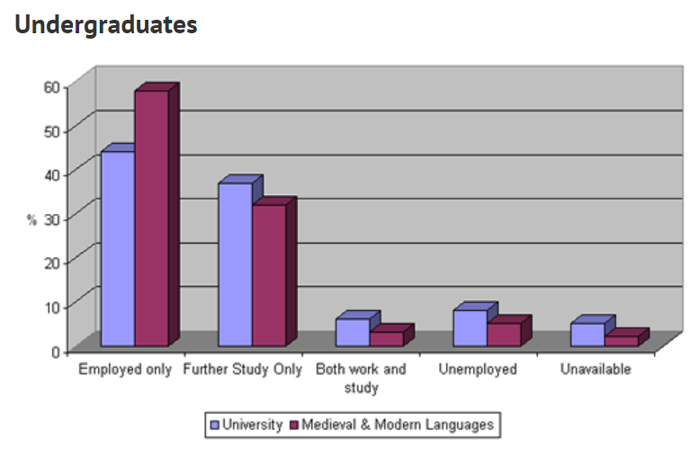
Languages open up job opportunities
Oxford University

Slide 8
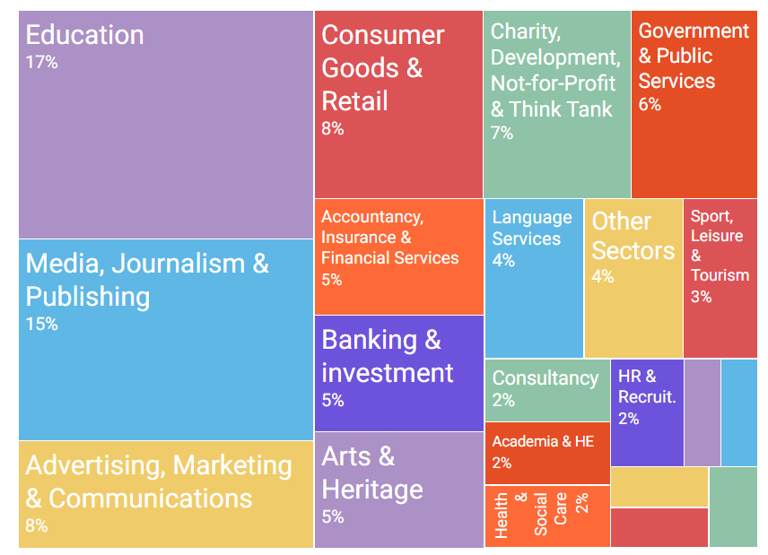
Languages open up job opportunities
Multiple studies show that learning a language can add 10-15% to your salary

Slide 9
Studying languages can complement science / maths
NK - Grade 9 in French - studies english Lit, maths, further maths, french - applied for maths with a year abroad
LC - Grade 9 GCSE French - early applicant for Oxbridge - applied for computer science - Studies chemistry, computing, maths
GT - Grade 9 GCSE French - early applicant for medicine - Studies biology, chemistry, maths
Studies show that the deduction skills learned in languages directly complement maths learning.

Slide 10
Languages set you apart from the crowd

