Slide 1
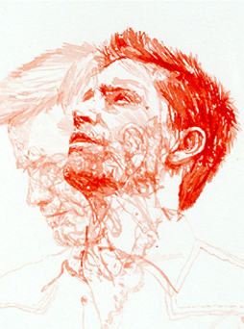
ART a level
Exam BOARD – EDEXCEL
60% COURSEWORK
40% EXAM
ART A LEVEL
WITH FINE ART
SPECIFICATION

Slide 2
Coursework
Introduction Project -
Technical skills.
Processes, media exploration, firsthand recording.
Project overviews.
Gallery visits – integrated into projects.
Studying the work of other Artists, crafts people and designers.
Personal Study -
Application of skills critical engagement through independent personal project. Developing on a given starting point through the study of your own work and the work of others.
Coursework
Essay -
Illustrated critical study essay based upon a topic related to your own studio work.
1000 – 3000 words
Exam
Project title set by Edexcel as a starting point.
Students work towards an independent outcome resolved during a 15 hour exam.
Sketchbooks /Portfolios
Sketchbooks - support and extend your thinking and discoveries!
They house ideas, thoughts and feelings, as well as drawings, paintings and photos. - trapping your journey as an artist.
Portfolios – build up over the two-year course and support your application to Foundation course / University course.
All work is used in a final exhibition to celebrate your discoveries as an Artist.

Slide 3
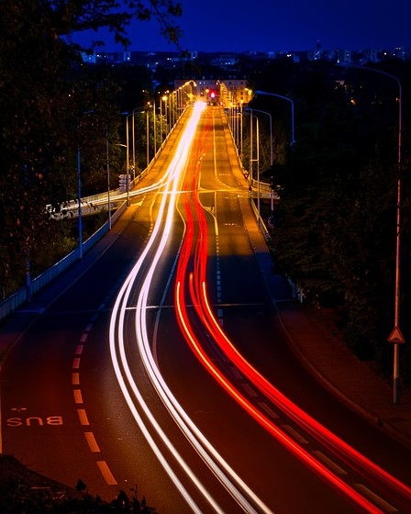
PHOTOGRAPHY a level
Exam BOARD – EDEXCEL
60% COURSEWORK
40% EXAM
ART A LEVEL
WITH PHOTOGRAPHY
SPECIFICATION

Slide 4
Coursework
Introduction Project -
Technical skills.
processes, alternative process and image making.
Digital – Photoshop and editing software.
Studying the work of other Artists and Photographers.
Personal Study -
Application of skill through independent personal project Developing on a given starting point through the study of your own work and the work of others.
Coursework
Essay -
Illustrated critical study essay based upon a topic related to your own studio work.
1000 word minimum
Exam
Project title set by Edexcel as a starting point.
Students work towards an independent outcome resolved during a 15 hour exam.
Digital Sketchbooks
In September 2020 work / sketchbooks will be digital only. Created using Office 365 and any other software of your choosing.
All work will be digitized and saved online.
Take your work anywhere and create and update where ever you are!

Slide 5
A collection of Art Gallery web links – Virtual Gallery Tours
Watch and Listen to Leadings Arts Experts
Arts Activities to engage your Creative Self
Listen to readings of Shakespeare’s Plays
Classical music concerts on every Sunday and Thursday evening
Watch Royal Opera house Ballet and Opera performances
Creative Arts Digital Resource Pack

Slide 6
ARTS
Culture in Quarantine
Bringing arts and culture into your home
Explore cultural links across the Arts & get creative at home:
Visual Arts Music Theatre Dance Audio Books
https://www.bbc.co.uk/arts

Slide 7
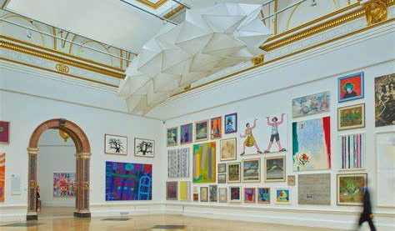
https://www.royalacademy.org.uk/
https://www.royalacademy.org.uk/news-and-blog
https://www.royalacademy.org.uk/art-artists

Slide 8
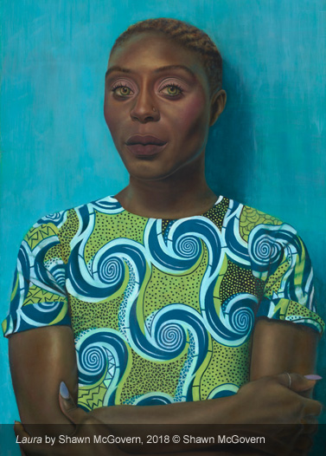
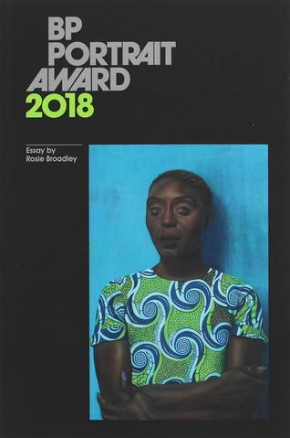
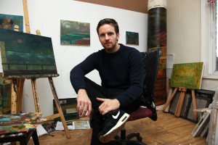
Shawn McGovern Ex Trinity Student - Working Contemporary Artist painted ‘Laura’ 2018 BP Portrait Award
https://www.npg.org.uk/
https://www.npg.org.uk/collections/

Slide 9
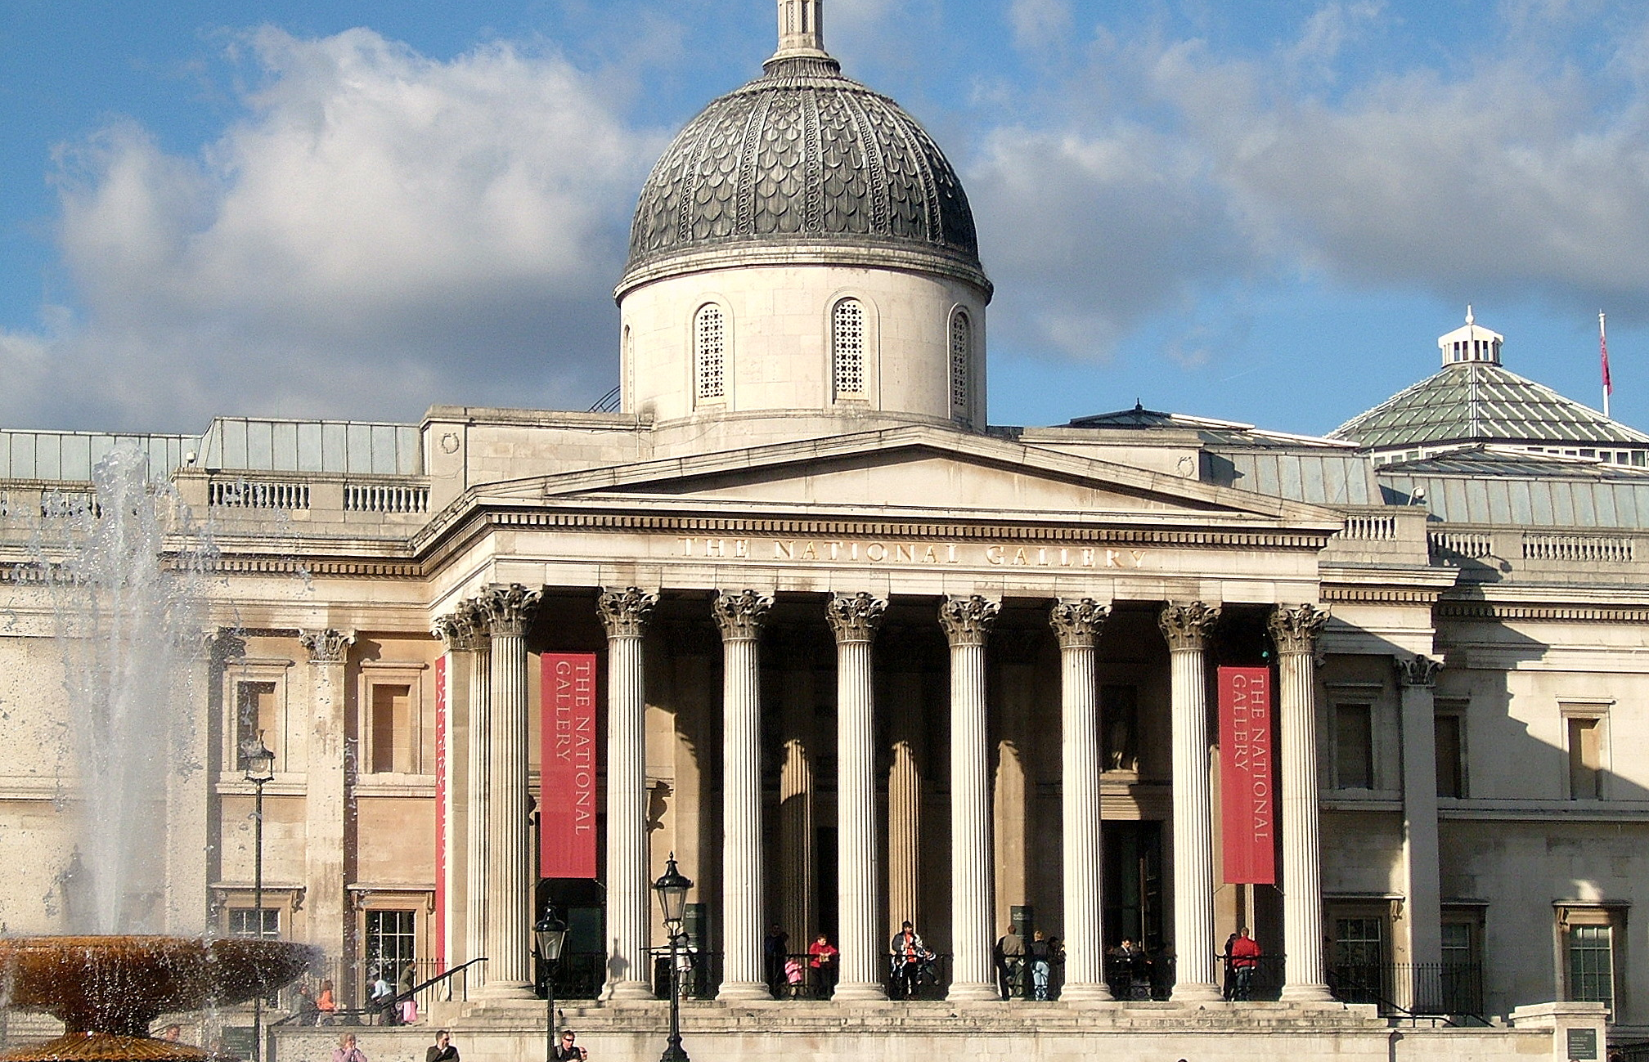
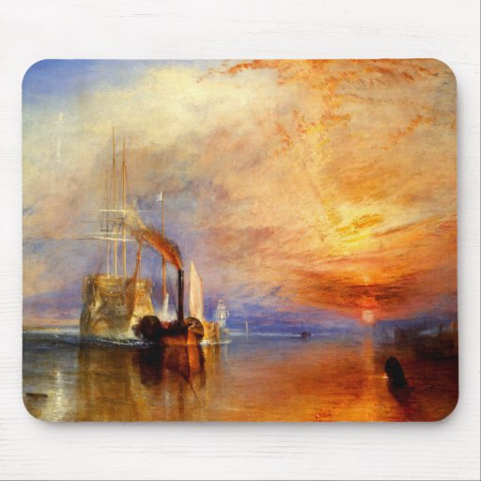
https://www.nationalgallery.org.uk/behind-the-scenes/film-series-restoring-artemisia-gentileschis-self-portrait?
https://www.nationalgallery.org.uk/paintings/search-the-collection
https://www.youtube.com/watch?v=r1Xq4qsC5ww&utm_source=wordfly&utm_medium=email&utm_campaign=NG
https://www.nationalgallery.org.uk/learning/young-producers
https://www.nationalgallery.org.uk/

Slide 10
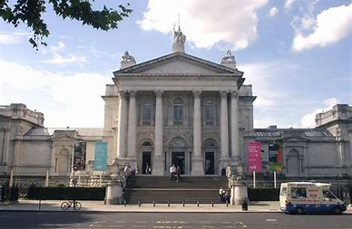
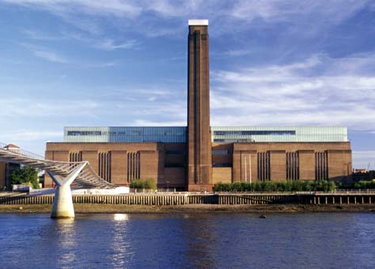
The Tate http:// www.tate.org.uk
https://www.tate.org.uk/art
https://www.tate.org.uk/artist-rooms
https://www.tate.org.uk/tate-collective (16-25? Want access to £5 exhibition tickets, free events, creative opportunities and discounts across Tate? Sign up for free Tate Collective account.)
Tate Collective gives access to the following areas of interest: Reading Lists / Podcasts / Creative Projects / Quizzes / Getting Started as an Artist / Student Resources including exploring careers advice, exam help and more.

Slide 11
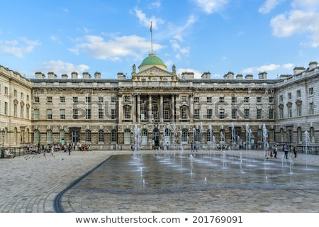
https://www.somersethouse.org.uk/
https://www.somersethouse.org.uk/blog
(Access to videos and interviews from leading Arts practitioners, career insights, debate, critique on exhibitions and ideas)

Slide 12
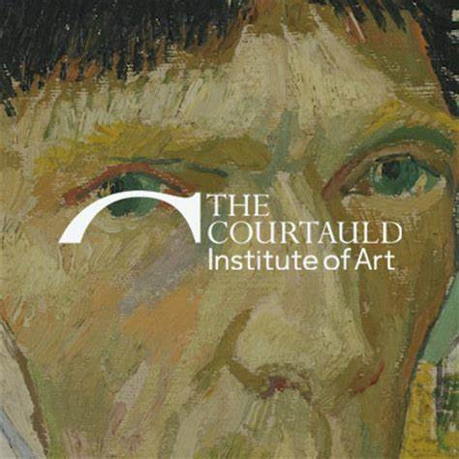
https://courtauld.ac.uk/
https://courtauld.ac.uk/gallery/about/3d-gallery-virtual-tour?

Slide 13
https://designmuseum.org https://designmuseum.org/exhibitions (exhibition guides and notes)
https://designmuseum.org/digital-design-calendar
https://designmuseum.org/design https://designmuseum.org/designers

Slide 14
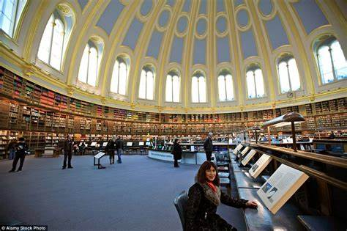
https://www.bl.uk/

Slide 15
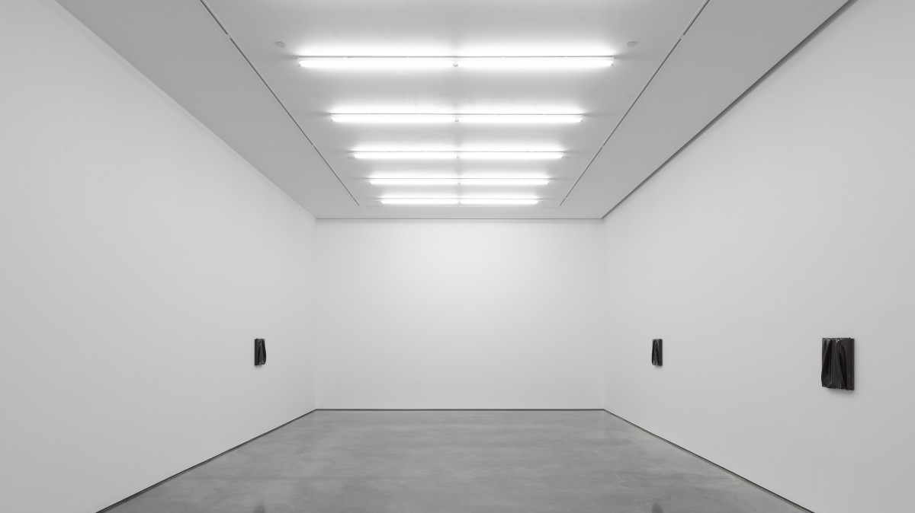
https://whitecube.com/
https://whitecube.com/channel (A series of videos from various artists)
https://whitecube.com/artists

Slide 16
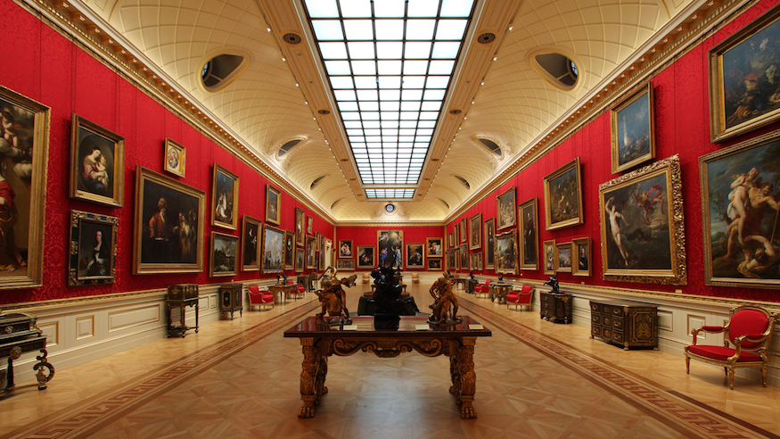
https://www.wallacecollection.org/

Slide 17
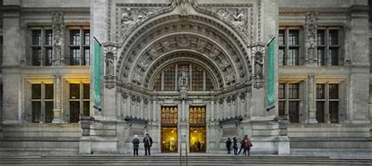
https://www.vam.ac.uk/
https://www.vam.ac.uk/collections?type=featured (A look at the collections)

Slide 18
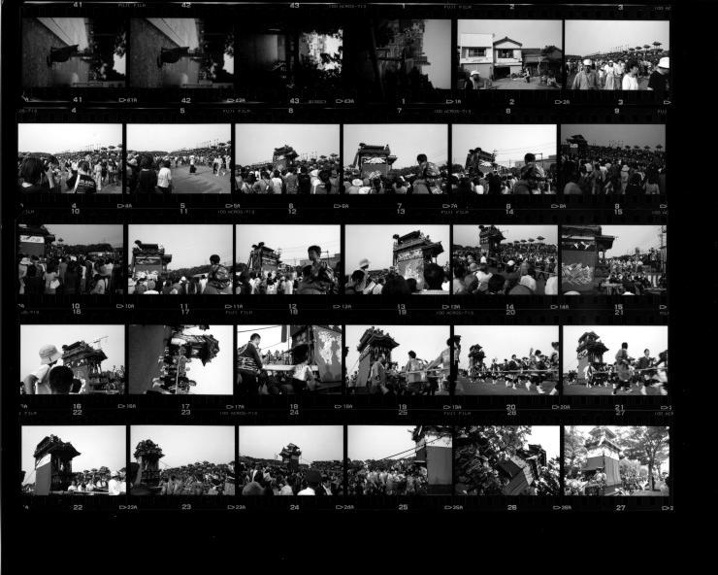
https://thephotographersgallery.org.uk/
https://thephotographersgallery.org.uk/viewpoints

Slide 19
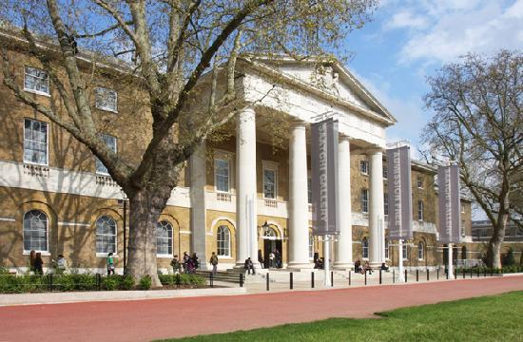
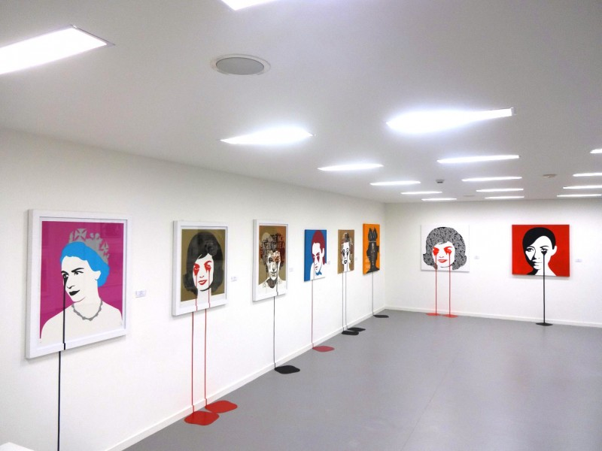
https://www.saatchigallery.com/
https://www.saatchigallery.com/video_tours.php
(Virtual Tours – Many to choose from)

Slide 20
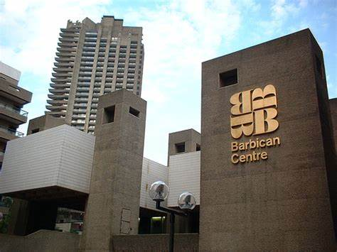
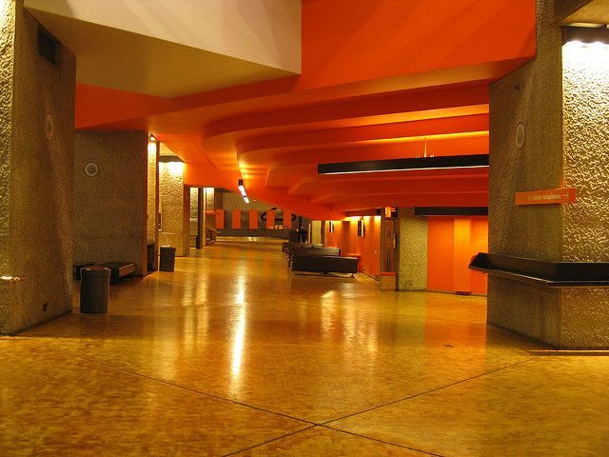
https://www.barbican.org.uk/
https://www.barbican.org.uk/read-watch-listen
https://www.barbican.org.uk/whats-on/series/creative-careers

Slide 21
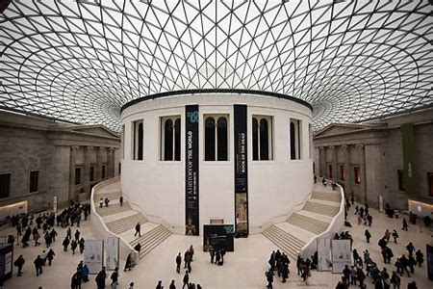
Explore the Collection
https://research.britishmuseum.org/research/collection_online/search.aspx
https://blog.britishmuseum.org/category/objects-in-focus/
https://blog.britishmuseum.org/category/podcasts/

Slide 22
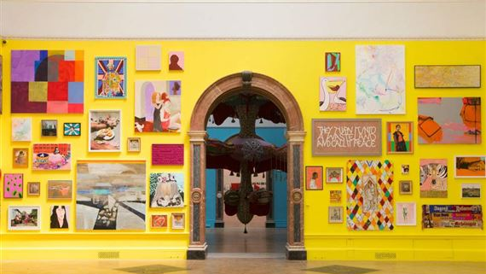
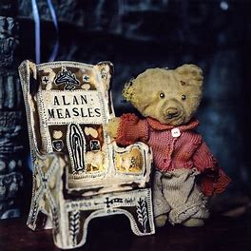
Grayson’s Art Club Monday evenings 8pm on Channel 4 from 27th April

Slide 23
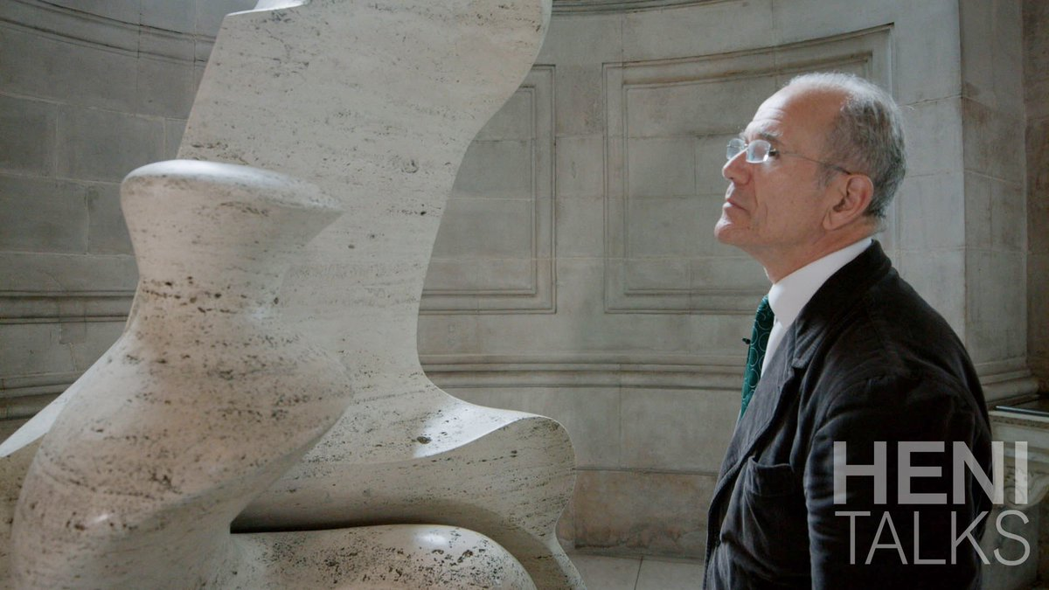
Stories of Art from the world’s leading academic experts
HENI TALKS
https://henitalks.com/

Slide 24
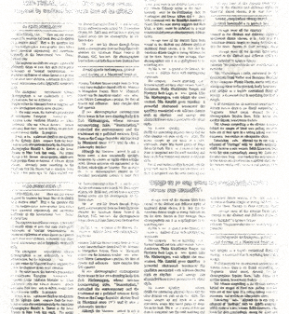
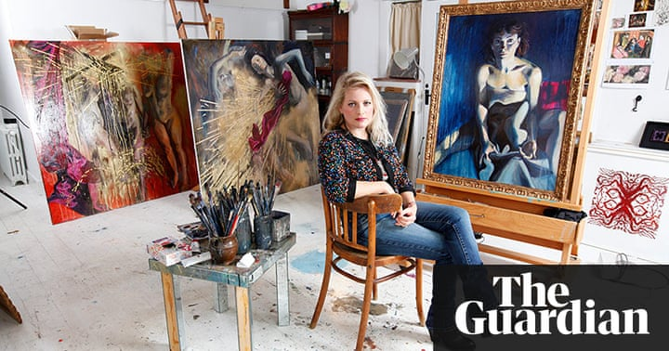
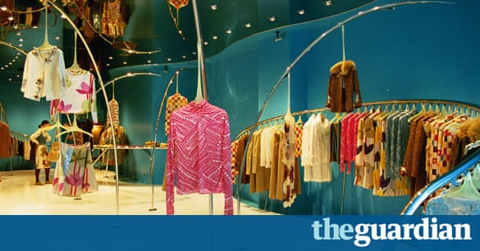
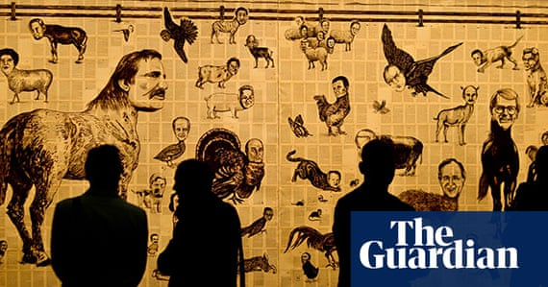
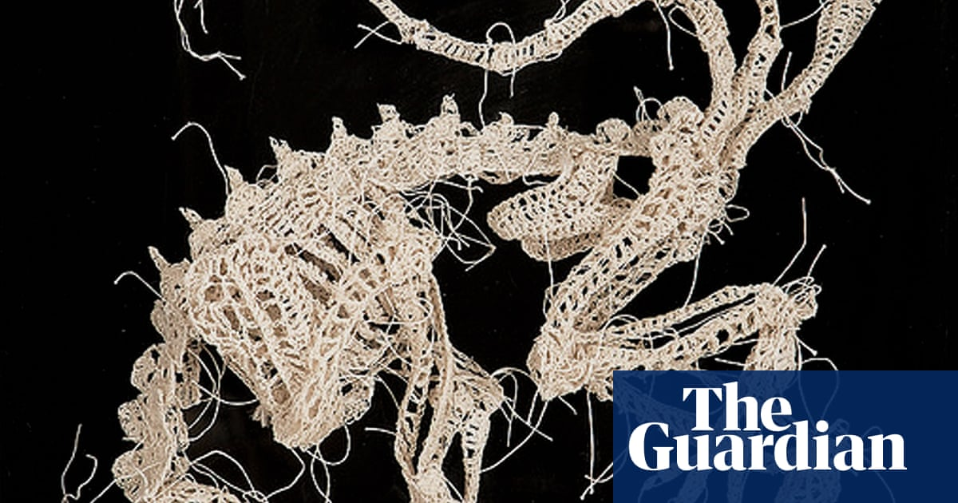
https://www.theguardian.com/artanddesign

Slide 25
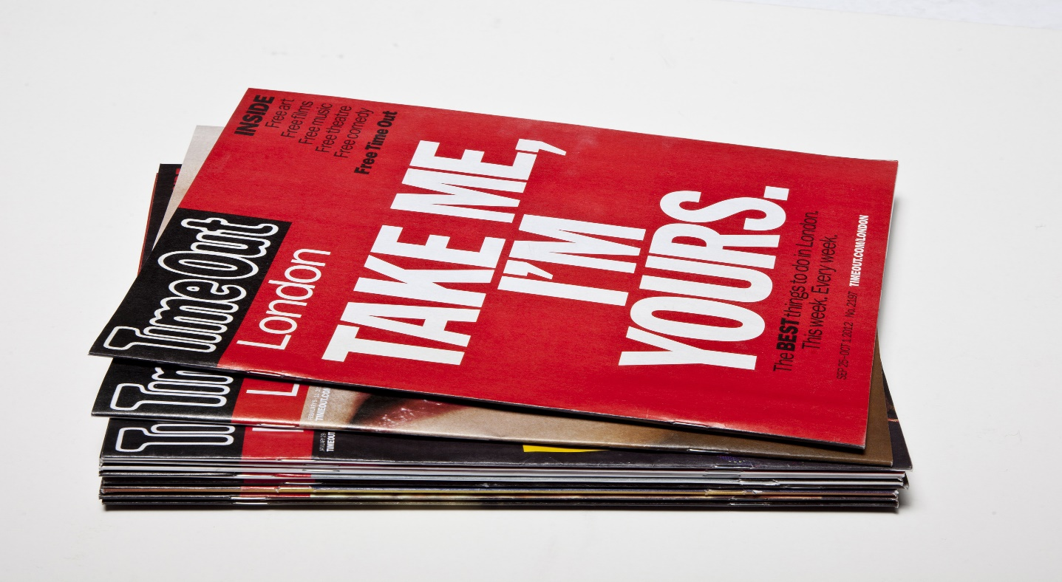
https://www.timeout.com/london/news/a-live-streaming-reading-group-is-performing-all-of-shakespeares-plays-in-order-031920
(Live readings of Shakespeare plays)
https://www.timeout.com/london/things-to-do/london-symphony-orchestra-always-playing
Classical concerts every Sunday and Thursday from the 22nd March at 7pm)
https://www.timeout.com/london/news/the-royal-opera-house-will-stream-opera-and-ballet-for-free-during-the-coronavirus-outbreak-032020
(Dates for performances on the link)
ONLINE ONLY

