Slide 1
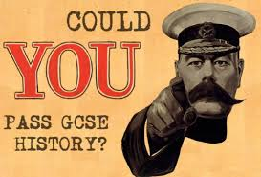

Slide 2
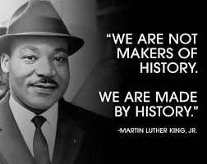
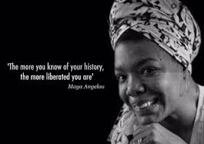
History is his-story…
History is her-story…
History is our-story!!!

Slide 3
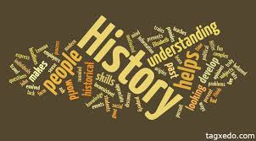
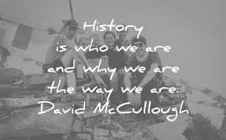
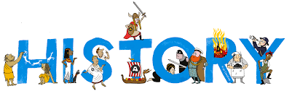
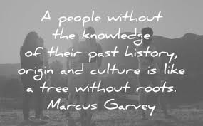

People who study history are fearless explorers of the past. They investigate past politics, societies, cultures, languages, health, art, education, money, conflicts and more, look at how things have developed over time and connect the dots to understand how we got where we are today.
It might be about the past, but there are plenty of careers in history that you can pursue today. Why study history? Because it's great news for your future!

Slide 4
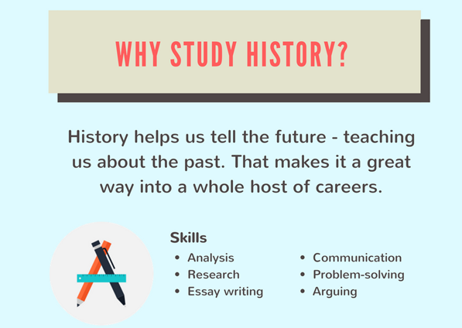

Slide 5
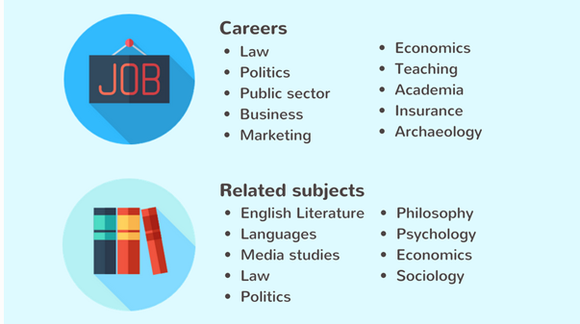

Slide 6
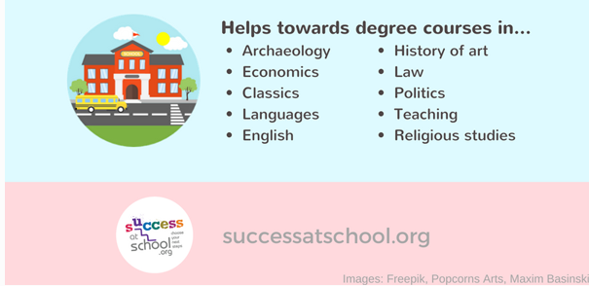
This is a good website as it suggests lots of careers linked to HISTORY

Slide 7
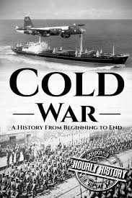
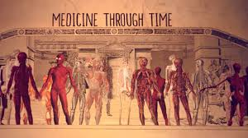
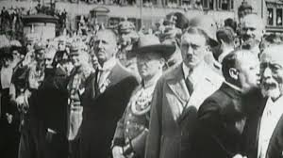
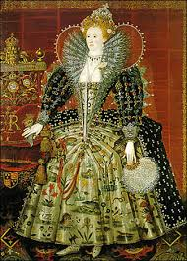
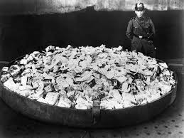
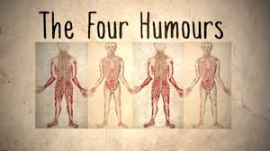
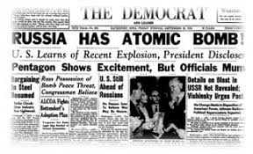
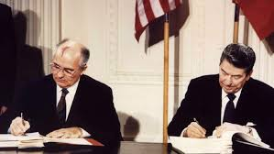
What do we study?
Some of what you will cover you have come across before, and you will learn about it in more detail.
A lot will be new to you and covers some fascinating topics!!

Slide 8
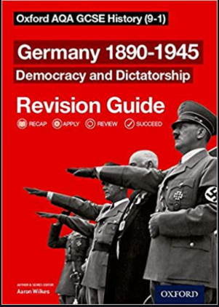
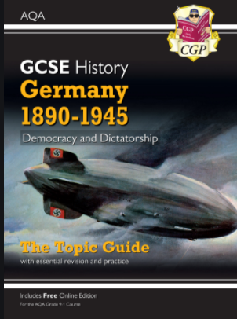
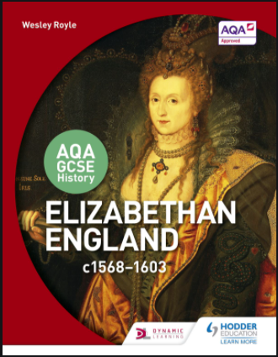
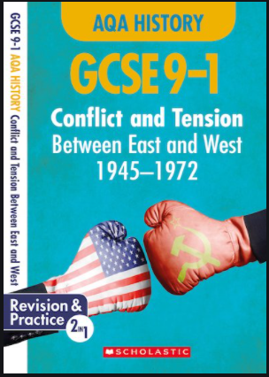
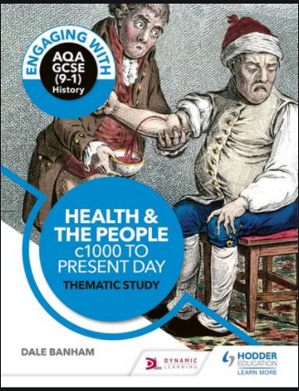
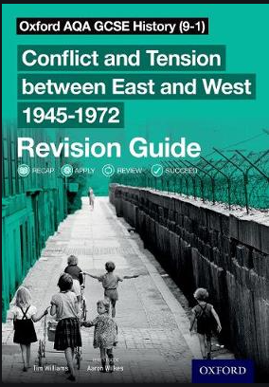
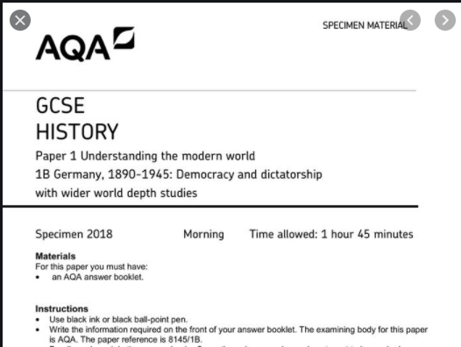

Slide 9
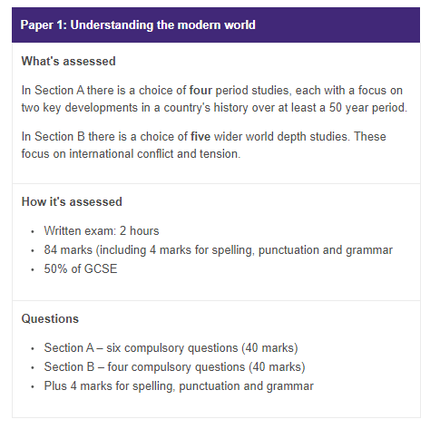
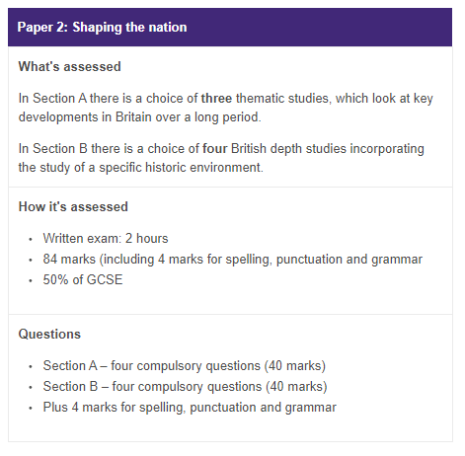

Slide 10
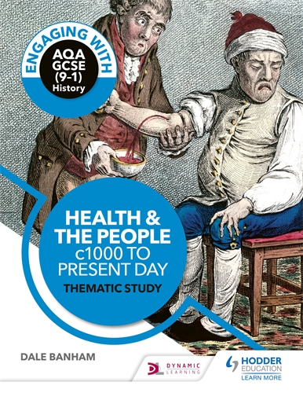
Medicine in the Middle Ages
Beliefs about the causes of illness and methods of prevention and treatment
Role of the Christian church
Islamic medicine
Surgery in Medieval times
The Black Death in Britain
Renaissance Britain
improvements in knowledge of anatomy
William Harvey
Ambroise Pare
The Great Plague
Hospitals, training and physicians
Edward Jenner and smallpox vaccination
19th Century, Revolution in Medicine
Louis Pasteur
Vaccinations, magic bullets and treatments
Problems of surgery: Simpson, Lister
Public Health in industrial Britain
20th Century, Modern Medicine
Fleming and development of penicillin
Impact of WW1 and 2 on surgery
NHS
21st century healthcare issues

Slide 11
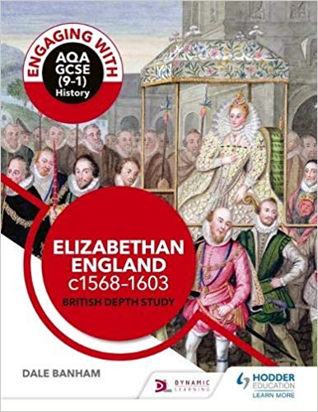
Elizabeth’s court and parliament
Elizabeth and her court
Difficulties of a female ruler
Elizabeth and marriage
Rebellions at home
Life in Elizabethan Times
a ‘Golden Age’ – fashion and theatre
Causes of poverty
Attitudes to the poor
Sir Francis Drake and voyages of exploration
Troubles at home and abroad
Religious changes and reactions
Catholic threat
Puritans
Mary Queen of Scots
Naval Warfare
Spanish Armada

Slide 12
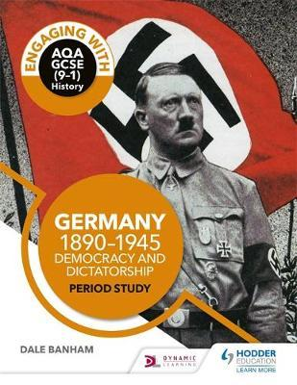
Germany and the growth of democracy, 1890-1923
Kaiser Wilhelm and the difficulties of ruling Germany
Impact of WW1
Treaty of Versailles
Hyperinflation
Munich Putsch
Weimar republic under Stresemann
Germany and the Depression, 1929-1934
Causes and impact of the depression
Role of SA
Reasons for growth of the NSDAP
Failure of Weimar democracy
Reichstag Fire
The Night of the Long Knives
The experiences of Germans under the Nazis, 1933-45
Impact on the economy
Persecution of the Jews
The Final Solution
Women and young people
Police state and terror
Culture and propaganda

Slide 13
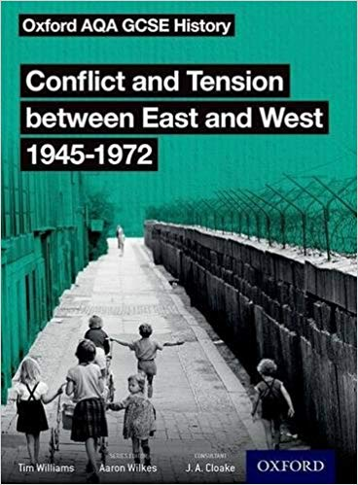
Origins of the Cold War
How the cold war started
Relations between the allies in WWII
Yalta and Potsdam
Atomic bomb
Truman Doctrine and the Marshall Plan
The Berlin Blockade
Communism in China
Korean and Vietnam Wars
The Development of the Cold War
NATO and the Warsaw Pact
Arms race and space race
Hungarian uprising
The Berlin Wall
Transformation of the Cold War
Cuban Missile crisis
The Prague Spring
The Brezhnev Doctrine
Detente

Slide 14
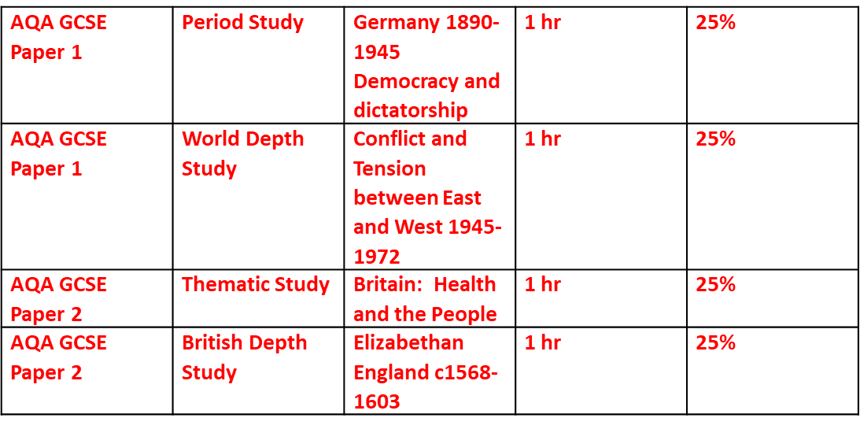
GCSE EXAM RESULTS
Year | Grade 9-7 | Grade 9-5 | Grade 9-4
2019 | 37% | 67% | 82%
2020 | 41% | 74% | 93%
2021 | 40% | 80% | 87%
2022 | 42% | 74% | 86%

Slide 15
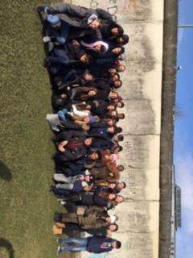
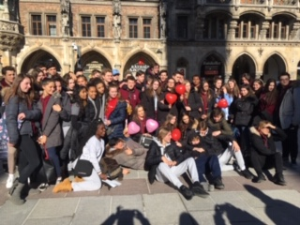
Germany Trip – Berlin or Munich
February Mid-Term Break

Slide 16
