Slide 1

Geography GCSE/EBacc
Mrs K Reid

Slide 2
Geography helps students to make sense of the world around them. It is hands on, it is relevant and it is fun!
GCSE geography courses are a good mix of topics such as urban issues, world development, extreme environments, rivers, and hazards – to name but a few. The course will give your child the chance to get to grips with some of the big issues which affect our world, and understand the social, economic and physical forces and processes which shape and change our world.
GCSE geography is designed to allow a large number of topics to be studied and to provide an insight into a variety of the most important and relevant geographical issues. This diversity also allows all students to find topics they are interested and engaged in. A selection of these are described on the following slides.

Slide 3
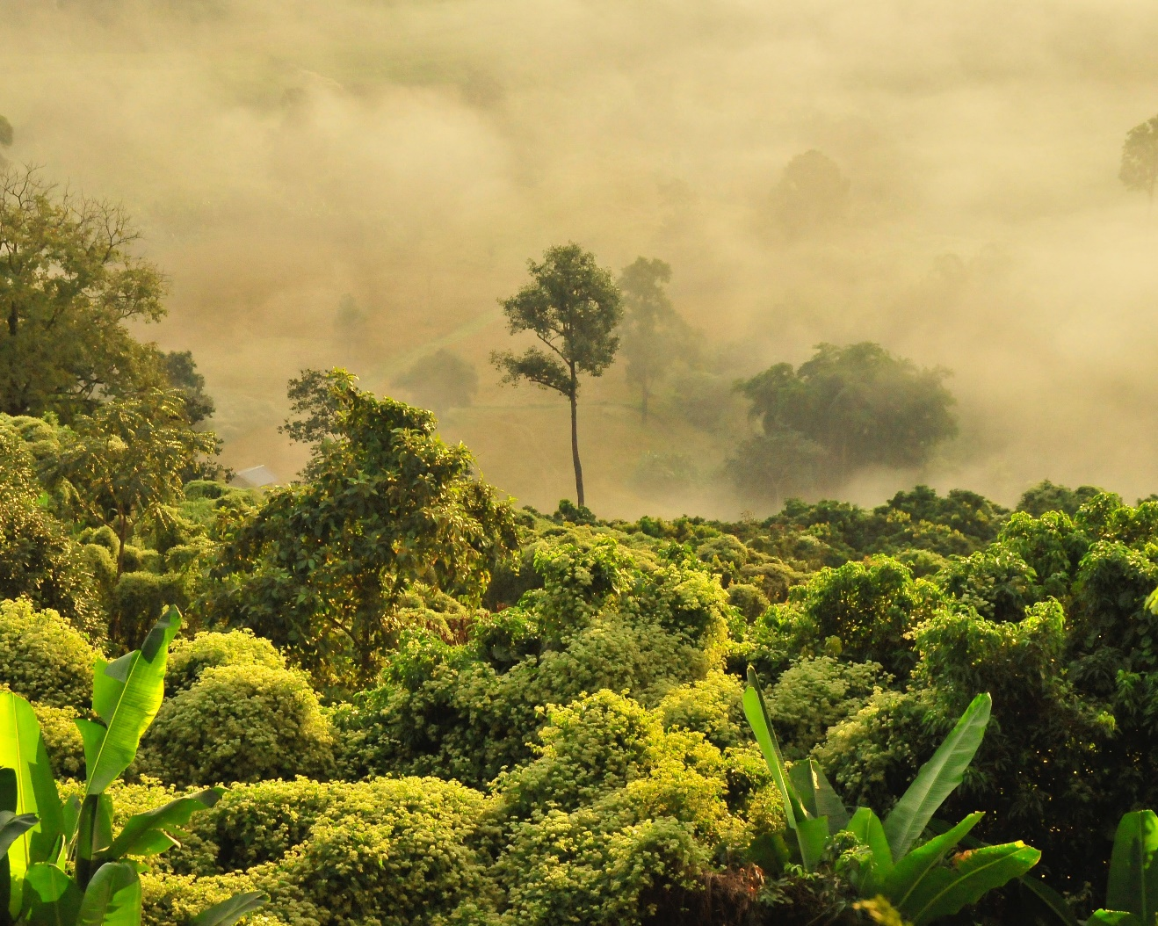
Physical geography
Global ecosystems
Global ecosystems - ranging from hot arid to cold tundra environments - all have distinctive characteristics, which have lead to distinctive adaptations within their plant and animal communities. Whilst these environments all provide economic opportunities such as using rainforests for logging, farming or energy, they are extremely fragile environments which require sustainable management.

Slide 4

Human Geography
Urban issues and challenges
Cities and urban areas are some of the most dynamic regions of the world. For the first time, a majority of the global population now lives in towns and cities, with the UN predicting this will increase to 75% by 2050 - highlighting the importance of studying these settlements. This topic looks at reasons why urban areas emerge and develop unevenly within and between countries and the challenges and opportunities that this creates.

Slide 5
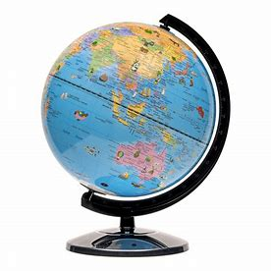
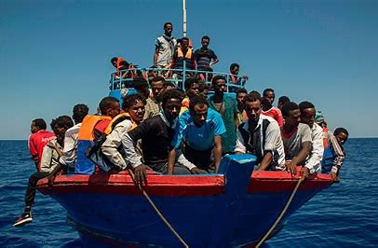
Gaining transferable skills
Studying GCSE geography provides students with a variety of valuable skills and knowledge that can be transferred and used across other subject areas and in everyday life. Key skills and knowledge gained are listed below:
Highly relevant knowledge
Your child will study issues that are extremely relevant to the challenges the world is facing today both environmentally and in wider society. This equips them with valuable knowledge for future studies.
Looking at issues differently
Geographers uniquely tackle and investigate big issues across a variety of scales. Students will also learn how to bring together perspectives from multiple disciplines.

Slide 6
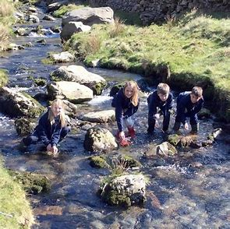
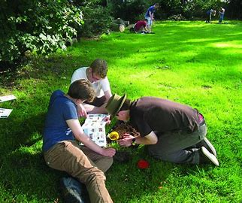
Fieldwork
Fieldwork is an enjoyable opportunity to explore new environments, improving students’ understanding of topics as they come to life. Fieldwork provides students with useful skills in collecting, understanding and later communicating data to different audiences.
Teamwork
Working in teams during fieldwork and in the classroom will help develop communication and collaboration skills.

Slide 7
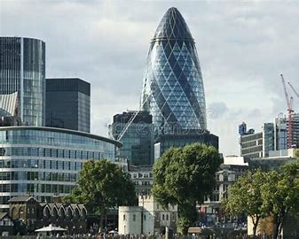
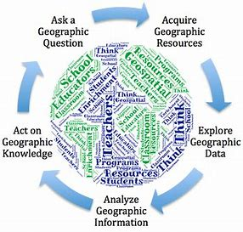
Place knowledge
Students will develop an in-depth knowledge and understanding of the UK’s economic, social and environmental geography.
Geographical argument
Students will gain strong research and analytical skills, helping them to produce convincing arguments and to communicate ideas effectively, which is particularly useful in all other essay-based subjects.

Slide 8
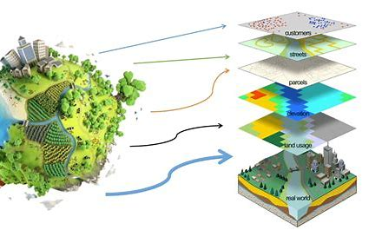
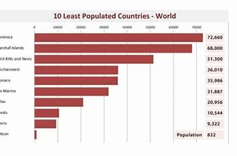
Data and geospatial skills
Geography is practical and will give students opportunities to learn new skills such as computer-based mapping (GIS), map skills, interpreting photographs and fieldwork skills. It will make practical use of their numeracy skills when they interpret data and construct graphs.
Visual communication skills
Geography gives students the opportunity to gather, analyse and present data in a variety of ways so they will also develop their visual communication skills using maps, graphs, diagrams and images to problem solve.

Slide 9
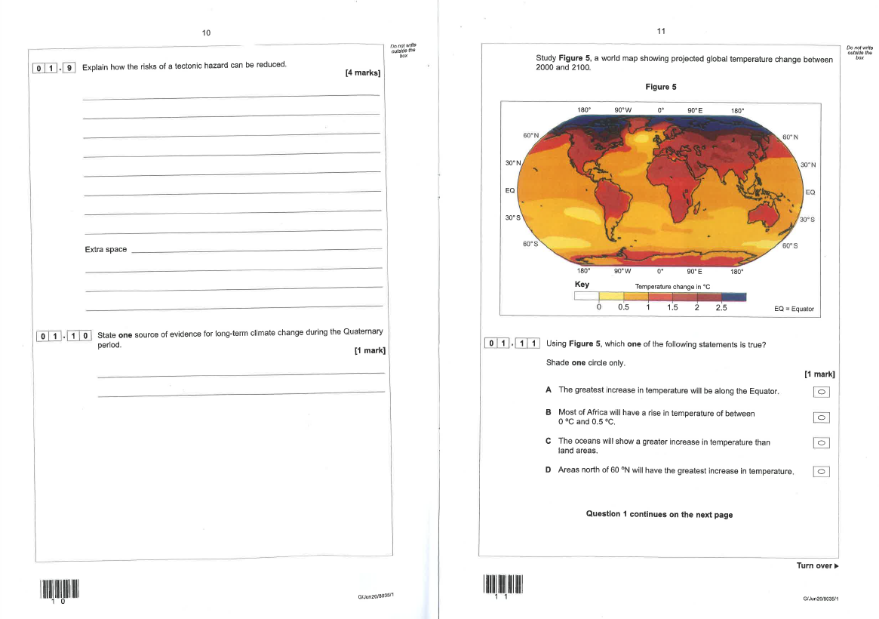
Assessment
A range of question styles from longer written answers, sentence answers to multiple choice so it caters for all ability levels.
Paper 1
Living with the Physical Environment (1hr 30 mins)
Paper 2
Challenges in the Human Environment (1hr 30mins)
Paper 3
Geographical Applications
(1hr 15mins)
Fieldwork and Issue Investigations

Slide 10
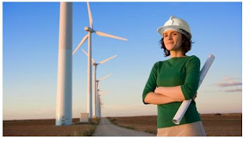
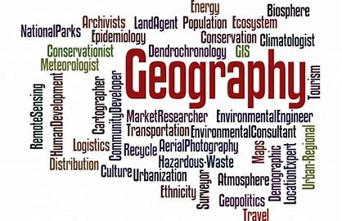
Geography and future careers
There has never been a more important time to use geographical knowledge and skills to pursue a career. None of the changes and challenges facing the UK and the world in the 21st century, including climate change, energy security, migration, urbanisation and globalisation, can be properly understood, let alone tackled, without geography. This is the discipline that connects the natural and the human, the local and the global and in doing so, enables us plan sustainably for the future. Whether your child’s future career lies in the environmental sector, business, education, the natural or social sciences, the media, in geospatial industries or in travel, geography opens up a range of choices for their future work and career.

