Slide 1
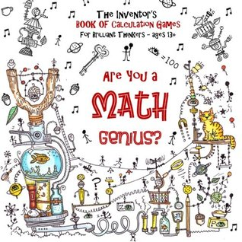
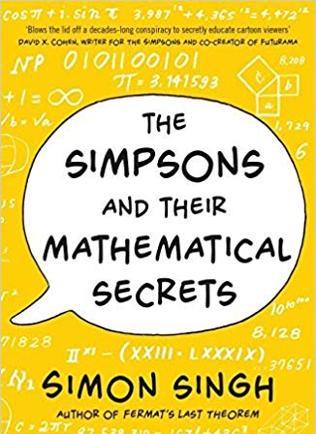
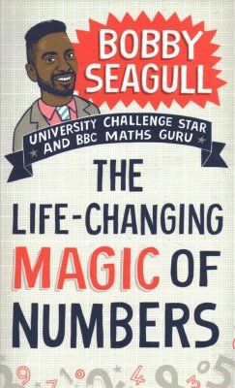
Year 10-1ab Mathematics
Algebra Manipulation
Reading Books
Basic Algebra, Factorisation, Quadratic Expansion, Expanding Squares, More than two binomials, Quadratic Factorisation, Factorising ax²+bx+c, Changing the subject of a formula
Linear Graphs
Draw graphs from points, gradient-intercept method, equation of a line from the graph, real-life use of graphs, simultaneous equations, parallel and perpendicular lines
Right-angled Triangles
3D Pythagoras’, trigonometry to find missing lengths and angles, applied trigonometry to solve problems involving isosceles triangles. Bearings and trigonometry.
Similarity, Probability & Standard Form
Autumn Test
1 x Calculator Paper
Similar triangles, areas and volumes of similar shapes, experimental probability, expectation, two-way tables, frequency trees, Venn diagrams powers, multiplying and dividing using standard form
Equations & Inequalities
DID YOU KNOW?
A googol is the large number 10¹⁰⁰
In decimal notation, it is written as the digit 1 followed by one hundred zeroes.
Linear equations, elimination, substitution, balancing coefficients, solving problems, linear inequalities, trial and improvement
DID YOU KNOW?
Learning algebra helps to develop your critical thinking skills. This includes problem solving, logic, patterns, and reasoning. You need to know algebra for many professions, especially those in science and maths.
Mid-Year Test
1 x Non-Calculator Paper
1 x Calculator Paper
Count, Accuracy, Power & Surds
DID YOU KNOW?
The famous NBA 24 second shot was created using an quadratic equation
Quadratic Equations
Rational numbers, reciprocals, terminating and recurring decimals, estimation, powers and roots, negative and fractional indices, surds, solving problems using limits of accuracy, choices and outcomes
Plotting quadratics, solving by quadratic formula, solving by completing the square, significant points of a quadratic curve, solve linear and non-linear, solve by intersection, quadratic simultaneous equations and quadratic inequalities
Probability
Combined events, addition rules, probability tree diagrams, independent events, conditional probability
End of Year Test
DID YOU KNOW?
There were more Selfie related fatalities than Shark attack deaths in 2018
1 x Non Calculator
1 x Calculator
Variation
Statistics
Direct and inverse proportion
Sampling data, frequency polygons, cumulative frequency graphs, box plots, comparing data and histograms
DID YOU KNOW?
People who were good at maths as young children go on to earn more than other similar children by the time they are 30, a study has found. Source: BBC NEWS
2022-23

Slide 2
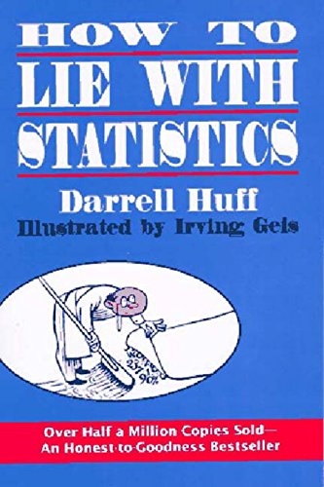
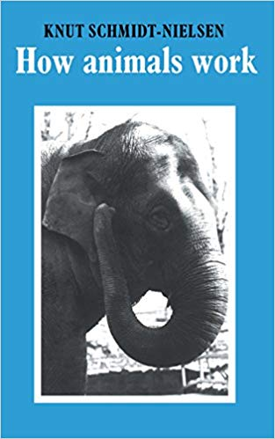
Year 10-1ab Statistics
Collection of Data
Reading Books
Describing data, primary and secondary data, capture-recapture formula, random sampling, non-random sampling, stratified sampling, collection of data, questionnaires, interviews, hypothesis, and designing investigations,
Processing & Representing Data
Autumn Test
Tables, two-way tables, pictograms, bar charts, stem and leaf diagrams, pie charts, comparative pie charts, population pyramids, choropleth maps, histograms and frequency polygons. Cumulative frequency diagrams, shape of distribution, unequal width histograms, misleading diagrams and selecting the right diagram
1 x Calculator Paper
Probability
Using probability to assess risk, experimental probability, mutually exclusive and exhaustive events, addition law, independent events, Venn diagrams, sample space diagrams, tree diagrams, conditional probability and formula for conditional probability
Mid-Year Test
1 x assessment paper
Summarising Data
DID YOU KNOW?
A career as an Actuary offers a wide range of opportunities and gives you the chance to apply your mathematical and statistical skills to real life challenges
Averages, frequency tables, grouped data, transforming data, geometric and weighted mean, measures of dispersion, standard deviation, box plots, outliers, skewness, choices, comparing data and making estimates.
Scatter Diagrams & Correlation
Time Series
Scatter diagrams, correlation, causal relationships, lines of best fit, finding the equation of the line of best fit, interpolation and extrapolation, Spearman’s rank interpretation and calculation PMCC
Time series graphs, trend lines, variation, moving point averages, seasonal variation,
Index Numbers
End of Year Test
Simple index numbers, RPI, CPI, GDP, chain base, index numbers and rates of change
Assessment paper
Probability Distributions
DID YOU KNOW?
Statistician is listed among the Bureau of Labor Statistics’ fastest growing careers in 2018 and it’s predicted to grow 33 percent by 2026. During that same period, jobs are only expected to grow by 7.4 percent. In 2016, the median statistician made over $80,000, much higher than average $50,620.
It’s a great time to be a statistician!
Binomial distribution, Normal distribution, standardised scores, quality assurance, control charts.
2022-23

Slide 3
Year 11-H 1ab Mathematics
Properties of Circles
Reading Books
Circle theorems, cyclic quadrilaterals, tangent and chords, Alternate Segment Theorem
Triangles
Using trigonometric ratios to solve further 2D and 3D problems, trigonometric ratios of angles between 0° and 360°, graphs and exact values, sine and cosine rules to solve problems involving non right-angled triangles, area of a triangle.
Graphs
Distance-time graphs, velocity-time graphs, estimating and interpreting the area under a curve, rates of change, work out and interpret a gradient at a point on a curve, equation of a circle, cubic, reciprocal and exponential graphs, transformations of the graph y = f(x).
Probability Distributions
Algebraic fractions and functions
Binomial distribution, Normal distribution, standardised scores, quality assurance
November Mock Exams
Simplify algebraic fractions, solve equations involving algebraic fractions, change the subject of a formula, inverse and composite functions, using iteration to find an approximate solution for an equation.
1 x Non-Calculator Paper
2 x Calculator Papers
Vector Geometry
Problem Solving, Revision and Exam Practice
Add and subtract vectors, properties of vectors, using vectors to solve geometric problems, proving geometric results.
Spring Mock Exams
DID YOU KNOW?
Sergey Brin, co-founder of Google studied maths (and computer science) at university.
1 x Non-Calculator Paper
2 x Calculator Papers
Problem Solving, Revision and Exam Practice
DID YOU KNOW?
Your body contains more bacterial cells than human ones? The average adult is made up of 10 million million cells but there are 10 times as many bacterial cells living inside us.
GCSE Exams
1 x Non-Calculator Paper
2 x Calculator Papers
DID YOU KNOW?
The human brain is made up of more neurons than there are stars in the galaxy – over 100 billion. Pathways in your brain are rewired second to second as you learn to do new things.
2022-23

