Slide 1
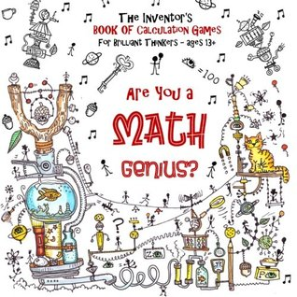
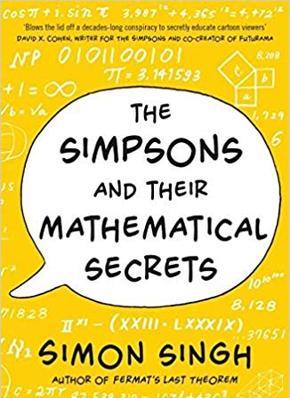
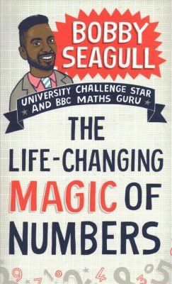
Year 10-F (3abc) Mathematics
Expressions & Formulae
Reading Books
Basic algebra, substitution, expanding brackets, factorization, quadratic expansion, quadratic factorization, and changing the subject of a formula
Linear Graphs
Graphs and equations, gradient of a line, y= mx + c, find the equation from a graph, parallel lines, real life graphs, simultaneous equations using graphs
Ratio, Speed & Proportion
Ratio, speed, distance, time, direct proportion and best buys
Autumn Test
DID YOU KNOW?
Learning algebra helps to develop your critical thinking skills. This includes problem solving, logic, patterns, and reasoning. You need to know algebra for many professions, especially those in science and maths.
1 x Calculator Paper
Transformations & Probability
Rotational symmetry, translations, reflections, rotations, enlargements, combined transformations, calculating probabilities, probability of not happening, mutually exclusive events, experimental probability, expected outcomes and choices
Volumes & Surface Area
3D Shapes, volume and surface area of a cuboid, volume and surface area of a prism and cylinder
DID YOU KNOW?
People who were good at maths as young children go on to earn more than other similar children by the time they are 30, a study has found. Source: BBC NEWS
Mid-Year Test
1 x Non-Calculator Paper
1 x Calculator Paper
Linear Equations
DID YOU KNOW?
A googol is the large number 10¹⁰⁰
In decimal notation, it is written as the digit 1 followed by one hundred zeroes.
Solving linear equations using the balance method, sole equations with brackets, solve equations with an unknown on both sides
Percentages
Equivalence, Percentage of a quantity, increase/decrease, one quantity as a percentage of another, compound measures, compound interest, repeated percentage change, reverse percentages, direct and inverse proportion.
Curved Shapes & Pyramids
Statistics
Sectors, pyramids, cones and spheres.
Sampling, pie charts, scatter diagrams and lines of best fit, grouped data and averages
Constructions & Loci
End of Year Test
Constructing triangles, angles, bisectors, perpendicular bisectors, defining a locus, loci problems
1 x Non Calculator
1 x Calculator
DID YOU KNOW?
A locus (plural: loci) (Latin word for "place", "location") is a set of all points (commonly, a line, a line segment, a curve or a surface), whose location satisfies or is determined by one or more specified conditions.
2022-23

Slide 2
Year 11-F (3abc) Mathematics
Number and Sequences
Reading Books
Patterns in number, number sequences, finding the nth term of a linear sequences, special sequences,
Right-angled Triangles
Congruency and Similarity
Pythagoras theorem, applying Pythagoras theorem in real-life situations and to isosceles triangles, trigonometric ratios to calculate lengths and angles, non calculator strategies, trigonometry and bearings and isosceles triangles.
Showing that two triangles are congruent, working out the scale factor for two similar shapes, working out the lengths of sides in similar shapes.
Revision and November Mock Exams
Combined events
1 x Non-Calculator Paper
2 x Calculator Papers
DID YOU KNOW?
Your body contains more bacterial cells than human ones? The average adult is made up of 10 million million cells but there are 10 times as many bacterial cells living inside us.
Working out the probabilities for two or more events, two-way tables, Venn diagrams, frequency tree diagrams, probability tree diagrams.
Powers and Standard form
Simultaneous Equations and Linear Inequalities
Calculating with powers, writing numbers in standard form, calculating with numbers in standard form.
Solving simultaneous equations algebraically, solving a linear inequality and representing the solution on a number line
Non-linear Graphs
DID YOU KNOW?
Sergey Brin, co-founder of Google studied maths (and computer science) at university.
Distance-time graphs, velocity-time graphs, plotting quadratic graphs, solving quadratic equations by factorisation, significant points of a quadratic courve, cubic and recrprocal graphs.
Revision and Spring Mock Exams
DID YOU KNOW?
Markings on animal bones indicate that humans have been doing maths since around 30,000BC.
1 x Non-Calculator Paper
2 x Calculator Papers
GCSE Exams
1 x Non-Calculator Paper
2 x Calculator Papers
DID YOU KNOW?
The human brain is made up of more neurons than there are stars in the galaxy – over 100 billion. Pathways in your brain are rewired second to second as you learn to do new things.
2022-23

