Slide 1
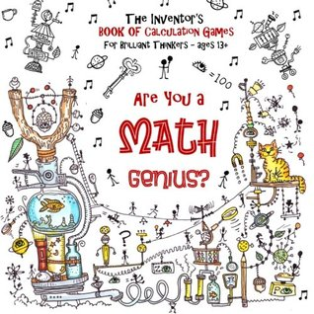
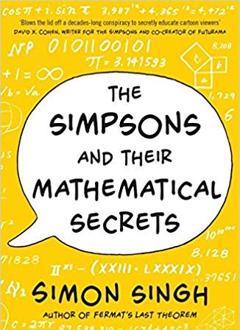
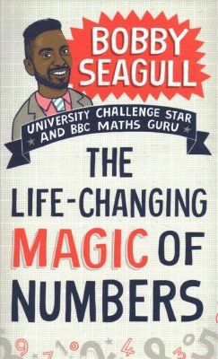
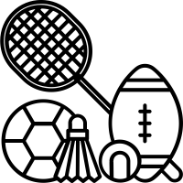
Year 10-H(1c2abc) Mathematics
Algebra Manipulation
Reading Books
Basic Algebra, Factorisation, Quadratic Expansion, Expanding Squares, More than two binomials, Quadratic Factorisation, Factorising ax²+bx+c, Changing the subject of a formula
Linear Graphs
Draw graphs from points, gradient-intercept method, equation of a line from the graph, real-life use of graphs, simultaneous equations, parallel and perpendicular lines
Right-angled Triangles
3D Pythagoras’, trigonometry to find missing lengths and angles, applied trigonometry to solve problems involving isosceles triangles. Bearings and trigonometry.
Similarity, Probability & Standard Form
Autumn Test
1 x Calculator Paper
Similar triangles, areas and volumes of similar shapes, experimental probability, expectation, two-way tables, frequency trees, Venn diagrams powers, multiplying and dividing using standard form
Equations & Inequalities
DID YOU KNOW?
A googol is the large number 10¹⁰⁰
In decimal notation, it is written as the digit 1 followed by one hundred zeroes.
Linear equations, elimination, substitution, balancing coefficients, solving problems, linear inequalities, trial and improvement
DID YOU KNOW?
Learning algebra helps to develop your critical thinking skills. This includes problem solving, logic, patterns, and reasoning. You need to know algebra for many professions, especially those in science and maths.
Mid-Year Test
1 x Non-Calculator Paper
1 x Calculator Paper
Count, Accuracy, Power & Surds
DID YOU KNOW?
The famous NBA 24 second shot was created using an quadratic equation
Quadratic Equations
Rational numbers, reciprocals, terminating and recurring decimals, estimation, powers and roots, negative and fractional indices, surds, solving problems using limits of accuracy, choices and outcomes
Plotting quadratics, solving by quadratic formula, solving by completing the square, significant points of a quadratic curve, solve linear and non-linear, solve by intersection, quadratic simultaneous equations and quadratic inequalities
Probability
Combined events, addition rules, probability tree diagrams, independent events, conditional probability
End of Year Test
DID YOU KNOW?
There were more Selfie related fatalities than Shark attack deaths in 2018
1 x Non Calculator
1 x Calculator
Variation
Statistics
Direct and inverse proportion
Sampling data, frequency polygons, cumulative frequency graphs, box plots, comparing data and histograms
DID YOU KNOW?
People who were good at maths as young children go on to earn more than other similar children by the time they are 30, a study has found. Source: BBC NEWS
2022-23

Slide 2
Year 11-H(1c2abc) Mathematics
Properties of Circles
Reading Books
Circle theorems, cyclic quadrilaterals, tangent and chords, Alternate Segment Theorem
Triangles
Using trigonometric ratios to solve further 2D and 3D problems, trigonometric ratios of angles between 0° and 360°, graphs and exact values, sine and cosine rules to solve problems involving non right-angled triangles, area of a triangle.
Graphs
Distance-time graphs, velocity-time graphs, estimating and interpreting the area under a curve, rates of change, work out and interpret a gradient at a point on a curve, equation of a circle, cubic, reciprocal and exponential graphs, transformations of the graph y = f(x).
Revision and November Mock Exams
Algebraic fractions and functions
1 x Non-Calculator Paper
2 x Calculator Papers
DID YOU KNOW?
Markings on animal bones indicate that humans have been doing maths since around 30,000BC.
Simplify algebraic fractions, solve equations involving algebraic fractions, change the subject of a formula, inverse and composite functions, using iteration to find an approximate solution for an equation.
Vector Geometry
Problem Solving, Revision and Exam Practice
Add and subtract vectors, properties of vectors, using vectors to solve geometric problems, proving geometric results.
Spring Mock Exams
DID YOU KNOW?
Sergey Brin, co-founder of Google studied maths (and computer science) at university.
1 x Non-Calculator Paper
2 x Calculator Papers
Problem Solving, Revision and Exam Practice
DID YOU KNOW?
Your body contains more bacterial cells than human ones? The average adult is made up of 10 million million cells but there are 10 times as many bacterial cells living inside us.
GCSE Exams
1 x Non-Calculator Paper
2 x Calculator Papers
DID YOU KNOW?
The human brain is made up of more neurons than there are stars in the galaxy – over 100 billion. Pathways in your brain are rewired second to second as you learn to do new things.
2022-23

