Slide 1
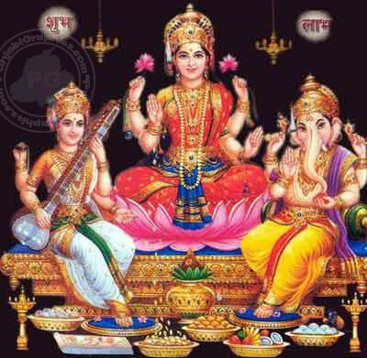
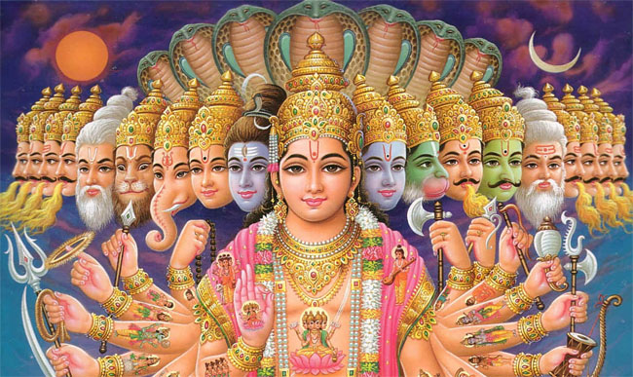
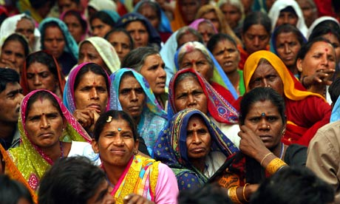
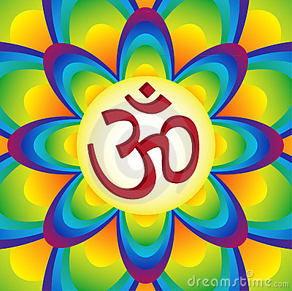
Notes:
Let these slides run as pupils are coming into the assembly. In the background you could play the ‘Happy Divali’ from the film Home Delivery. The song can be found on You tube at this address http://www.youtube.com/watch?v=aZj-MEqy2CM&feature=related

Slide 2
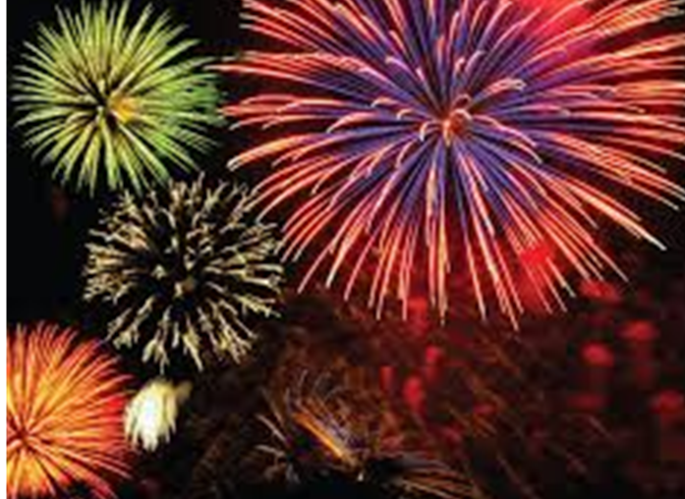

Slide 3
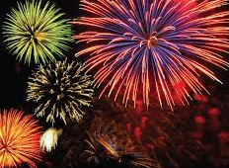
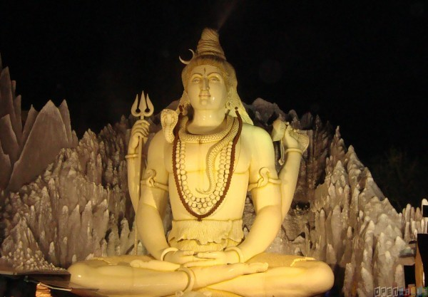

Slide 4
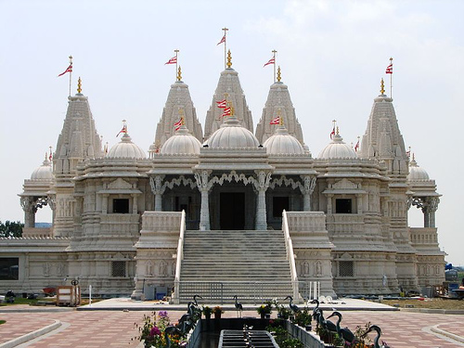

Slide 5
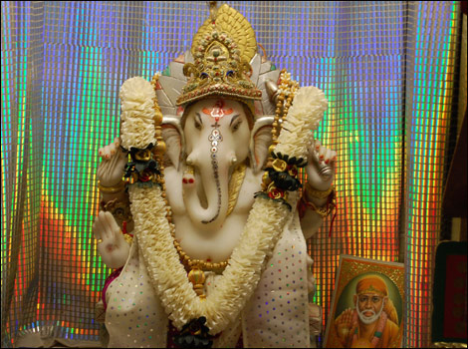

Slide 6
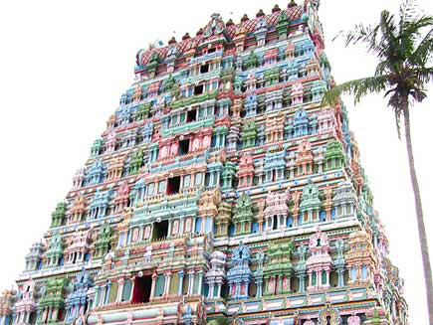

Slide 7
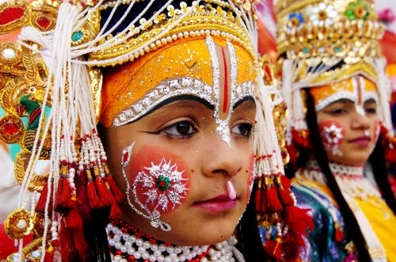

Slide 8
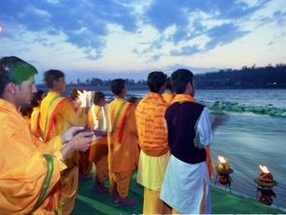

Slide 9
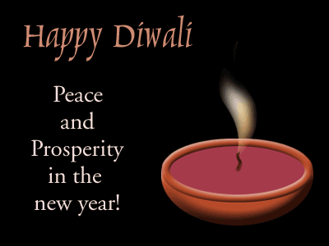
Notes:
This assembly is based on the script for a Divali assembly from the assemblies site, found at http://www.assemblies.org.uk/current/nov12pri_divali.php

Slide 10
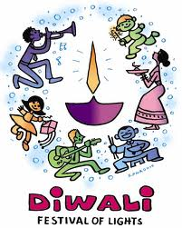
Diwali is the main festival for people of the Hindu and Sikh religion.
It is called the ‘festival of light’.
It celebrates the victory of good over evil – light over dark.
It also marks the start of a new year for Hindus.

Slide 11
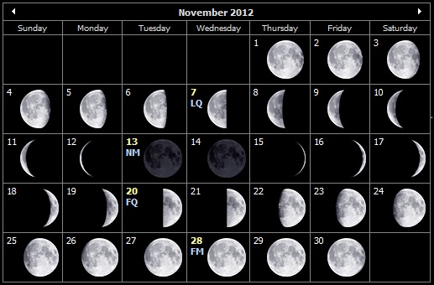
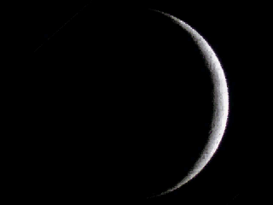
Diwali is held on the darkest night in the Hindu month of Kartika (October/November).
It is held on the night of a new moon (when there is no moon is the sky – the darkest night).
The date of the festival changes each year because the cycle of the moon is not in line with the months.
This year, the date of the festival is today, Monday 20th October.

Slide 12
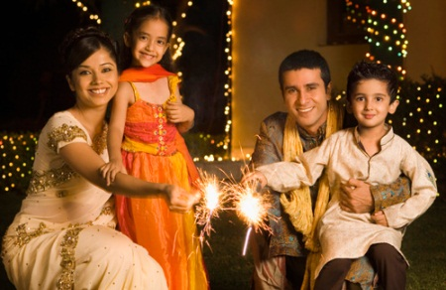
Notes:
This section is about ways in which people will celebrate divali. I would suggest that you set up six pupils who can read out what each of the next 6 pictures will show.

Slide 13
Families clean and decorate their homes in preparation.

Slide 14
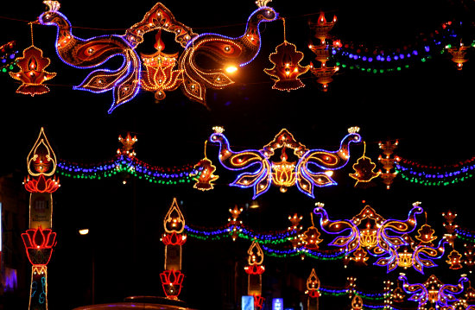

Slide 15
Families clean and decorate their homes in preparation.
Streets and buildings are decorated with lights.

Slide 16
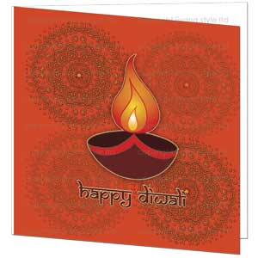

Slide 17
Families clean and decorate their homes in preparation.
Streets and buildings are decorated with lights.
Cards are sent and gifts exchanged.

Slide 18
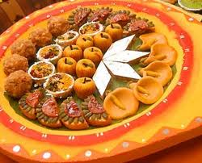

Slide 19
Families clean and decorate their homes in preparation.
Streets and buildings are decorated with lights.
Cards are sent and gifts exchanged.
Special food and sweets are enjoyed.

Slide 20
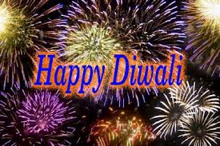

Slide 21
Families clean and decorate their homes in preparation.
Streets and buildings are decorated with lights.
Cards are sent and gifts exchanged.
Special food and sweets are enjoyed.
Fireworks are often part of the celebrations.

Slide 22
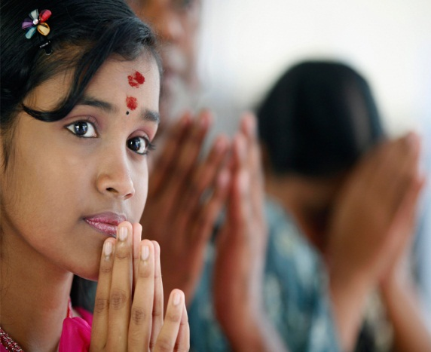

Slide 23
Families clean and decorate their homes in preparation.
Streets and buildings are decorated with lights.
Cards are sent and gifts exchanged.
Special food and sweets are enjoyed.
Fireworks are often part of the celebrations.
Everyone prays for prosperity and good fortune in the days that lie ahead.

Slide 24
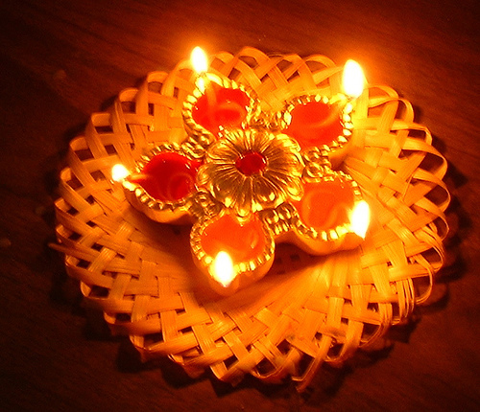
Most especially, small clay lamps (called divas) are lit.
Notes:
On this one, I would suggest that you read this out and then say that the reason that these lamps are used is because of the story of Divali (which is shown on the next few slides).

Slide 25
https://www.youtube.com/watch?v=rXJ5_dFOaB4
Rama and Sita story (play or share slides…or find your own)

Slide 26
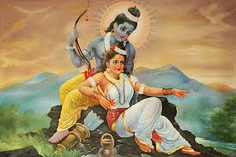
Lord Rama was a prince who married a beautiful princess, Sita. His father wanted Rama to become king, but his mother didn’t agree. She wanted Rama’s brother, Bharat, to have that honour.

Slide 27
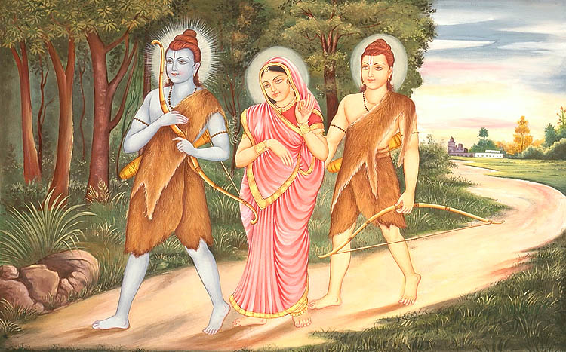
Rama and Sita were told that they must leave the kingdom for 14 years. Another brother, Lakshman, went with them to live in the forest.

Slide 28
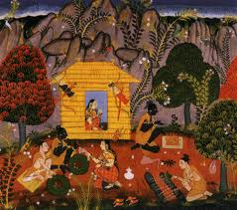
Eventually, the old king died. Knowing and honouring his father’s wishes, Bharat went to a far-off forest where he found Rama and Lakshman and invited them to return as king and queen. But they had promised to stay away for 14 years and Rama insisted they must be true to their word.

Slide 29
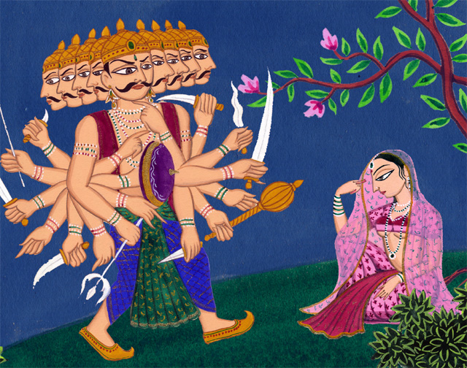
So they stayed in the forest where, one day, an evil demon named Ravana captured Sita and carried her off to an island. Here he imprisoned her in his palace.

Slide 30
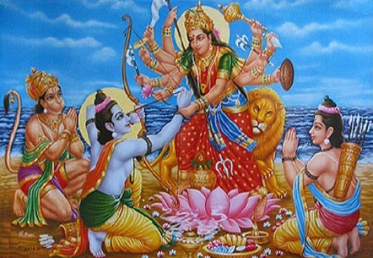
Rama and Lakshman searched for her. A bird told them where she was being held. With the help of Hanuman, the monkey general, Rama went to the castle where there was a huge battle. Eventually, Rama killed the demon king with a golden arrow and rescued Sita.

Slide 31
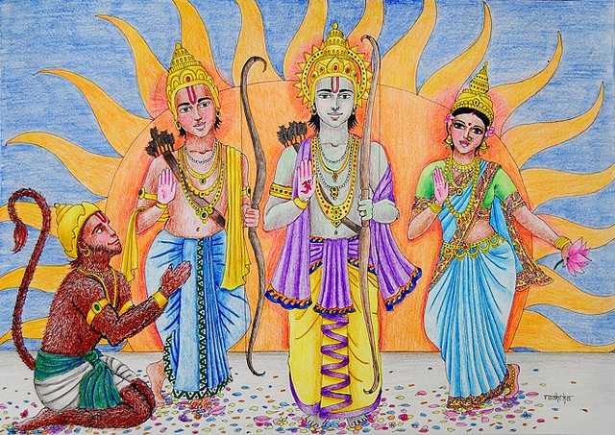
After 14 years, it was time for Rama to return home. Towards the end of their journey, the night was very dark, with no moon to light the path ahead. So to help King Rama and Queen Sita find their way, all their people placed small lamps outside their houses.

Slide 32
Let us pray
We pray for those who are celebrating Diwali at this time. May they have a happy and holy celebration.
God has created us all in his own image and loves all of us equally. We pray for peace and harmony between people of all faiths, even when we are sometimes not aware of the background of their faith.

Slide 33
