Slide 2
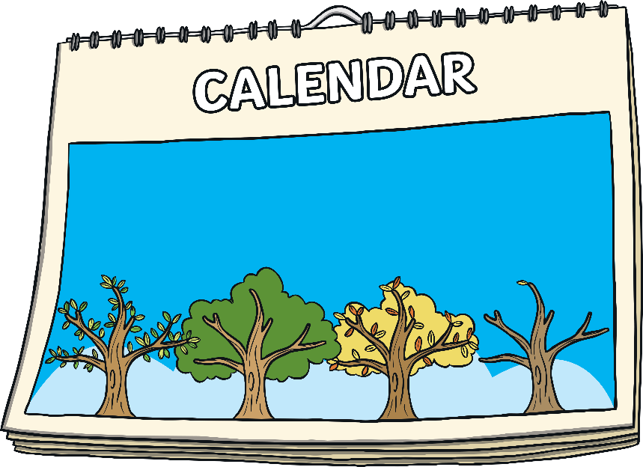
History Months
Throughout the year, there are months that celebrate the history (past) of different groups of people.
The history of different groups of
people is part of all history so we
should learn about everyone’s
history all year round. However, these specific months help people learn more about groups of people, their history and their importance to the wider world.
“Title of Image Used” by [Author] is licensed under CC BY 2.0

Slide 3
Black History Month
Black History Month is celebrated each year in October. It is a chance to celebrate the achievements of Black people in the past and present.
It is celebrated in schools, museums, universities and lots of other places. People learn about important Black people and the impact they have had on society.
Black History Month was first celebrated in the UK in the 1980s.
“Title of Image Used” by [Author] is licensed under CC BY 2.0

Slide 4
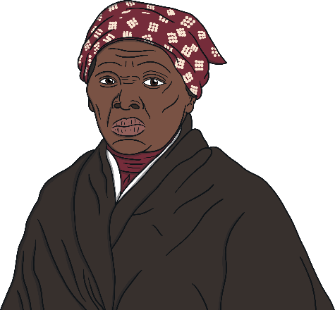
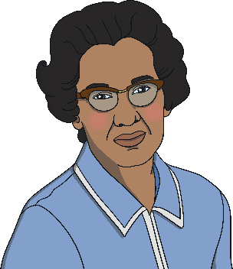
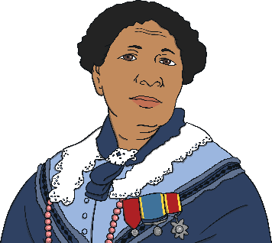
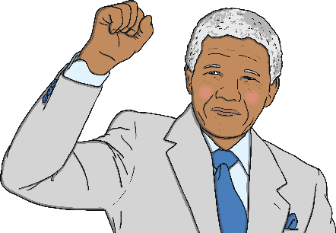
Why Do We Have Black History Month?
Black people have been an important part of society for a long time. Even though many Black people have achieved important things, they weren’t often mentioned in history books, television shows about the past or even in school history lessons.
This meant that lots of people didn’t know about all the amazing things that they had done. We have Black History Month so that people can learn about the important achievements of those people and help people to remember them.
Do you know who any of these people are?
Harriet Tubman
Mary Seacole
Nelson Mandela
Katherine Johnson
“Title of Image Used” by [Author] is licensed under CC BY 2.0

Slide 5
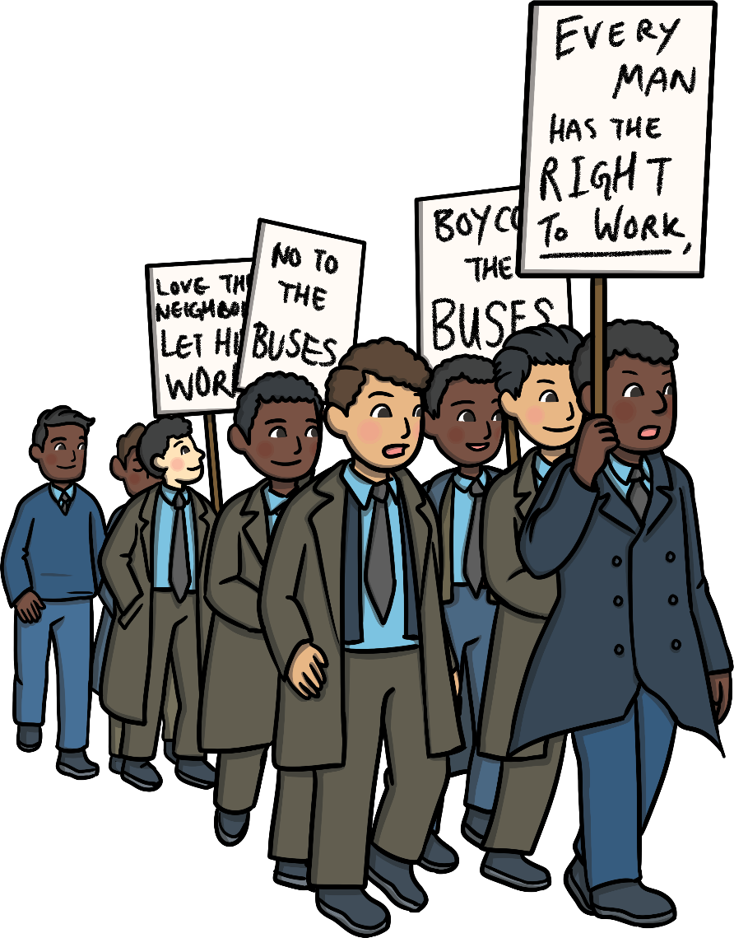
Racism
Racism has meant that the achievements of Black people in history have often not been recognised. Racism is when a person is treated unfairly or wrongly because of parts of their cultural identity or characteristics such as the colour of someone’s skin.
Examples of racism in the past include:
In the USA, Black people used to have to sit at the back of buses and give up their seats if a White person wanted their seat;
In South Africa, Black people could only live in certain places, often without electricity or running water;
In the UK, some people wouldn’t rent houses or rooms to Black people.
“Title of Image Used” by [Author] is licensed under CC BY 2.0

Slide 6
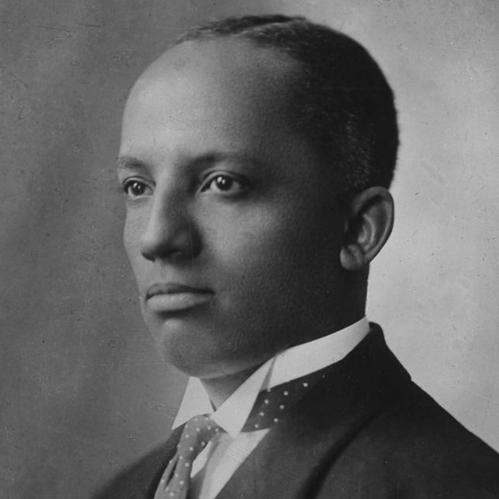
How Did Black History Month Start?
In 1875, Carter G Woodson was born in the USA. Because of the racism he experienced, Carter didn’t have many opportunities to have an education or a well-paid job. However, he eventually managed to go to one of the top universities in the USA.
He noticed that there was almost no mention of Black people in history books and wanted to change this. In 1926, he announced the first ever Black History Month. Carter became known as the ‘Father of Black History’.
universities – Places where people can go to learn after they have finished school.
“Title of Image Used” by [Author] is licensed under CC BY 2.0

Slide 7
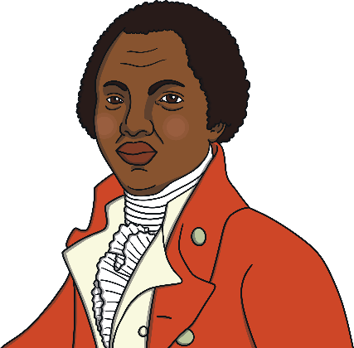
Significant Black People
Here are just some of the people you might learn about during Black History Month.
Olaudah Equiano lived in Britain over 200 years ago. He had been an enslaved person. He wrote a book about how unfairly Black people were treated and called for the end of enslavement.
Harriet Tubman was born in the USA around 200 years ago. She was an enslaved person but eventually managed to escape. Harriet helped many other people escape too.
enslaved person – Someone who is ‘owned’ by someone else and forced to work.
“Title of Image Used” by [Author] is licensed under CC BY 2.0

Slide 8
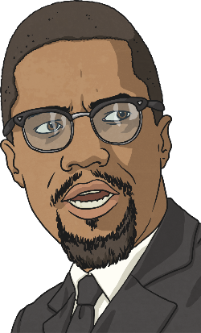
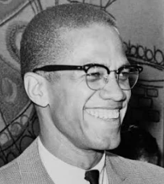
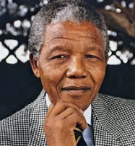
Significant Black People
Malcolm X was a leader in the USA who campaigned for Black people to be treated equally.
Nelson Mandela was the first president to be fairly voted for by the people of South Africa and is known and loved around the world for his commitment to peace, negotiation and reconciliation between races.
“Title of Image Used” by [Author] is licensed under CC BY 2.0

Slide 9
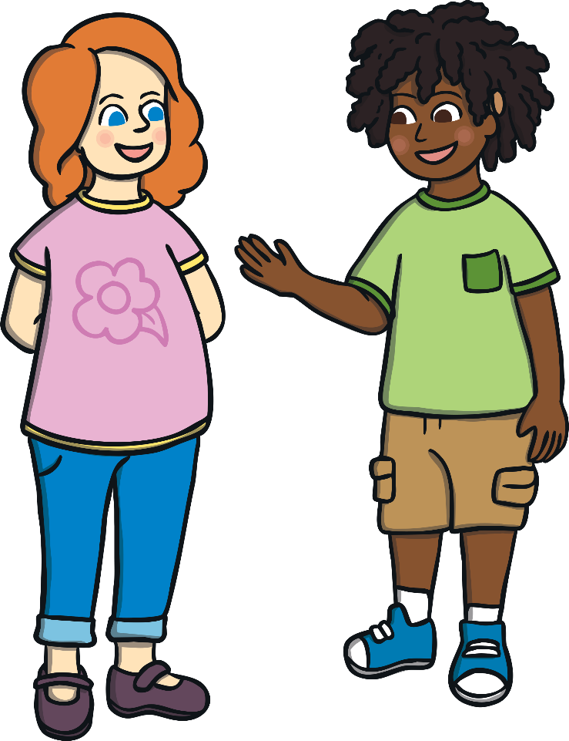
Talk About It
What could we do? Create a time line of important people?
Find out more about one particular person?
Create a class collage of faces to make the words – i.e. Black History
Have a think…what can we do to show that racism is not something that we would ever accept in our school
Why do you think Black History Month is important?
How could you celebrate Black History Month?
Are there any people you would like to learn about?
Teachers – tell Mrs Davis who or what you children would like to learn more about this month
“Title of Image Used” by [Author] is licensed under CC BY 2.0

