Slide 1
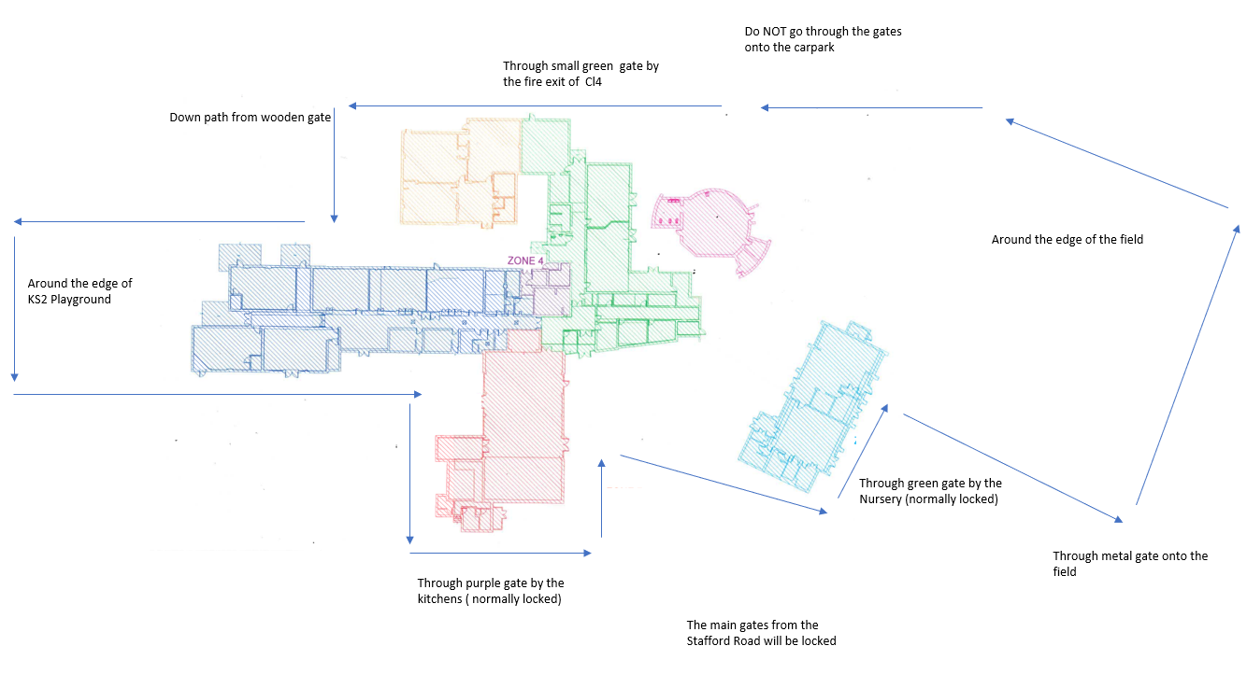
No break after Mass to allow Walk to start on the playgrounds
10:45-11:15 Class 3, 5, 8 and Class 10
11:15-11:45 Class 1, 2, 7 and 11
1:15-1:45 Class 4, 6, 9
Classes to walk round designated route (see map)
Children have been asked to carry a bag but if they don’t have one then that is fine
Nursery to complete small walk on an ad hoc basis
Children to wear appropriate footwear
Walk round the circuit with your class of course. Stress it isn’t a race. The gates to the drive will be shut, the gates to the carpark will be shut.
A lap of the course is about 0.3 of a mile. This means that just over 3 laps is a mile and 6 and a half laps is 2 miles.
Give them a number of laps to try and complete (you can decide an appropriate distance- but please do not go past your allotted time)
During the walk chatting is fine but try and get them to contemplate the homeless situation for at least a little.
Taking water bottle on the walk is absolutely fine.

