Slide 2
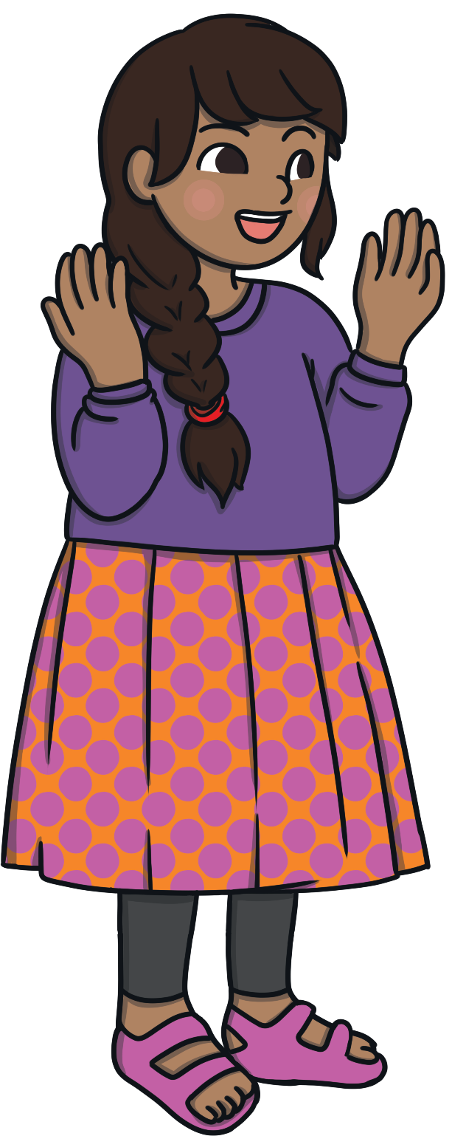
International Women's Day
International Women’s Day takes place every year on 8th March.
International Women’s Day celebrates the many amazing things done by women. It is a day to think about how women have influenced the world.

Slide 3
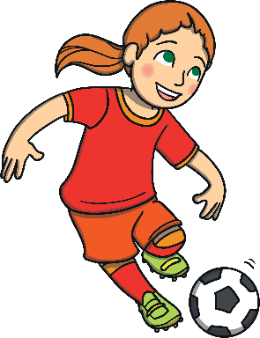
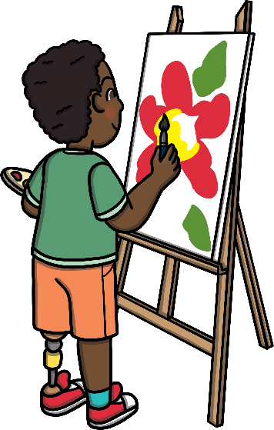

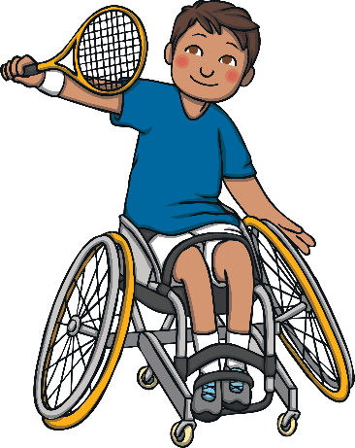

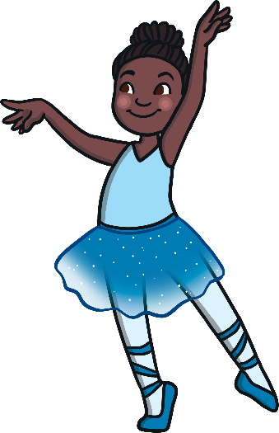
What Are You Good At?
Think about what you are good at.
What are your friends good at?
Do you have to be a boy to be good at some things and a girl to be good at others? Tell a friend what you think.

Slide 4
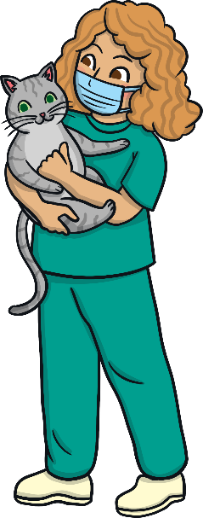
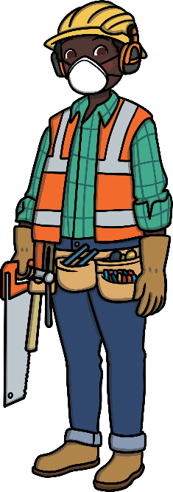
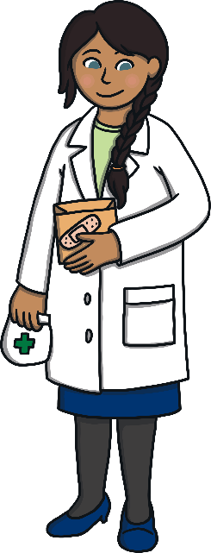
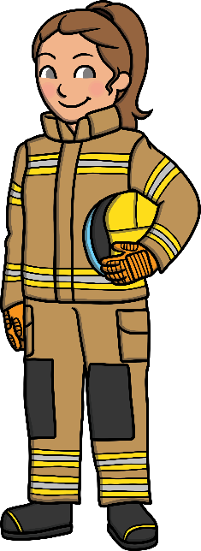
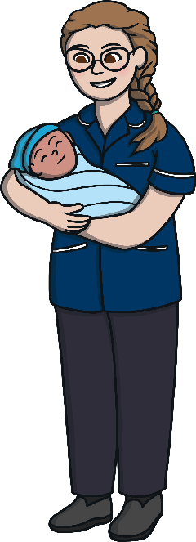
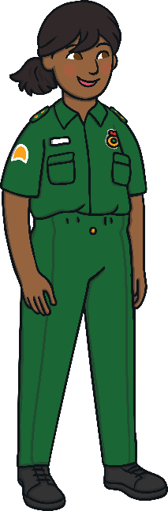
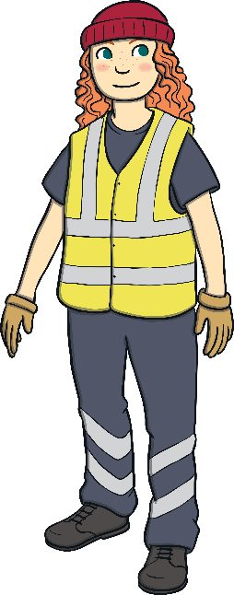
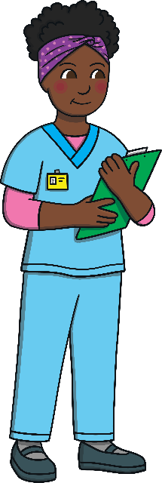
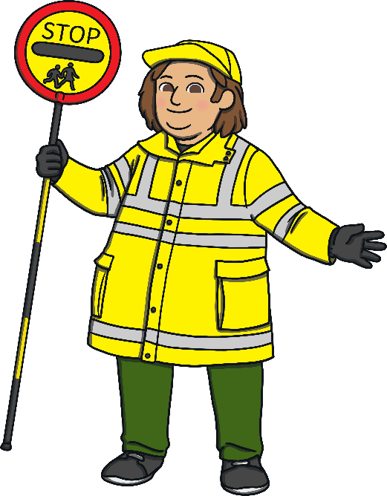
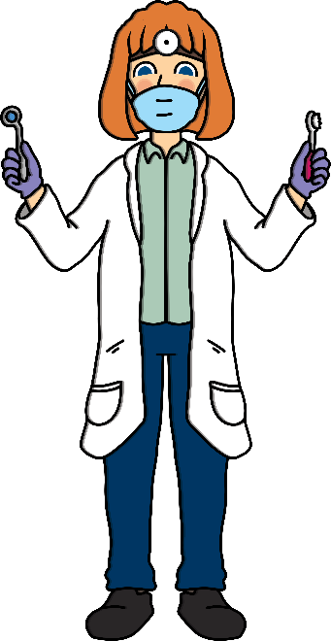
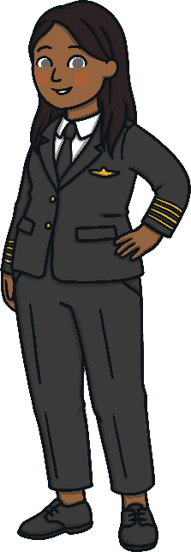
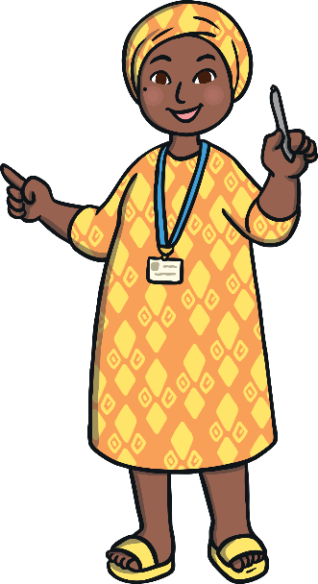
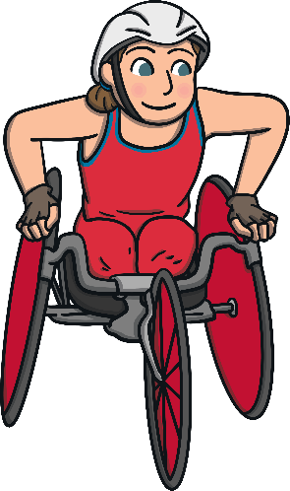
Women Can Do Anything

Slide 5
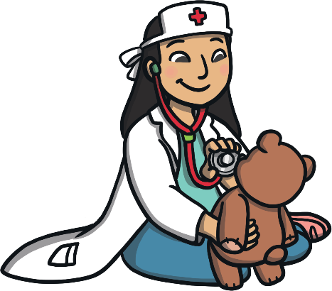
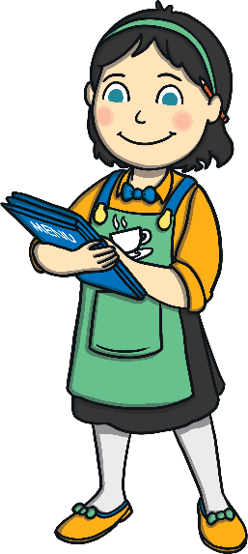
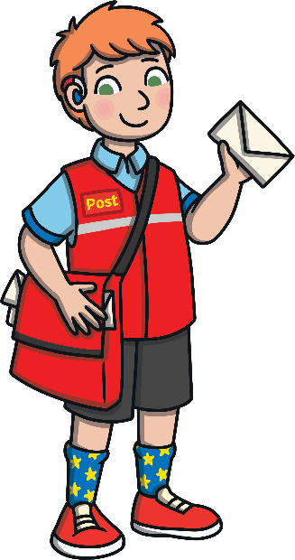
Follow Your Dreams
Everyone – girls and boys – should be able to follow their dreams.
International Women’s Day was created to make sure that everyone,
especially girls, has the right to be the best they can be.
It’s important for boys to be the best they can be too!

Slide 6


What Do You Want to Be?
What would you like to be when you’re older?
Perhaps you'd like to be a builder, a firefighter or a doctor?
Girls or boys can do any of these jobs.

Slide 7
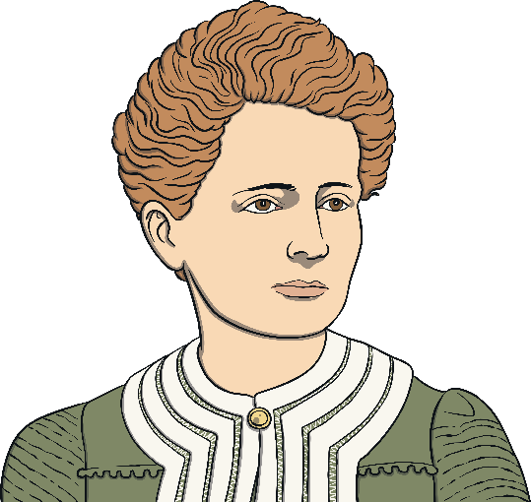
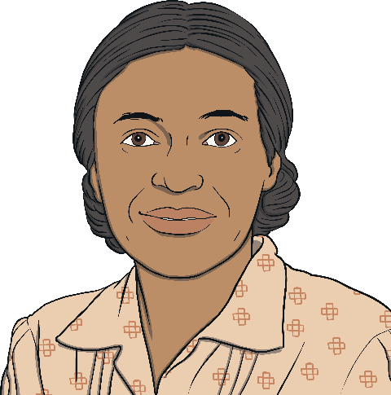
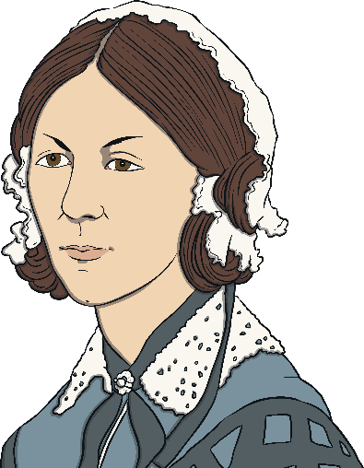
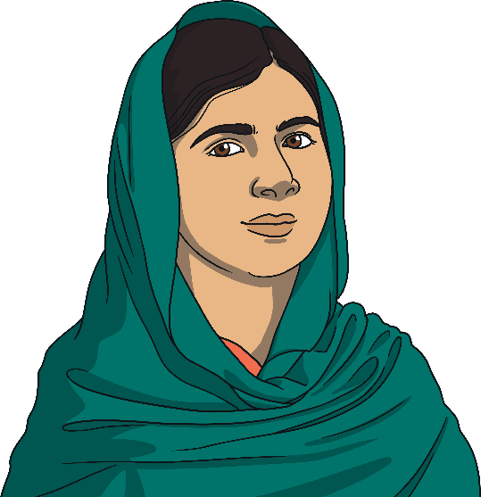
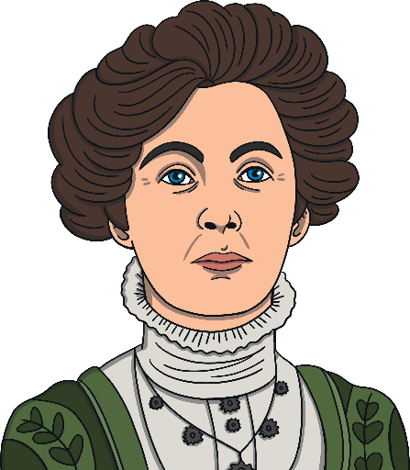
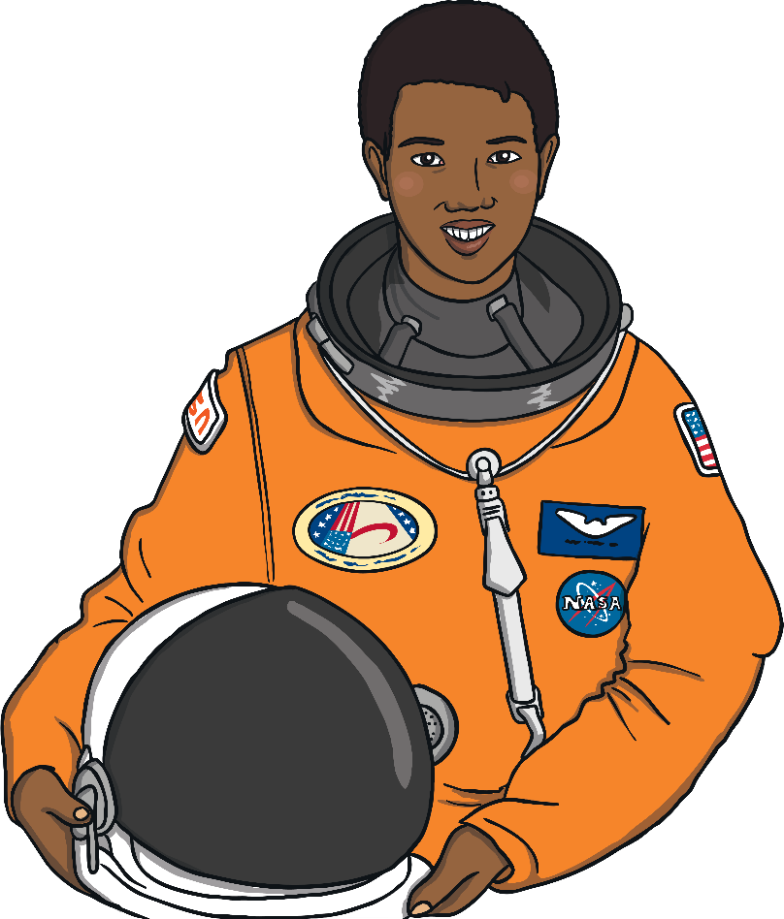
Inspiring Women
International Women’s Day is a day when we can think about inspiring women and all of the good things they've done.

Slide 8


International Women’s Day
Some inspiring women lived in the past.
Florence Nightingale
“I was a nurse who helped soldiers. I also
made their hospitals much better.”
Marie Curie
“I spent my life looking for ways to make poorly people better with medicine.”

Slide 9
International Women’s Day
Some inspiring women campaigned for fairness.
Rosa Parks
"I campaigned for black people to be treated fairly."
Emmeline Pankhurst
“I campaigned for the right of
women to vote.”

Slide 10
International Women’s Day
There are many inspiring women alive today too.
Mae Jemison
“I was the first black woman astronaut to
travel into space. I help people to learn
about science.”
Malala Yousafzai
“I campaign for the rights of girls and women to have an education. I won a Nobel Peace Prize.”

Slide 11
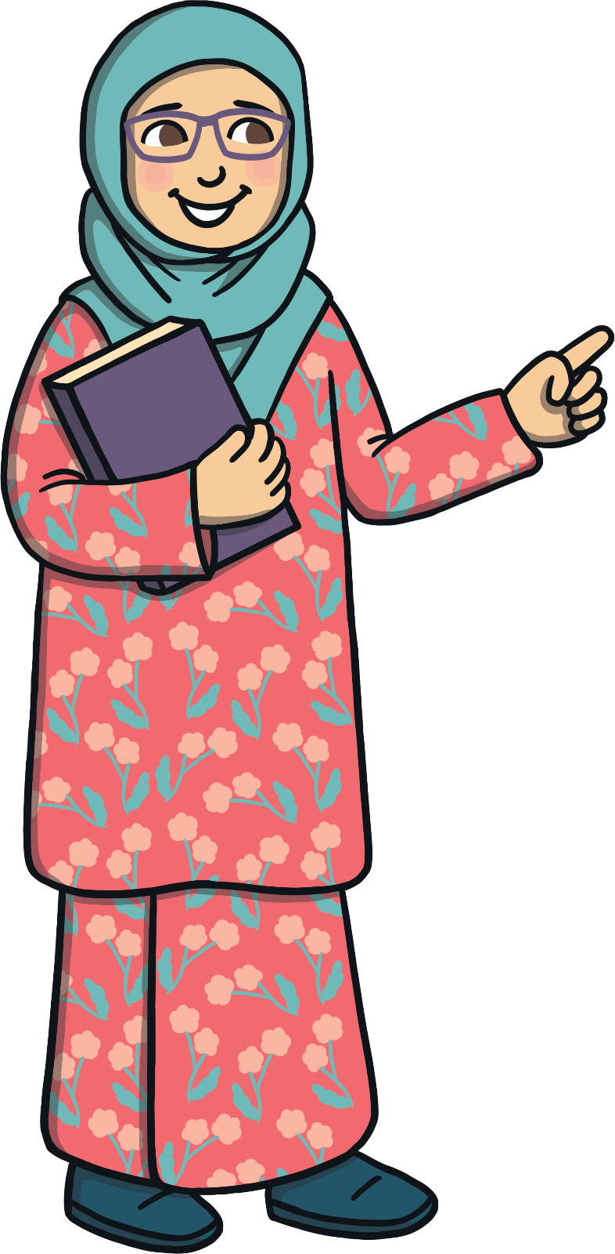
Why Celebrate International Women’s Day?
International Women’s Day was first celebrated over 100 years ago in 1910. The aim was for men and women across the world to be treated equally.

Slide 12

Why Celebrate International Women’s Day?
Since then, things have become much more equal for some men and women. However, we still need to work hard to make sure everyone is treated equally.

